Slide 1
FDA’s Clinical Investigator Course
Preparing an IND Application
(Clinical Considerations for Cell and Gene Therapy Products)
CBER Breakout Session
    Rachel Witten, M.D.
    FDA/CBER/OTAT/DCEPT
    Clinical Investigator Training Course
    November 9, 2016

Slide 2

What is an IND?
When do you need an IND?
Who can apply for an IND?
What should an IND contain?
How does FDA review an IND?
Expectation for a First-in-Human Study
Overview

Slide 3
Investigational New Drug application
A formal document with defined structure and content
Purpose is to request exemption from premarketing requirements and to allow lawful shipment of drug for clinical investigation
Regulations (21CFR312) outline requirements for
Use of Investigational drug
Submission of application to FDA
Review by FDA

Slide 4
When Do You Need to Submit an IND Application for Your Research
An IND application is required for:
Clinical investigation of a new drug or biologic
Change to an existing approved drug or biologic, including a new:
  Indication or significant labeling or advertising change
  Dosage form and schedule
  Route of administration
  Patient population (e.g., pediatric, gender)

Slide 5
When Exemptions From IND Application Requirements Apply to Your Research
Criteria for exemption from the IND regulations (21 CFR 312.2(b))
Drug or biologic product is lawfully marketed in the United States
No intent to support new use or labeling change
No intent to support change in advertising
No new factor --- such as route of administration, dosage, or study population --- that significantly increases risk
No promotion or representation of product as safe or effective treatment for condition under study

Slide 6
Who can apply for IND application
IND applicant is called a “sponsor”
Sponsor takes responsibility for and initiates a clinical investigation
IND sponsor may be a company, institution, or an individual
IND sponsor-investigator
An individual who both initiates and conducts the clinical trial

Slide 7

You Have Decided to Submit an IND Application
The time required to prepare an IND will depend on available information on product characterization, extend of pre-clinical data, and any clinical data from relevant studies.
Study the relevant FDA instructions and forms.
Determine how your organization can best meet those requirements.

Slide 8
Pre-IND meeting
Highly recommended for new products
A consultation provided to sponsors and investigators planning to submit an IND application
This meeting is usually scheduled 3-9 months before the planned IND submission
Pre-IND package may include:
IND product’s characteristics
manufacturing processes
planned or completed pre-clinical studies
development plan
design of the planned investigation in humans
Please provide specific questions to the Agency about any or all of the above.

Slide 9
Know IND Application’s Content and Format
(21 CFR 312.23(a))
Form 1571 (21 CFR.§312.23(a)(1))
Table of Contents (21 CFR.§312.23(a)(2))
Introductory Statement (21 CFR.§312.23(a)(3))
General Investigational Plan
Investigator’s Brochure (21 CFR.§312.23(a)(5))
Clinical Protocols 21 CFR.§312.23(a)(6))
Form 1572 (21 CFR.§312.23(a)(6))
Chemistry, Manufacturing & Control Information (21 CFR.§ 312.23(a)(7))
Pharmacology & Toxicology information (21 CFR.§312.23(a)(8))
A summary of previous human experience with the investigational product (21 CFR.§312.23(a)(9))
Additional or relevant Information (e.g., reference to previous submissions)

Slide 10
Structure of the FDA Review Team
Regulatory project manager
CMC product reviewer
Preclinical pharm/tox reviewer
Clinical reviewer
Biostatistician
Consultants

Slide 11
IND Application: Introductory Statement and General Investigational Plan 21 CFR 312.23(a)(3)
Brief, 2-3 page summary
Intended to place the developmental plan for the drug into perspective and to help FDA anticipate the needs of the future program
Detailed developmental plan may not be well established yet and could be contingent on many factors; investigator (sponsor) should state this

Slide 12
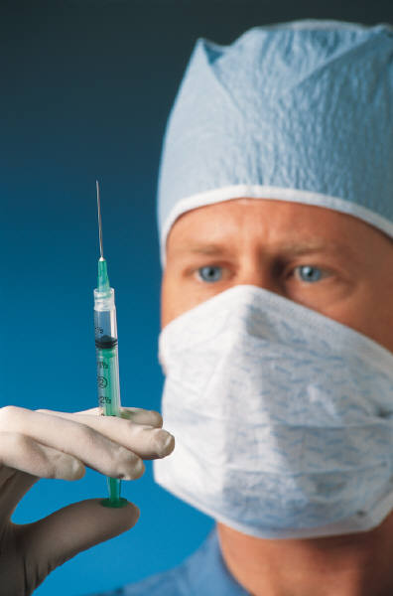
IND Application: Protocols 21 CFR 312.23(a)(6)
A protocol for each proposed clinical trial
Phase 1 protocol may be less detailed, but should provide all the critical details regarding assessments of safety, including
# of patients, dosing plan, safety exclusion criteria, toxicity stopping rules , plan for staggering of subjects, and procedures for safety assessments,
Phase 2 and 3 protocols should provide sufficient details describing all aspects of the trial
All potential deviations from trial design should be built into the protocol from the outset
Objectives and purposes should be clearly stated
The protocol should contain details of the observations and measurements to be made to fulfill the objectives of the trial
The protocol should provide a description of clinical procedures, lab tests, and all measures to be taken to monitor the effects of the drug
DON’T forget sufficient descriptions of safety monitoring in your protocol, irrespective of phase of development.

Slide 13
IND Application: Protocols (cont.) Adverse Event (AE) Recording and Reporting in Clinical Protocols
For all trial protocols in any phase, AE recording, grading, and reporting should be specified
System for AE recording (MedDRA or other)
AE grading is important in relation to the studied population:
Select appropriate AE grading scale for the study
Anticipate merging of safety data from multiple trials
Have a consistent mechanism for judging relatedness
AE reporting should be described in the protocol and performed according to the respective regulations (21CFR 312.32)

Slide 14
The Procedural Aspects:
Under 21 CFR 312.23(d) one original IND application and 2 copies are required
Regulatory review and all interactions with an IND sponsor must occur within 30 days of the receipt date:
Information Requests
Teleconferences
Additional data submissions
Protocol modifications
By Day 30, the FDA will notify the sponsor that the IND application (studies)
May proceed, OR will be placed on “hold”

Slide 15
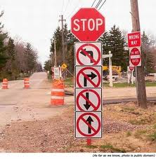
Understand the Grounds for Imposition of Clinical Hold (21 CFR 312.42)
Phase 1 studies
Human subjects are exposed to an unreasonable and
significant risk of illness or injury
Clinical investigators are not qualified by reason of their
scientific training and experience to conduct the investigation
described in the IND application
Investigator Brochure is misleading, erroneous, or incomplete
IND application does not contain sufficient information to
assess the risks to subjects
Inadequately described product preparation or formulation
IND application is for the treatment of a life-threatening or
serious disease affecting both genders and only one gender is
included in the proposed trial and there are no plans to include both
genders in subsequent trials
Phase 2 and 3 studies
Any of the above, OR
The protocol is deficient in design to meet its stated objectives

Slide 16

When your IND Could be Release from
Clinical Hold
FDA sends a letter stating the reasons for hold and how to address them
IND sponsor submits a written response to be reviewed within 30 days
If the response is adequate, the protocol is
released from hold and the IND application is in effect
FDA sends a letter stating the study may proceed.

Slide 17
IND Application’s Status
Active (ongoing)
Inactivated (upon FDA’s or sponsor’s proposal)
Reactivated : If activities under the IND application have restarted
Withdrawn (upon sponsor’s request)
•Studies are not showing effectiveness
•A safety issue has emerged
Terminated (upon FDA’s proposal)
•Human subjects would be exposed to unreasonable or significant risk
•Manufacturing processes are inadequate to establish and maintain appropriate standards
Other grounds for termination under 21 CFR 312.44

Slide 18
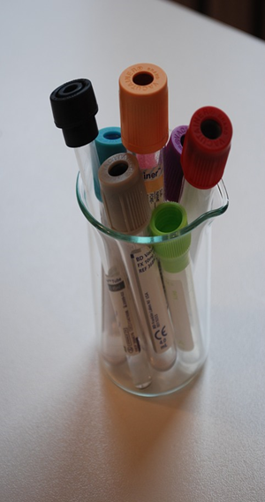
Cell and Gene Therapies: Unique Issues
  Complexity of products
  May impose practical limits on dose produced or
  on the concentration or volume that can be delivered
  Might restrict the range of doses that are feasible
  Objectives then usually include simply beginning
  to characterize the safety profile of feasible dose levels
May impose practical limits on dose produced or on the concentration o Preliminary assessments of product activity,
using either short-term responses or longer-term outcomes---e.g.,
  Gene expression
  Cell engraftment
  Changes in immune function
  Physiologic responses
  Prospective biomarkers
    volume that can be delivered
    Might restrict the range of doses that are feasible
    Objectives then usually include simply beginning to characterize the safety profile of feasible dose levels

Slide 19
Cell and Gene Therapies: (cont)
Choice of Study Population
FDA looks at overall risk-benefit for the study population
FDA looks at overall risk-benefit for the study population
Healthy normal subjects are almost never included in trials for cellular and gene therapy products
Products might have long-term risks or permanent adverse effects
Patients with advanced disease and limited options
Might be preferred population, if they make the risks acceptable in spite of uncertain benefit
Are not necessarily the preferred choice for use in early-phase trials for every product
Might be more vulnerable to complications of adverse reactions, which might increase the risks
Confounding adverse events due to underlying disease could make safety data difficult to interpret
Advanced disease state may present irreversible pathology, which may not respond to the experimental therapy
  Products might have long-term risks or permanent adverse effects
never included in trials for cellular and gene therapy pro

Slide 20
Cell and Gene Therapies: (cont)
Treatment Plan
Most first-in-human trials of cellular and gene therapies include staggered administration to limit overall risk
Staggered administration
  There is a specified follow-up interval between administration to the first subject and administration to the second subject in each cohort
  The interval is intended to be long enough to monitor for acute and subacute adverse events
Cohort size can vary depending on the amount of risk that is acceptable for the indication
Smaller cohorts might be adequate for a product intended to improve survival
Larger cohorts may be useful to provide assurance about safety before escalating the dose of a product expected to provide only a modest benefit
r cohorts might be adequate for a product intended to improve survival

Slide 21
Cell and Gene Therapies: (cont)
Safety Evaluation and follow-up
Routine assessment for general safety using common clinical measurements
Should also include special assessments targeting specific safety issues that could be anticipated with cellular or gene therapies such as:
  Infusion reactions
  Evidence of autoimmunity
  Graft failure
  Graft-vs-host disease
  New malignancy
  Transmitted infectious disease
  Viral reactivation
Long-Term Safety Monitoring may be appropriate for certain types of gene therapy

Slide 22

How to avoid problems?
Don’t ignore Pre-IND Input from FDA!
Create reviewer-friendly IND submission
Include copy of the protocol, including
details of safety monitoring plan
Provide background information and
scientific rationale for your study
Don’t forget to include previous human
experience (letter of cross reference)
Provide your rationale for the dose selection
Endpoints (primary and secondary)
Stopping rules
Informed Consent and assent forms
Be available for any discussion during the first 30 days!

Slide 23
Contact Information for CBER/OTAT
Rachel Witten M.D.
Rachel.witten@fda.hhs.gov
Regulatory Questions: Contact the Regulatory Management Staff in OTAT at CBEROTATRMS@fda.hhs.gov or Lori.Tull@fda.hhs.gov
or by calling 240-402-8361
OTAT Learn Webinar Series: http://www.fda.gov/BiologicsBloodVaccines/NewsEvents/ucm232821.htm

Slide 24
Public Access to CBER
CBER website
http://www.fda.gov/BiologicsBloodVaccines/default.htm
Phone: 1-800-835-4709 or 240-402-8010
Consumer Affairs Branch (CAB)
Email: ocod@fda.hhs.gov
Phone: 240-402-7800
Manufacturers Assistance and Technical Training Branch (MATTB)
Email: industry.biologics@fda.gov
Phone: 240-402-8020
Follow us on Twitter
https://www.twitter.com/fdacber

