Slide 1
Safety Considerations: Regulatory Definitions and Practical Considerations
Ramy Abdelrahman, MD
Division of Pediatric and Maternal Health (DPMH)
Office of New Drugs
Centre of Drug Evaluation and Research
February 28, 2019

Slide 2
Disclaimer
I’ve no financial interests or relationships to disclose
The views presented here are personal and do not necessarily reflect the views of the Agency

Slide 3
Outline
Definitions
Investigator and sponsor reporting responsibilities
IND safety reporting time frame

Slide 4
Adverse Event
Adverse event means any untoward medical occurrence associated with the use of a drug in humans, whether or not considered drug related

Slide 5
Suspected Adverse Reaction
Suspected adverse reaction means any adverse event for which there is a reasonable possibility that the drug caused the adverse event
For the purposes of IND safety reporting, ‘reasonable possibility’ means there is evidence to suggest a causal relationship between the drug and the adverse event.
Who is responsible for making the causality judgment?
FDA: the sponsor
ICH E2A guidance: either the investigator or the sponsor
Notes:
A suspected adverse reaction implies a lesser degree of certainty about causality than adverse reaction, which means any adverse event caused by a drug.
We consider the application of the reasonable possibility causality standard to be consistent with the discussion about causality in the International Conference on Harmonization (ICH) E2A Guideline (“ICH E2A guidance”). However, the Agency notes there is a difference between this rule and the ICH E2A guidance with respect to who is responsible for making the causality judgment. The sponsor is responsible for making the causality judgment for this rule, whereas the ICH E2A guidance recommends that the judgment be based on either the investigator’s or the sponsor’s opinion.

Slide 6
Individual Occurrences
Certain serious adverse events are informative as single cases because they are uncommon and are known to be strongly associated with drug exposure (e.g., angioedema, blood dyscrasias, rhabdomyolysis, hepatic injury, anaphylaxis, and Stevens-Johnson Syndrome)
Notes:
FDA makes clear the meaning of reasonable possibility by providing the following examples of types of evidence that would suggest a causal relationship between the drug and the adverse event

Slide 7
One or More Occurrences
One or more occurrences of an event that is not commonly associated with drug exposure, but is otherwise uncommon in the population exposed to the drug
If the event occurs in association with other factors strongly suggesting causation (e.g., strong temporal association, event recurs on rechallenge), a single case may be sufficiently persuasive to report in an IND safety report
Examples: tendon rupture or heart valve lesions in young adults, or intussusception in healthy infants
Notes:
Often, more than one occurrence from one or multiple studies would be needed before the sponsor could determine that there is a reasonable possibility that the drug caused the event

Slide 8
Aggregate Analysis of Specific Events
An aggregate analysis of specific events observed in a clinical trial that indicates those events occur more frequently in the drug treatment group than in a concurrent or historical control group
Examples:
Non-acute death observed in a trial in cancer patients
Acute myocardial infarction observed in a long-duration trial in an elderly population with cancer
Notes:
(such as known consequences of the underlying disease or condition under investigation or other events that commonly occur in the study population independent of drug therapy)
Although these serious adverse events meet the definition of unexpected at 21 CFR 312.32(a), as they are not listed in the investigator brochure, (these events do not warrant expedited reporting as individual cases because it is not possible, based on a single case, to determine that there is a reasonable possibility that the drug caused the event. As a result, they do not meet the definition of a suspected adverse reaction
In cases where a randomized comparison is not available, the estimate of whether the rate is greater than in a control population would have to be based on some other group not receiving the drug, such as the general population or populations similar to the drug population with respect to demographics and disease state but not receiving the test drug (e.g., a historical control).

Slide 9
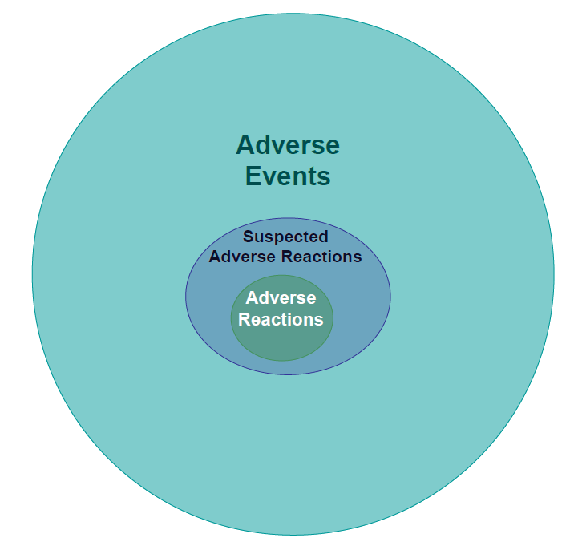
Adverse Reaction
An adverse reaction means any adverse event caused by a drug
Notes:
Adverse reactions are a subset of all suspected adverse reactions where there is reason to conclude that the drug caused the event

Slide 10
Unexpected Adverse Events
An adverse event or suspected adverse reaction is considered “unexpected” if it is:
Not listed in the investigator brochure for the particular drug under investigation (or elsewhere in the general investigational plan if an investigator brochure is not required or available)
Not listed at the specificity or severity that has been observed, examples:
Hepatic necrosis would be unexpected (by virtue of greater severity) if the investigator brochure referred only to elevated hepatic enzymes or hepatitis
Cerebral thromboembolism and cerebral vasculitis would be unexpected (by virtue of greater specificity) if the investigator brochure listed only cerebral vascular accidents
Notes:
In the clinical trial setting, there has been some confusion with the term “expected” as it has been used to mean “anticipated” for the disease being treated or population being studied rather than “listed in the investigator brochure
This means that events not listed for the particular drug under investigation in the investigator brochure are considered “unexpected” and those listed are considered “expected.”
Listed in the investigator brochure as occurring with members of the same class of drugs, or as anticipated from the pharmacological properties of the drug, but are not specifically mentioned as occurring with the particular drug under investigation For example
although angioedema is anticipated to occur in some patients exposed to drugs in the angiotensin-converting enzyme (ACE) inhibitor class and angioedema would be described in the investigator brochure as a class effect, a case of angioedema observed with the drug under investigation should be considered unexpected for reporting purposes until it is included in the investigator brochure as occurring with the drug under investigation

Slide 11
Serious Adverse Events
An adverse event or suspected adverse reaction is considered “serious” if, in the view of either the investigator or sponsor, it results in any of the following outcomes:
Death
Life-threatening adverse event
Inpatient hospitalization or prolongation of existing hospitalization
A persistent or significant incapacity or substantial disruption of the ability to conduct normal life functions, or a congenital anomaly/birth defect
Important medical events may be considered serious when, based upon appropriate medical judgment, they may jeopardize the patient or subject and may require medical or surgical intervention to prevent one of the outcomes listed in this definition, Examples:
Allergic bronchospasm requiring intensive treatment in an emergency room or at home
Blood dyscrasias or convulsions that do not result in inpatient hospitalization
Notes:
the definition of “serious” differs slightly from the ICH E2A guidance7 (i.e., FDA definition uses “and” rather than “or” in the sentence “Important medical events that may not result in death, be life-threatening, or require hospitalization may be considered serious when, based upon appropriate medical judgment, they may jeopardize the patient or subject and may require medical or surgical intervention to prevent one of the outcomes listed in this definition”). We will accept application of either the FDA definition (i.e., “and”) or the ICH E2A guidance criteria (i.e., “or”) in determining the seriousness of an event
If either the sponsor or investigator believes that the event is serious, the event must be considered serious and evaluated by the sponsor for expedited reporting

Slide 12
Life-Threatening Adverse Events
An adverse event or suspected adverse reaction is considered “life-threatening” if, in the view of either the investigator or sponsor, its occurrence places the patient or subject at immediate risk of death.
It does not include an adverse event or suspected adverse reaction that, had it occurred in a more severe form, might have caused death.

Slide 13
IND safety reporting
The sponsor must submit an IND safety report when any of the following criteria are met:
Serious and Unexpected Suspected Adverse Reaction
Increased Occurrence of Serious Suspected Adverse Reactions
Findings From Other Sources
Notes:
Under 21 CFR 312.64, investigators are required to provide a causality assessment for each serious adverse event reported to the sponsor. For serious events that are unexpected, the sponsor considers the investigator’s causality assessment but submits an IND safety report only for those events for which the sponsor determines there is a reasonable possibility that the drug caused the event, regardless of the investigator’s causality assessment.
For example:
Sponsor would not report events for which the investigator’s assessment is positive for causality, but where the sponsor’s evaluation did not find evidence to suggest a causal relationship between the drug and the event.
Sponsor would report events for which the investigator’s assessment is negative for causality, but where the sponsor’s evaluation found evidence to suggest a causal relationship between the drug and the event.

Slide 14
Findings From Other Sources
The sponsor must report any findings that suggest a significant risk in humans exposed to the drug
from:
Epidemiological studies, pooled analyses of multiple studies or clinical studies
Animal or in vitro testing, whether or not conducted under an IND or by the sponsor
Notes:
For example, any clinically important finding from a drug interaction study, from a study evaluating the QT interval, or from a study of a marketed drug would be reported under this provision. An example of such a finding would be a prolongation of the QT interval in subjects receiving the investigational product
A finding that suggests a significant risk would ordinarily result in a safety-related change in the protocol, informed consent, investigator brochure, or other aspects of the overall conduct of the clinical investigation

Slide 15
Investigator and Sponsor Reporting Responsibilities
Term | Investigator Responsibility | Sponsor Responsibility | Final Determination Responsibility
Serious (or life-threatening) | Yes (Investigator must report all serious adverse events to the sponsor immediately) | Yes | An event is considered serious or life-threatening, based on either the investigator’s or sponsor’s opinion.
Unexpected | No (No requirement to assess “expectedness”) | Yes | The sponsor is responsible for determining whether event meets the definition of “unexpected,” based on whether the event is listed in the investigator brochure; or if an investigator brochure is not required or available, is not consistent with the risk information described elsewhere in the general investigational plan or elsewhere in the current application.
Suspected Adverse Reaction – (causality assessment standard - “reasonable possibility”) | Yes (Investigator must provide sponsor with an assessment of causality) | Yes (Sponsor’s assessment determines reportability, regardless of investigator’s assessment) | The sponsor is responsible for determining whether there is a reasonable possibility that the drug caused the adverse event, taking into consideration the investigator’s assessment
Notes:
The sponsor reports serious and unexpected suspected adverse reaction to the FDA and all participating investigators.

Slide 16
IND Safety Reporting Time Frame
Initial reporting
No later than 15 calendar days for unexpected serious suspected adverse reactions and observations from animal studies suggesting significant risk to human subjects
No later than 7 calendar days for unexpected fatal or life-threatening suspected adverse reactions
Follow-up reporting
No later than 15 calendar days for follow-up information to a previously submitted IND safety report

Slide 17
References
21 CFR part 312 and part 320
FDA Guidance for Industry and Investigators: Safety Reporting Requirements for INDs and BA/BE Studies
FDA Draft Guidance for industry: Safety Assessment for IND Safety Reporting

