Slide 1
Structure and mandate of FDA
Leonard Sacks
Office of Medical Policy
CDER, FDA

Slide 2
Mission of regulatory agencies
Protection of people
Most countries in the world have regulatory institutions
Various levels of complexity

Slide 3
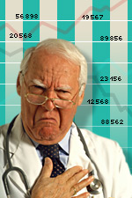
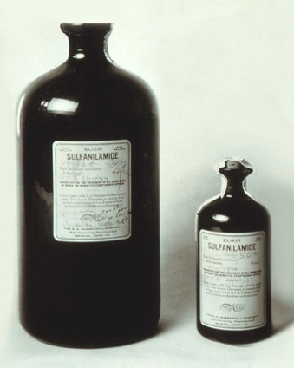
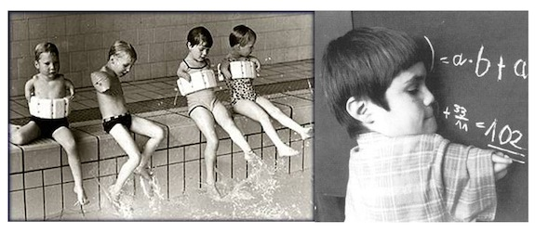
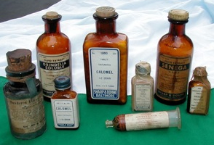
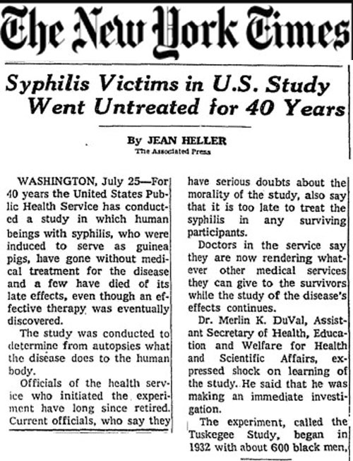
Why regulatory agencies?
Built on a legacy of failures:

Slide 4
Quick history
1902 - Biologics control act 1902
1906 - Pure Food and drug act 1906
1912 - Prohibits false therapeutic claims (Sherman amendment)
1930 - Named FDA
1938 - Food drug and cosmetic act – prove safety
1951 - Codified “Prescription only” (Durham Humphrey amendment)
1962 - Required to prove effectiveness (Kefauver Harris amendment)

Slide 5
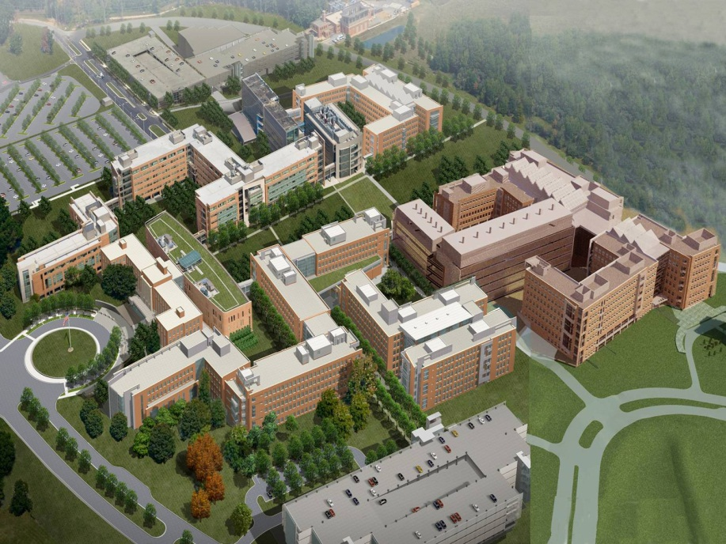
15,000 employees
Estimated to regulate 25% of expenditure in US
Operating budget of ~$4.7 billion in 2014

Slide 6
Three centers in FDA regulate human medical products
CDER-drugs
CBER-biologics
CDRH-devices

Slide 7
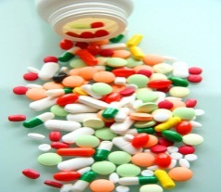
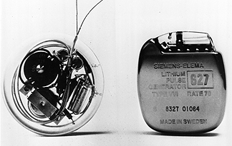
Medical products
Drugs | Biologics | Devices
Small molecules | Large molecules
Generally synthetic | Derived from living organisms | Manufactured
Analytically simple | Analytically complex: vaccines, gene therapy, tissues and blood and cellular products | Engineering/physical: Catheters, prosthetics, pacemakers, defibrillators, in vitro diagnostics
Heat stable | Heat labile
21CFR300 | 21CFR600 | 21CFR800

Slide 8
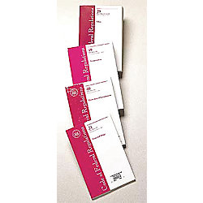
Code of Federal Regulations
21 CFR Sections
Parts 1-99
Part 14 Advisory Committees Part 50 Informed Consent Part 54 Financial Disclosure by Clinical Investigators Part 56 Institutional Review Boards (IRBs)
Part 300
Part 312 Investigational New Drug Application (IND) §312.20 Requirement for an IND §312.22 General principles of the IND submission §312.23 IND content and format §312.32 IND safety reporting §312.33 Annual reports §312.42 Clinical Hold §312.310 Emergency IND (E-IND)
Part 314 New Drug Application (NDA) §314.50 Content and format of an NDA §314.80 Postmarketing reporting of adverse drug experiences §314.126 Adequate and well-controlled studies §314.500 (Subpart H) – Accelerated Approval §316.20 (Subpart C) - Orphan drugs
Part 600 Biological License Application (BLA) Part 800 Devices

Slide 9
Investigational new drug application (Protection of human subjects)
Investigational new drug application (IND) - (21 CFR 312)
Required in order to initiate human studies
Allows shipping of investigational drug for the purpose of conducting a clinical trial
Ensures:
That studies are safe and ethical
That they are likely to produce meaningful results
Satisfactory monitoring and reporting of safety
Exemption (21 CFR 312.2(b)):
Lawfully marketed drugs used in doses and populations that do not increase risk
Not intended to support changes in labeling or advertising
Clinical hold (21 CFR 312.42):
Studies can be delayed or halted by FDA for safety concerns

Slide 10
New drug application (NDA) Biologics license application (BLA)
Requirements for a marketing application
Required components
Safety reports
NDA includes, for example:
Non-clinical studies: chemistry, in vitro, animal
Efficacy and safety results from clinical studies performed under IND

Slide 11
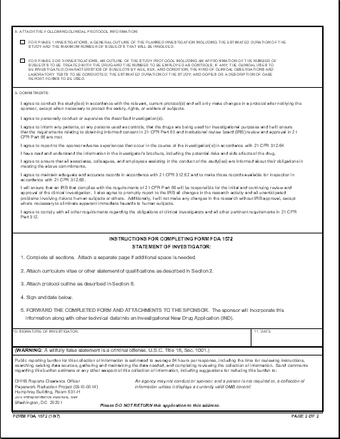
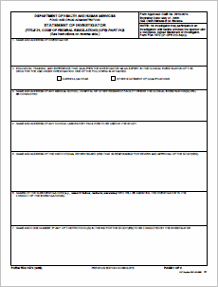
If you are involved in a study under IND…..
FDA needs to review the IND/study protocol to allow the study to proceed
You need to be aware of responsibilities of investigators – see e.g., Form FDA 1572
Informed consent, IRB review, safety reporting, reasonable expectation of a meaningful result

Slide 12
1572 commitments
Comply with protocol
Personally conduct/supervise investigation
Informed consent and IRB review
Report adverse experiences
Read and understand investigator’s brochure
Ensure study staff are aware of responsibilities
Maintain adequate records and make them available for inspection
Ensure IRB oversight, and notify IRB of problems or changes

Slide 13
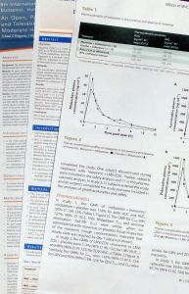
If you are involved in a study under IND…..
Investigators brochure
FDA reviews along with the protocol in the IND submission
On this basis you will have to decide if the study is safe and appropriate for your patients
Safety information
CMC-impurities, shelf-life, substance uniformity
Toxicology-general, geno, carcino, cardiac NOAELs
Clinical pharmacology-peaks, AUC’s, metabolites, drug interactions, ADME

Slide 14
Pre IND meeting- product characteristics and plans for development
IND submission
IND review- clinical holds meeting
Review of Study designs and supporting safety and efficacy data
Sponsor has completed sufficient studies to support an application
IND safety reports
End of phase 2 meeting- discussion of the study material to be included in the application
NDA submission
Filing meetings- determine that the package is complete and can be reviewed
NDA review- clinical, clinical pharmacology, CMC, Toxicology, microbiology, safety, risk management, pediatrics, compliance, labeling to address all regulations
Investigator responsibilities, record keeping
Advisory committee-public presentation of the application and input from experts
Approval/complete response
Phase 4 study
Ongoing surveillance and epidemiology
Labeling update/warning letters to doctors
Supplementary NDA
Withdrawal

Slide 15
Different types of NDA submissions
505 (b) (1)- full development program by sponsor including all primary phase 1, 2 and 3 data
505 (b) (2)- contains full reports of investigations of safety and effectiveness but where at least some of the information required for approval comes from studies not conducted by or for the applicant and for which the applicant has not obtained a right of reference (i.e. can refer to literature and to previous FDA findings relevant to the application)
505 J -(generic pathway) contains information to show that the proposed product is identical in active ingredient, dosage form, strength, route of administration, labeling, quality, performance characteristics, and intended use, among other things, to a previously approved product. (Based on chemistry and bioequivalence)
Subpart H adequate and well-controlled clinical trials establishing that the drug product has an effect on a surrogate endpoint that is reasonably likely, based on epidemiologic, therapeutic, pathophysiologic, or other evidence, to predict clinical benefit or on the basis of an effect on a clinical endpoint other than survival or irreversible morbidity (e.g. HIV drugs)
Animal rule - drug and biological product development when human efficacy studies are not ethical or feasible. e.g. anthrax prophylaxis

Slide 16
IDE (Investigational Device Exemption) 21CFR814
ensures protection of human subjects in clinical trials (equivalent to IND for drugs)
needed for studies of “Significant Risk Devices” (21 CFR 812.3) (Generally includes in vitro diagnostics where the result affects patient treatment.)
even if an IDE is not needed, informed consent and IRB review are most often necessary.

Slide 17
Medical Devices
Unlike drugs and biologics, devices are divided into 3 classes depending on the type of information needed to ensure safety and efficacy.
Class I | Class II | Class III
e.g., cotton swabs | e.g. lab tests, most devices | e.g. defibrillators
General controls | General and special controls
Exempt from premarket submission (with rare exceptions) | 510 (k) | Premarket approval (PMA)
Notes:
17

Slide 18
Pathways to approval/clearance of devices
510(k) (21 CFR 807)
substantial equivalence to a predicate device
e.g., does a new pulse oximeter perform as well as an existing, cleared device.
510(k) devices have a 90 day review and are cleared, not approved.
De novo
a predicate device does not exist
Regulated as 510(k) if special controls can be designated that provide a reasonable assurance of the safety and effectiveness of the device
PMA (21CFR814)
class III devices and new devices where risk cannot be mitigated by special controls.
PMAs have a 120 day review and added regulatory oversight.

Slide 19
How does FDA decide?
Scientific review
CFR
Guidances
Advisory committees

Slide 20
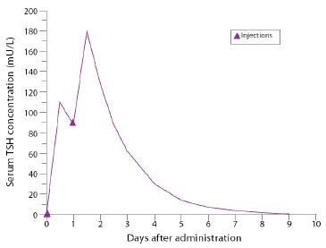
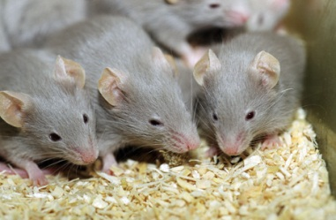
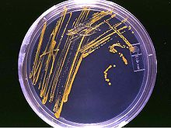
Review team
Chemistry
Clinical pharmacology
Toxicology
Microbiology
Clinical review
Statistical review

Slide 21
Substantial evidence of effectiveness
evidence consisting of adequate and well-controlled investigations, including clinical investigations,
by experts qualified by scientific training and experience to evaluate the effectiveness of the drug involved,
on the basis of which it could fairly and responsibly be concluded by such experts that the drug will have the effect it purports or is represented to have under the conditions of use prescribed, recommended, or suggested in the labeling or proposed labeling thereof.

Slide 22
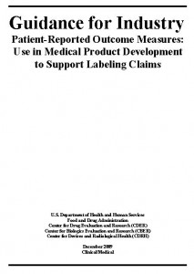
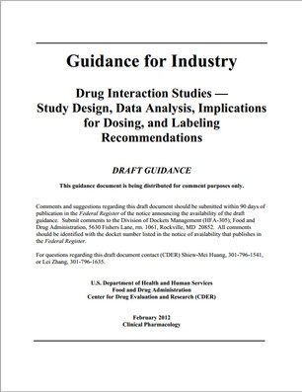
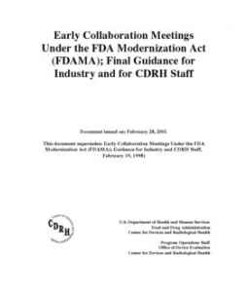
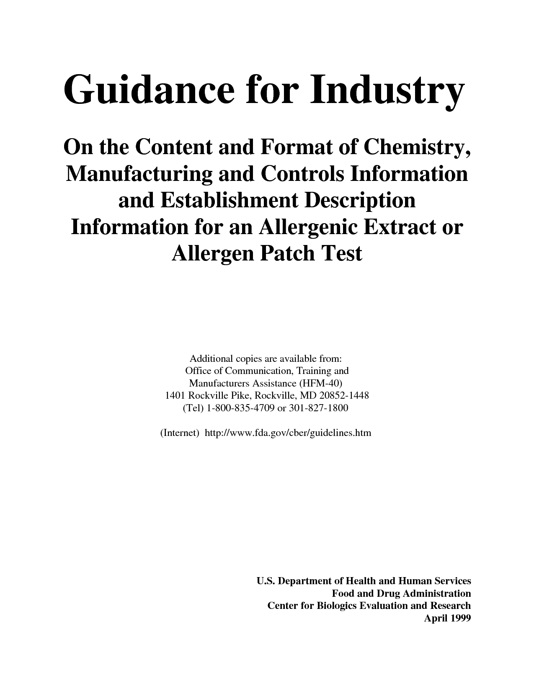
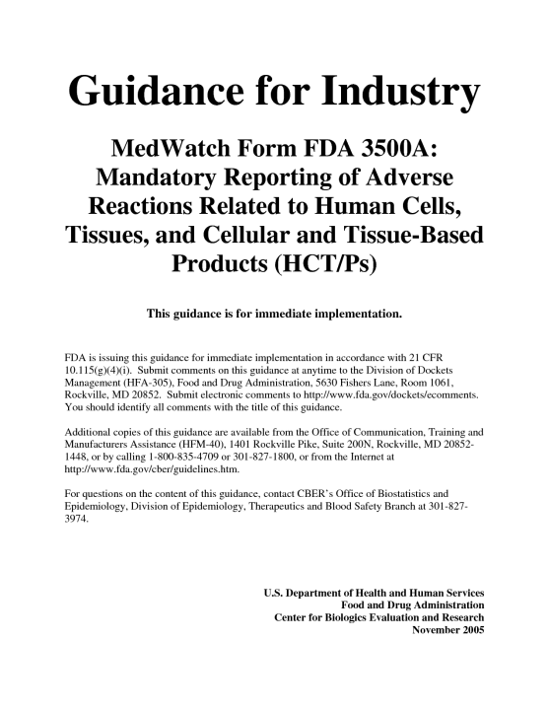
Guidance documents

Slide 23
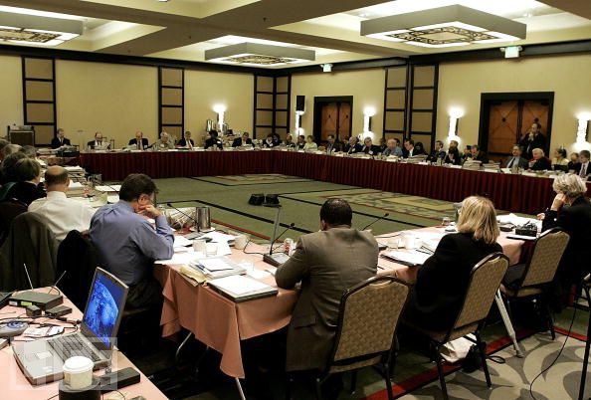
Advisory committee

Slide 24
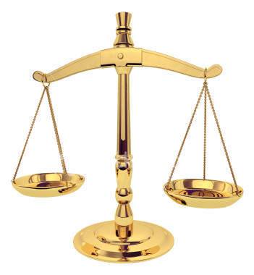
Risk benefit
Unmet need
Toxicity
Convenience of administration
Inappropriate use
Drug-drug interactions
Reduced toxicity
Superior efficacy

Slide 25
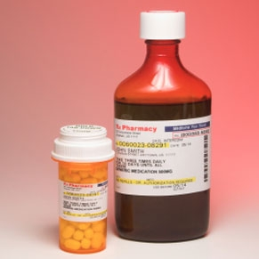
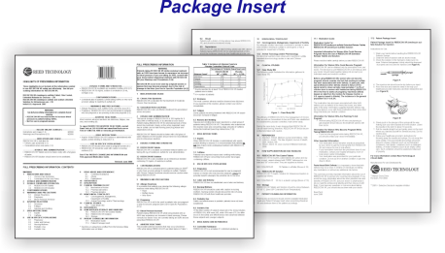
Product labeling
Contains information including
Approved indication and use
Dosage and administration
Warnings and adverse reactions
Drug interactions
Use in specific populations
Clinical studies
Used by health care professionals and patients for information on safe and effective use
Has implications for advertising and promotion

Slide 26
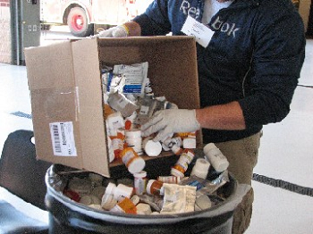
Drug failures
302 New molecular entity applications submitted to FDA between 2000 and 2012*
50% not approved on first submission
73.5% approved after one or more resubmissions
Efficacy deficiencies only 32%
Safety deficiencies only 26%
Safety and efficacy deficiencies 27%
Sacks et al. JAMA 2014;311(4):378-384

Slide 27
Why did they not get approved?
Dose selection | 15.9%
Study endpoints | 13.2%
Inconsistent results (for different endpoints) | 13.2%
Inconsistent results (for different trials or study sites) | 11.3%
Poor efficacy compared to standard of care | 13.2%
Data integrity | 5.3%
Chemistry, manufacturing, labeling | 1.3%

Slide 28
Adverse events seen in clinical trials that affected approval
Type of adverse event | Number of non-approvals
Cardiovascular | 14
Overall mortality | 11
hepatic | 9
Neuropsychiatric | 9
Hemostasis | 6
gastrointestinal | 5
Drug interactions | 4
Infections | 4
Allergy/immunology | 4
Neoplasm | 4
Renal | 3
Musculoskeletal | 2

Slide 29
Safety reasons that drugs were not approved
Theoretical risks (structure, mechanism of actions, class) | 7.3%
Potential risk based on animal toxicology (e.g., carcinogenicity) | 5.3%
Inadequate data in patients with renal/hepatic impairment | 4.6%
Unsatisfactory data on QT prolongation | 4.6%

Slide 30
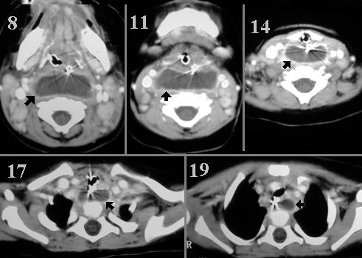
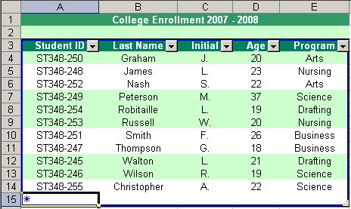
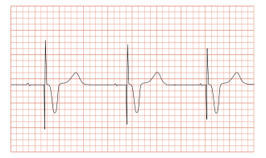
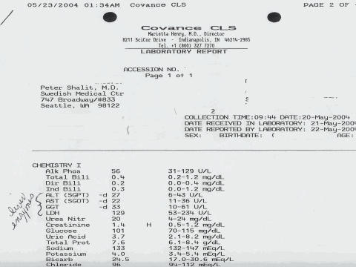
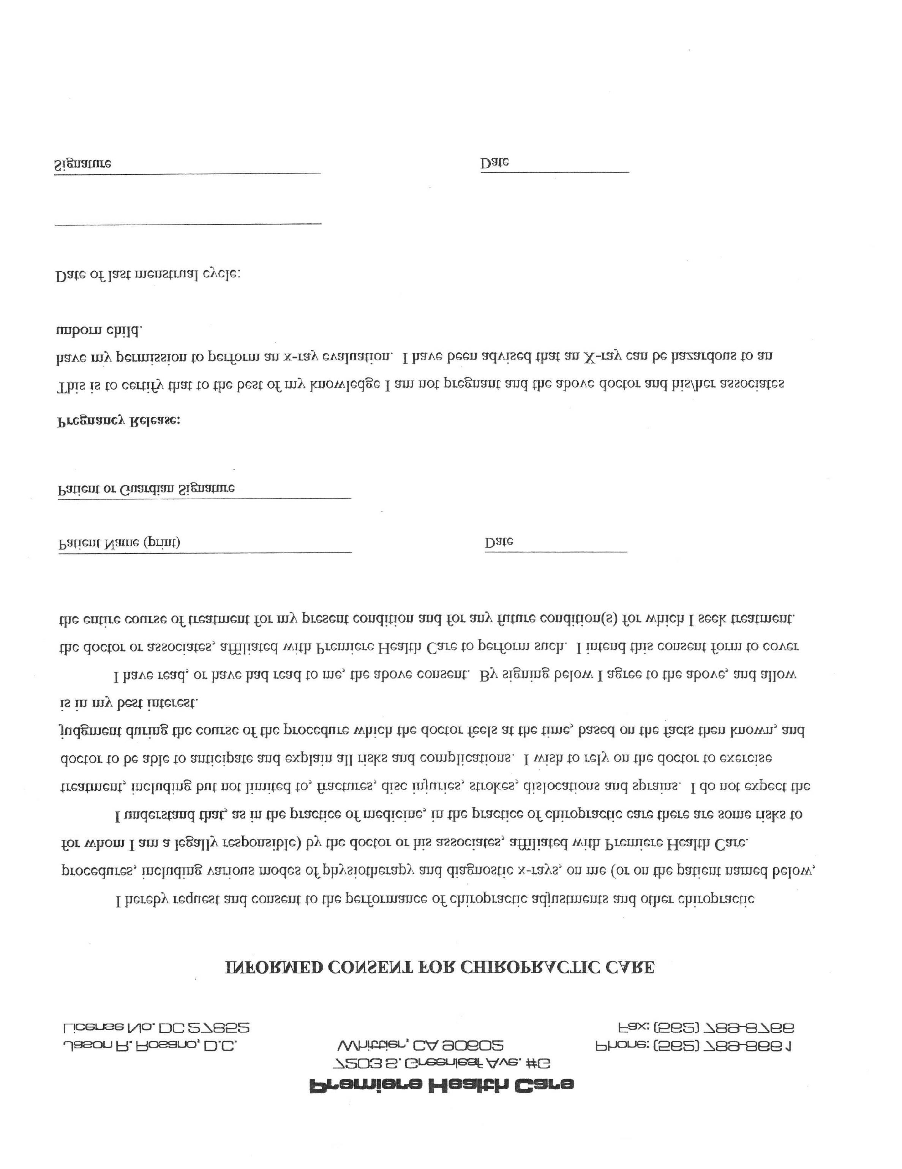
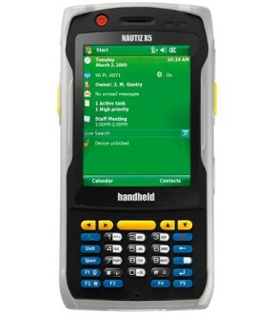
What’s new?
Electronic platforms for clinical trials
The study machine
Sponsor
IRB
CRO

Slide 31
New technologies
Mobile Technologies
Electronic health records
Electronic informed consent

Slide 32
New study design and analysis
Adaptive trial designs
Bayesian analyses
Basket trials
Pragmatic trials

