Slide 1
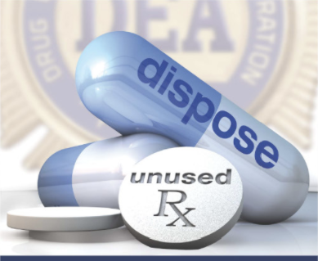
RIDRx
Anyen Fon
Olamide Olujohungbe
Chidiogo Eke
Hang Vo

Slide 2
Outline
Introduction
Current Options for Drug disposal
Our Solution: RidRx
Other Recommendations
Data Transmission
Challenges
Next Steps

Slide 3
Introduction
1

Slide 4
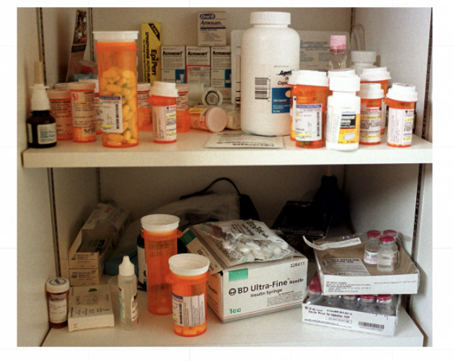
Public Health Safety Risks
Diversion and identity theft
Children and pet poisoning
Drug abuse
Environmental risks

Slide 5
Current Options for Drug disposal
2

Slide 6
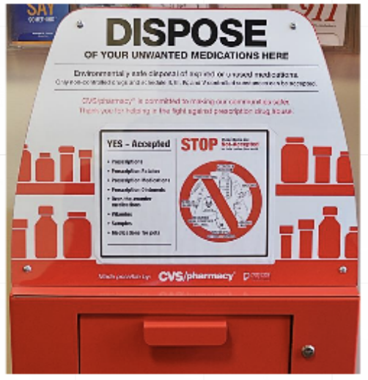
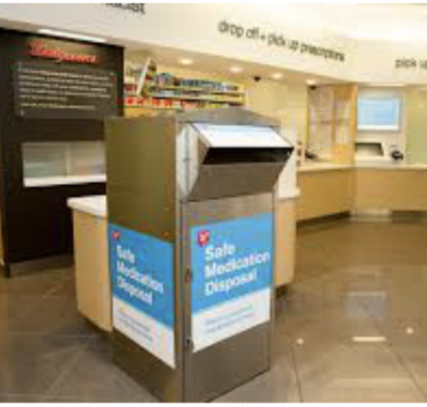
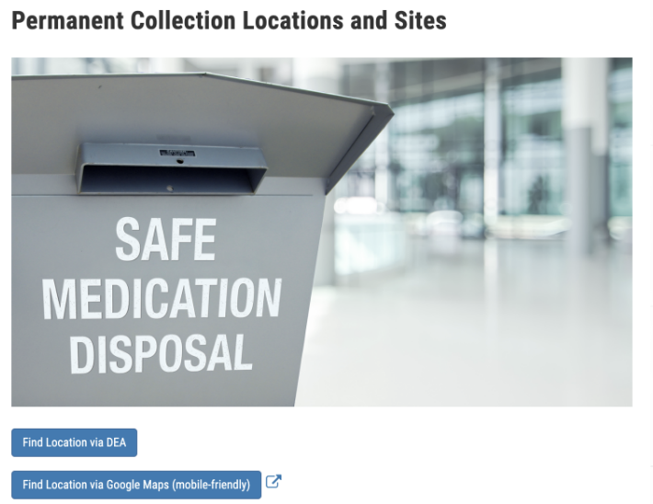
Dispose medications here!
CVS Disposal Drop Box
Walgreens Disposal Kiosks
DEA Controlled Substance Disposal Locations

Slide 7
OUR TARGET: RAISING AWARENESS
Raising awareness and streamlining available resources concerning proper and safe disposal of unused, unwanted, or expired medications.

Slide 8
Our Solution
3

Slide 9
The App: RIDRx
The phone app that helps you get RID of your medications the RIGHT way.

Slide 10
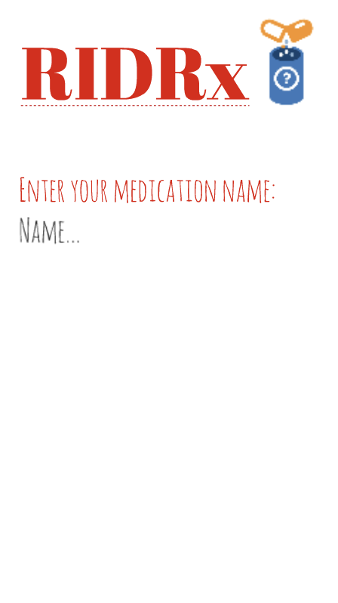
The App: RIDRx

Slide 11
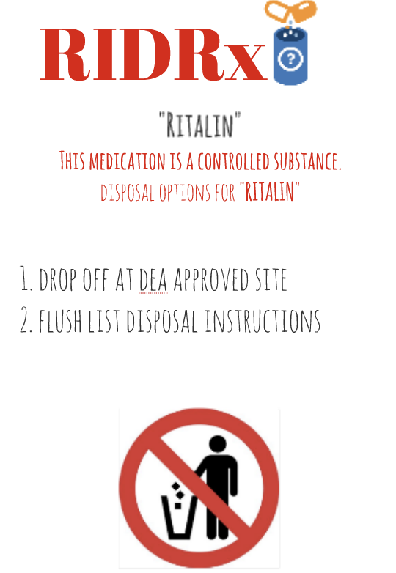
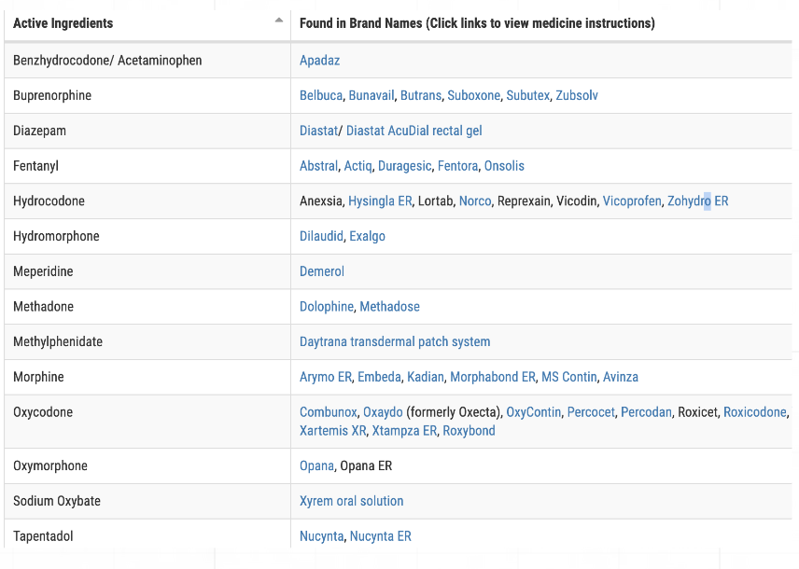
Incorporating the FDA Flush List

Slide 12
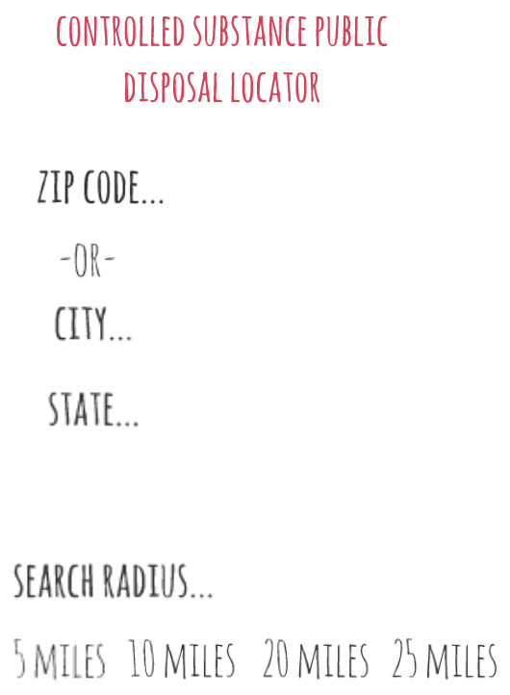
Includes DEA disposal Locator
The phone app that helps you get RID of your medications the RIGHT way.

Slide 13
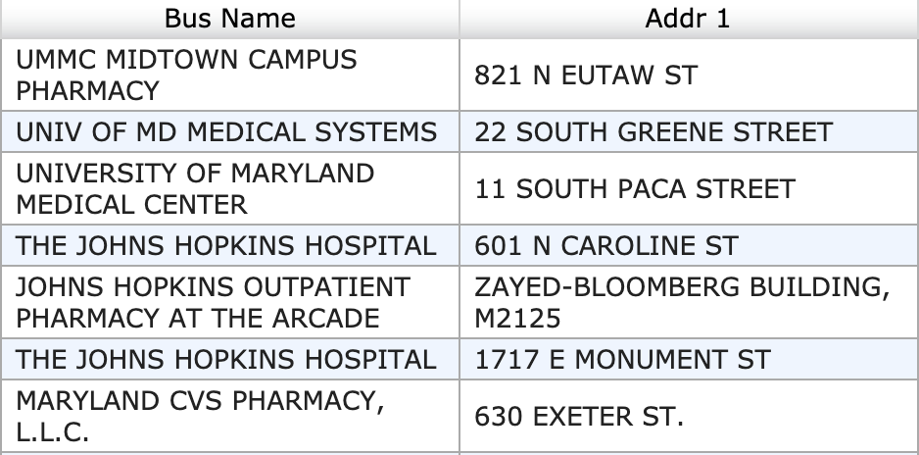

Slide 14
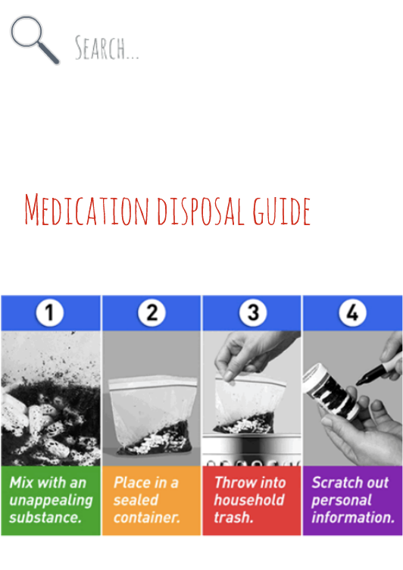
Home Medication Disposal Guide
How to safely dispose medications when dropping it off is not an option

Slide 15
Adding Labels
4

Slide 16
In addition...
Propose for FDA to work with the pharmaceutical companies to include RIDRx app in the package insert as well as the prescription bag label given at the pharmacies.

Slide 17
RITALIN-SR Package Insert
This information should be added right under storage information
How should I dispose unused Ritalin-SR?
Download RIDRx app from Google or Apple Play Stores for complete disposal information

Slide 18
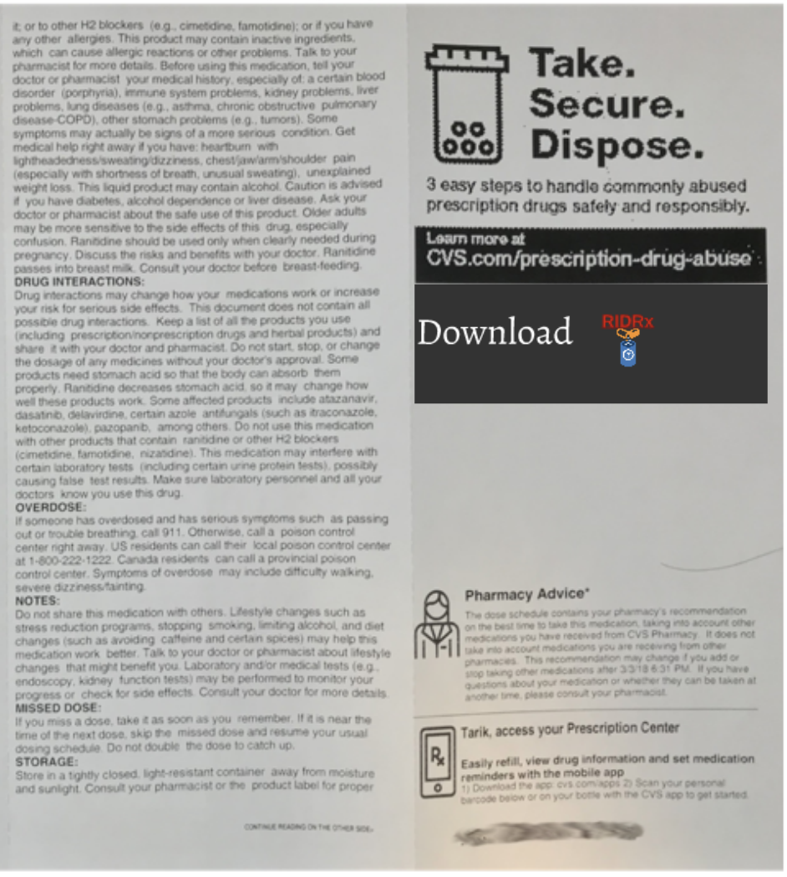
Prescription Bag Label
Add information about the RIDRx app.

Slide 19
Data Transmission
5

Slide 20
Your data is safe!
HIPPA does not protect data generated by patients on personal electronic devices.
Data generated from RIDRx will not be transmitted.

Slide 21
Challenges
6

Slide 22
Inaccessibility of the app
Funding for developing the app
Additional costs for app development
To begin the initiative with FDA and Sponsors to add disposal information on all package inserts

Slide 23
Next Steps
7

Slide 24
Mitigate other causes of lack of disposal
Coordinate with mail delivery services for home pick ups
Tamper proof take back packages
Efforts should be made to collaborate with mail delivery services in the future to create an effective home pick-up program to help mitigate other causes of inability to get to drug disposal locations

Slide 26
References:
1. Commissioner, O. of the. Where and How to Dispose of Unused Medicines. FDA (2019) http://www.fda.gov/consumers/consumer-updates/where-and-how-dispose-unused-medicines
2. Khan U, Bloom RA, Nicell JA, Laurenson JP. (2017) Risks associated with the environmental release of pharmaceuticals on the U.S. Food and Drug Administration "flush list". Retrieved from https://www.ncbi.nlm.nih.gov/pubmed/28787777
3. Monivenna M.G., Pramod Kumar T.M., Venkatesh M.P. (2019). Drug Disposal Regulations: Current Status in United States and Europe. Journal of Pharmaceutical Sciences and Research, 11(8), 2814-2819. https://search.proquest.com/openview/ae7bd2d35bd901b7ed268d25734b6c35/1.pdf?pq-origsite=gscholar&cbl=54977
4. Product Stewardship Institute (PSI). https://www.productstewardship.us/.
Center for Drug Evaluation and Research. Drug Disposal: Flush Potentially Dangerous Medicine [Internet]. U.S. Food and Drug Administration. FDA; [cited 2020Feb10]. Available from: https://www.fda.gov/drugs/disposal-unused-medicines-what-you-should-know/drug-disposal-flush-potentially-dangerous-medicine#FlushList
5. The Science of the total environment. U.S. National Library of Medicine; 2017 [cited 2020Feb10]. Available from: https://www.ncbi.nlm.nih.gov/pubmed/28787777
6. Title 21 Code of Federal Regulations [Internet]. PART 1317 - Subpart A - Disposal of Controlled Substances by Registrants. [cited 2020Feb10]. Available from: https://www.deadiversion.usdoj.gov/21cfr/cfr/1317/subpart_a.htm
7. Tucker, C. (2011, March). Drug takebacks aim to prevent abuse, protect environment. (cover story). Nation’s Health, pp. 1–15. Retrieved from http://search.ebscohost.com.proxy-hs.researchport.umd.edu/login.aspx?direct=true&db=hxh&AN=59290184&site=eds-live

Slide 27
Acknowledgments
Special thanks to all the people who supported and mentored us throughout this process.
FDA Mentor: Roberta Glass, MD, Senior Medical Officer, Division of Psychiatry, Center for Drug Evaluation and Research, FDA
UMB Mentor: UMB mentor: James Polli, PhD, Professor of Pharmaceutical Sciences, University of Maryland, Baltimore

Slide 28
THANKS!
Any questions?
Please do not hesitate to contact us:
afon@umaryland.edu

