Slide 1

Pediatric Clinical Investigator Training
GCP: Tips on Clinical Trial Conduct and
Preparing for FDA Inspection
Susan Leibenhaut, M.D.
Office of Scientific Investigations (OSI)
CDER/FDA
February 28, 2019

Slide 2
Good Clinical Practice - GCP
Outline of Topics
GCP: Science and Quality in Clinical Research
Regulations and Guidances
FDA Clinical Site Inspection

Slide 3
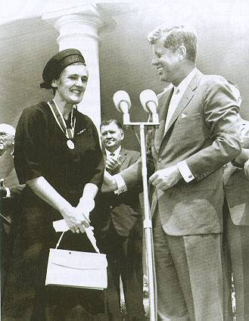
Inspection preparation begins with planning and start-up of the protocol
Frances Kelsey, PhD, MD receiving the President’s Award for
Distinguished Federal Service from President Kennedy 1962,
the same year as the passage of the
Kefauver Harris Amendment to the FD&C Act.

Slide 4
Quality in Clinical Research
Clinical trial: an experiment to determine whether the product is safe and effective
Statistical sampling (random) of a target population
Unbiased observations about product effect (endpoint) and AE collection and reporting

Slide 5
Quality: Why We Care
Lack of quality can lead to underestimation or overestimation of true treatment effect
Quality can influence the accuracy of safety reporting
Label: FDA/sponsor agreed communication with stakeholders
Accurate Dosing information

Slide 6
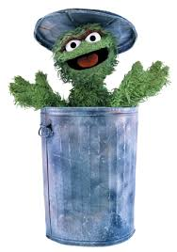
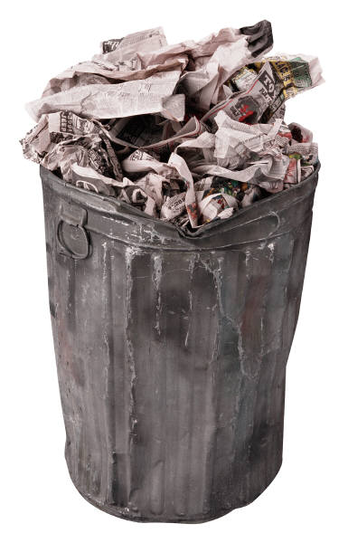
Trash Quality
If YOUR data is not usable, it will be THROWN OUT

Slide 7
Quality in Clinical Trials is
Good Science
and
It’s in the Regulations!

Slide 8
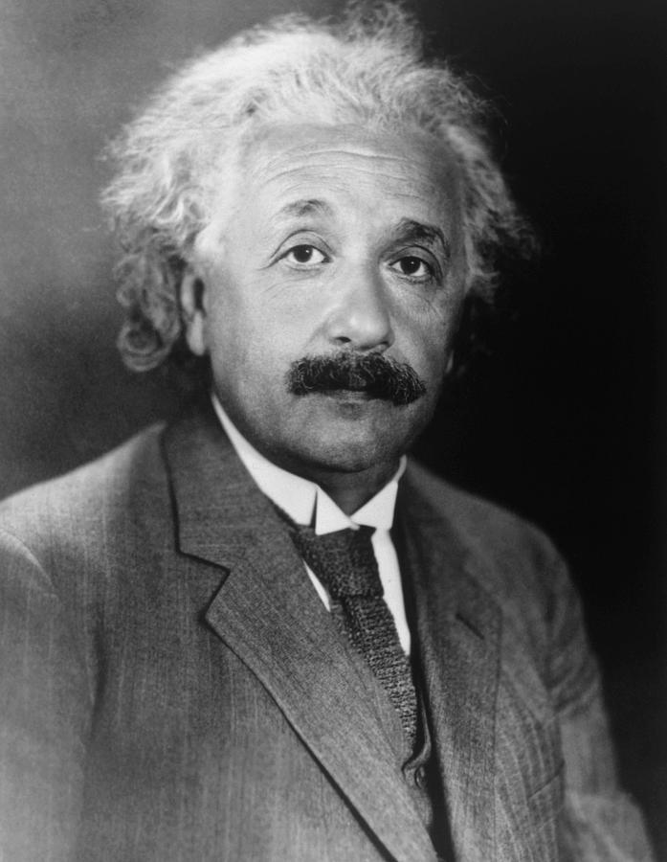

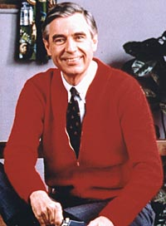
Science and Regulation

Slide 9
General Principles of an
IND Submission
21 CFR 312.22:
FDA's primary objectives in reviewing an IND are, in all phases of the investigation, to assure the safety and rights of subjects, and, in Phase 2 and 3, to help assure that the quality of the scientific evaluation of drugs is adequate to permit an evaluation of the drug's effectiveness and safety.

Slide 10
What is GCP?
According to the regulations 21 CFR 312.120 (a)(i)
For the purposes of this section, GCP is defined as a standard for the design, conduct, performance, monitoring, auditing, recording, analysis, and reporting of clinical trials in a way that provides assurance that the data and reported results are credible and accurate and that the rights, safety, and well-being of trial subjects are protected.
See also ICH E6

Slide 11
FDA Regulations
Regulatory oversight | Clinical Investigators Sponsors, CROs and Monitors Institutional Review Boards (IRBs)
Relevant Regulations 21 CFR | Part 50: Protection of Human Subjects and Informed Consent Part 54: Financial Disclosure Part 56: Institutional Review Boards

Slide 12
CDER Regulations
Relevant Regulations 21 CFR | SPECIFIC to DRUGS and BIOLOGICS Part 312: Subpart D IND Responsibilities 312.50: Sponsors 312.60: Investigators Part 314: New Drug Applications Part 320: Bioavailability and Bioequivalence Requirements

Slide 13
Elements of GCP
Well designed protocol and FOLLOW IT!
DOCUMENTATION
Accurately and completely collect the data
Analyze the data according to a prespecified plan
Accurately report results

Slide 14
Consider these…..
Adequate resources
Well trained staff
Culture of excellence-no fraud or cutting corners
Understanding of science of clinical trials

Slide 15

Regulation and Guidance

Slide 16
Regulation and Guidance
21CFR
REQUIRED
WHAT to do
Guidance
Optional or suggested
HOW to do it

Slide 17
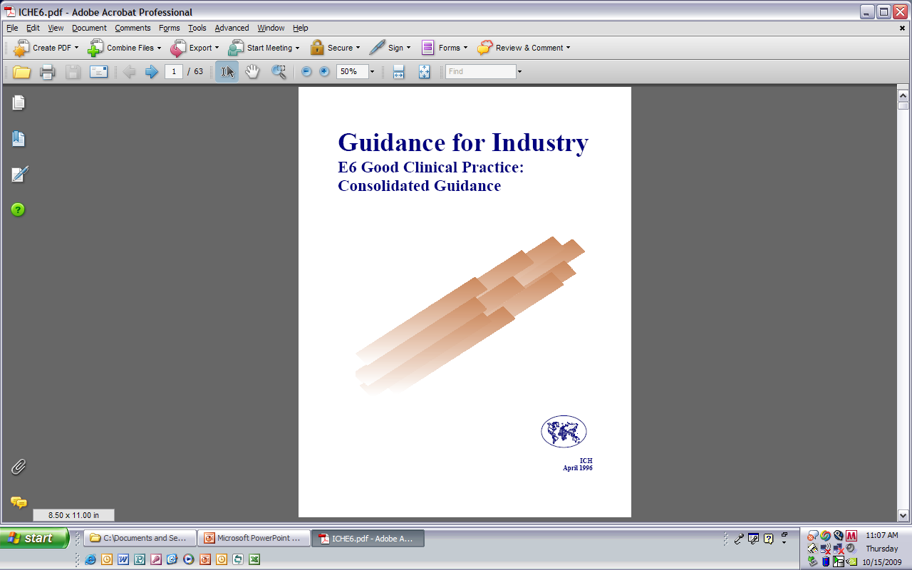
ICH E6
Good Clinical Practice (GCP): A standard for the design, conduct, performance, monitoring, auditing, recording, analyses, and reporting of clinical trials that provides assurance that the data and reported results are credible and accurate, and that the rights, integrity, and confidentiality of trial subjects are protected
https://www.fda.gov/downloads/Drugs/Guidances/UCM464506.pdf
17

Slide 18
Definitions 312.3
Sponsor: takes responsibility for and initiates a clinical investigation; may be an individual or pharmaceutical company, governmental agency, academic institution, private organization, or other organization.
Investigator: an individual who actually conducts a clinical investigation
Sponsor-investigator: an individual who fulfills both roles above

Slide 19


Interface with FDA
Clinical investigator interacts with Sponsor
Sponsor interacts with FDA
CI

Slide 20
Clinical Investigator Responsibilities
312.60 Protocol
Ensuring that an investigation is conducted according to:
  Signed investigator statement (Form 1572)
  Investigational plan
  Applicable regulations
Control of drugs under investigation

Slide 21
Clinical Investigator Responsibilities
312.60 Human Subject Protection
Ensuring that informed consent is adequately obtained according to 21 CFR 50
Ensuring IRB review, approval and reporting requirements are met 21 CFR 56

Slide 22
Clinical Investigator
Recordkeeping and Retention
21CFR 312.62
Drug disposition
Prepare and maintain adequate and accurate case histories
Record retention-2 years following the date of approval of marketing application

Slide 23
Clinical Investigator
Reports to the Sponsor
21CFR 312.64
Safety reports-Timely, appropriate
Financial disclosure: includes Family and Sub-Investigators http://www.fda.gov/downloads/RegulatoryInformation/Guidances/UCM341008.pdf
Progress and Final reports (if applicable)

Slide 24
Investigator Commitments
Form FDA 1572
Follow the current protocol
Personally conduct or supervise investigation(s)
Part 50 and 56 requirements (Subject protection and IRB review)
Timely adverse event reporting to the sponsor
Inform study staff of their obligations
Maintain records
Notes:
24

Slide 25
Guidance: “Investigator Responsibilities”
FDA Expectations for Study Oversight by
Clinical Investigator
Appropriate Delegation of study tasks
Adequate Training
Adequate Supervision
CI role in Oversight of Third Parties
http://www.fda.gov/downloads/Drugs/GuidanceComplianceRegulatoryInformation/Guidances/UCM187772.pdf

Slide 26
Guidance=Practical Advice
Delegation log
Documentation of training
Plans for supervision and oversight-SOPs
Procedure for documentation and timely correction of problems
Review of proficiency
Quality control

Slide 27
Sponsors & Contract Research Organizations (CROs) Responsibilities [21CFR312.50-312.59]
Costs Protocol Compliance
Protocol Development Qualified CIs
Regulatory Affairs Drug Disposition
Qualified Monitors Financial Reporting
Clinical Monitoring Records
AE Reporting

Slide 28
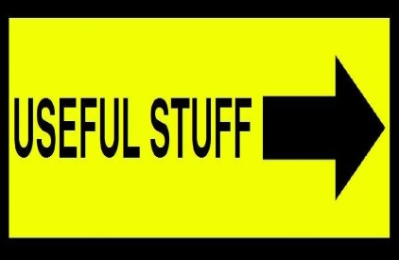
Investigator Initiated INDs aka “Sponsor Investigator” updated 2/22/18
https://www.fda.gov/Drugs/DevelopmentApprovalProcess/HowDrugsareDevelopedandApproved/ApprovalApplications/InvestigationalNewDrugINDApplication/ucm343349.htm

Slide 29
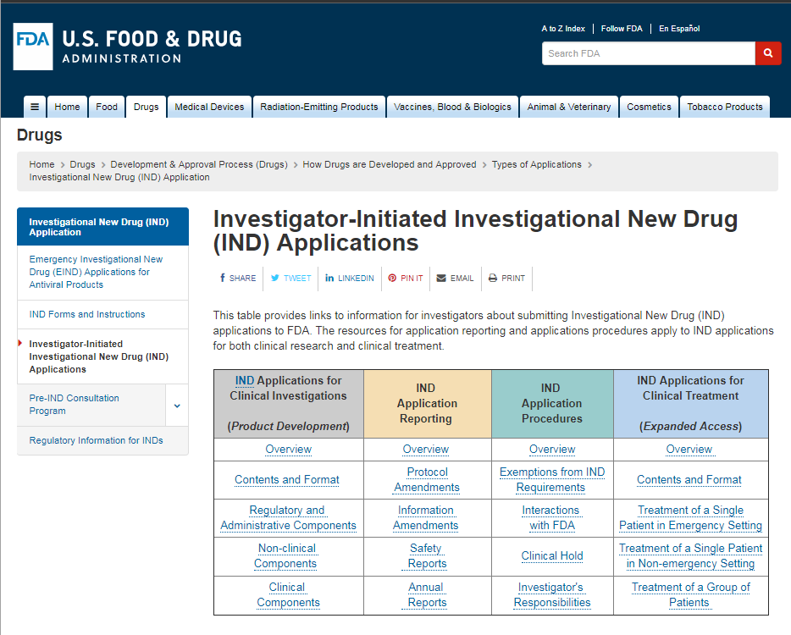

Slide 30

What happens in an
FDA BIMO Inspection?

Slide 31
What is BIMO?
Bioresearch monitoring begun by Francis Kelsey and Alan Lisook mid-1961 (see resource slide)
CDER/OSI issues assignment based on review of trial
On-site inspection by ORA for compliance with regulations, data verification
Center determines final classification
Compliance Program Guidance Manuals (CPGM)
  instructions
http://www.fda.gov/ICECI/ComplianceManuals/ComplianceProgramManual/ucm255614.htm

Slide 32
Inspection procedures
Phone call-not much advanced notice
Present Form FDA 482
Opening meeting
Interview staff during the inspection
Review of study records/regulatory binder
Collection (copy) of exhibits
Closing meeting-possible issue of “483”

Slide 33
Inspection at CI site
What type/how were subjects recruited, enrolled and randomized
Did the study involve blinded and unblinded staff and who had access to treatment
Was the protocol followed and do the study documents reflect this?
Control of “test article” drug/biologic

Slide 34
Inspection at CI site
Inspection of site to “re-create” the trial
Verification of data submitted to FDA
Source CRF Data submitted to FDA
Protocol adherence
Safety reporting
Human subject protection: IRB review and Consenting process
CRF=case report form

Slide 35

Inspection at CI site
Source documents: what are they?
  “First put pen to paper”
  ALCOA-C: accurate, legible, contemporaneous, original, attributable and complete
  May be defined in protocol
  Consider: paper office notes, EHR, direct patient data entry via web or PDA
  FDA Guidances and ICH E6

Slide 36
What can go wrong?
Violations of the protocol
Subjects not given proper instructions for PK samples: fasting, medication administration
Samples not processed correctly
Test article not stored correctly
Not technical violation: Misinterpretations of the protocol
Analytical Equipment malfunction or lack of calibration

Slide 37
What to do if you receive a 483?
A response is advised but there is no regulatory requirement to respond
FDA requests response within 15 business days
Include CORRECTIVE ACTION to prevent the finding from occurring again
“THE MONITOR should have caught it” is NOT an explanation!

Slide 38
After the Inspection
Final classification taking into account response from Clinical Investigator
OSI Recommendation to review division concerning reliability of data
Additional comments concerning clinical trial conduct
Post inspectional correspondence (letter) issued to the inspected party

Slide 39
Summary
Quality should be built into a clinical trial
Resources and culture of excellence are important components
Continuous assessment of procedures and FIX the problem (CAPA)
Adherence to the Regulations is required
Guidances available for advice

Slide 40
Contact Information
Susan Leibenhaut, M.D.
GCP Compliance Assessment Branch
Office of Scientific Investigations
Office of Compliance/FDA
White Oak, Bldg. 51, Rm. 5302
10903 New Hampshire Ave.
Silver Spring, MD 20993
Susan.leibenhaut@fda.hhs.gov
PH: 301-796-3626

Slide 42
Resources
Regulatory Affairs at Your Institution
Code of Federal Regulations
http://www.accessdata.fda.gov/scripts/cdrh/cfdocs/cfcfr/cfrsearch.cfm
ICH Guidances
https://www.fda.gov/ScienceResearch/SpecialTopics/RunningClinicalTrials/GuidancesInformationSheetsandNotices/ucm219488.htm

Slide 43
Resources: Training
FDA GCP Training Resources
http://www.fda.gov/scienceresearch/specialtopics/runningclinicaltrials/educationalmaterials/ucm112925.htm
SoCRA https://www.socra.org/
CTTI http://ctti-clinicaltrials.org/home

Slide 44
Resources: OSI
OSI and History of FDA’s BIMO program
http://www.fda.gov/AboutFDA/CentersOffices/OfficeofMedicalProductsandTobacco/CDER/ucm091393.htm#history
Clinical Investigator Inspection List (CLIIL) results going back to 1977
http://www.fda.gov/Drugs/InformationOnDrugs/ucm135198.htm

Slide 45
Resources: Inspection
CPGM: manual of instruction inspections and guidance for ORA investigators
http://www.fda.gov/ICECI/ComplianceManuals/ComplianceProgramManual/ucm255614.htm
Basics for Industry: What should I expect during and Inspection?
http://www.fda.gov/ForIndustry/FDABasicsforIndustry/ucm237624.htm

Slide 46
Resources: OGCP
Office of Good Clinical Practice (FDA-wide)
http://www.fda.gov/scienceresearch/specialtopics/runningclinicaltrials/default.htm
Guidance Search Page
http://www.fda.gov/drugs/guidancecomplianceregulatoryinformation/guidances/ucm310704.htm

Slide 47
Resources
OGCP Contacts and Mailbox
http://www.fda.gov/ScienceResearch/SpecialTopics/RunningClinicalTrials/ucm134476.htm
Archived replies
http://www.fda.gov/ScienceResearch/SpecialTopics/RunningClinicalTrials/RepliestoInquiriestoFDAonGoodClinicalPractice/default.htm
Searchable archives
http://www.firstclinical.com/fda-gcp/

Slide 48
Resources
When is an IND needed?
http://www.fda.gov/forindustry/fdabasicsforindustry/ucm237990.htm
Drug Development and Approval Process
http://www.fda.gov/Drugs/DevelopmentApprovalProcess/default.htm

Slide 49
Source Documents ICH E6
1.52 Source Documents:
Original documents, data, and records (e.g., hospital records, clinical and office charts, laboratory notes, memoranda, subjects' diaries or evaluation checklists, pharmacy dispensing records, recorded data from automated instruments, copies or transcriptions certified after verification as being accurate and complete, microfiches, photographic negatives, microfilm or magnetic media, x-rays, subject files, and records kept at the pharmacy, at the laboratories, and at medico-technical departments involved in the clinical trial).

Slide 50
Adequate and Well-Controlled Study 21 CFR 314.126
(a) The purpose of conducting clinical investigations of a drug is to distinguish the effect of a drug from other influences, such as spontaneous change in the course of the disease, placebo effect, or biased observation.
(b) An adequate and well controlled study has the following characteristics……..

Slide 51
Financial Disclosure
21CFR part 54
54.1 (b) Purpose
FDA may consider clinical studies inadequate and the data inadequate if, among other things, appropriate steps have not been taken in the design, conduct, reporting, and analysis of the studies to minimize bias. One potential source of bias in clinical studies is a financial interest of the clinical investigator in the outcome of the study because of the way payment is arranged (e.g., a royalty) or because the investigator has a proprietary interest in the product (e.g., a patent) or because the investigator has an equity interest in the sponsor of the covered study.

Slide 52
October 2009
http://www.fda.gov/downloads/Drugs/GuidanceComplianceRegulatoryInformation/Guidances/UCM187772.pdf

Slide 53
May 2010
http://www.fda.gov/downloads/RegulatoryInformation/Guidances/UCM214282.pdf

Slide 54
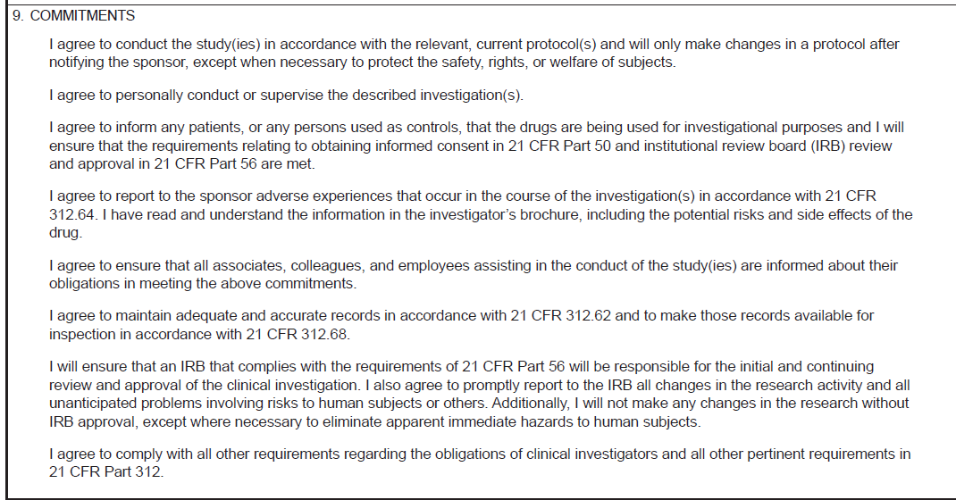
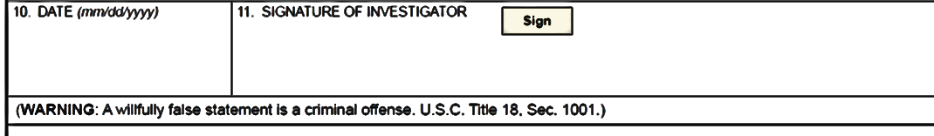
Your
Signature

Slide 55
Who is Listed on the 1572?
The investigator must sign the 1572
Item 6: Names of sub-investigators
  In general, if an individual is directly involved in the treatment or evaluation of research subjects, that person should be listed on the 1572
  For example, as part of the protocol or a clinical investigation, if each subject needs to visit a specified internist who will perform a full physical to qualify subjects for the study, that internist should be listed in Block #6
  Hospital staff, including nurses, residents, or fellows and office staff who provide ancillary or intermittent care but who do not make a direct and significant contribution to the data do not need to be listed individually
  It is not necessary to include in this block a person with only an occasional role in the conduct of the research, e.g., an on-call physician who temporarily dealt with a possible adverse effect or a temporary substitute for any research staff
http://www.fda.gov/OHRMS/DOCKETS/98fr/FDA-2008-D-0406-gdl.pdf

Slide 56
August 2013
http://www.fda.gov/downloads/Drugs/GuidanceComplianceRegulatoryInformation/Guidances/UCM269919.pdf

Slide 57
Why is monitoring so important?
Monitoring is a quality control tool for determining whether study activities are being carried out as planned, so that deficiencies can be identified and corrected.
Monitoring Guidance page 2

Slide 58
Focus on Conduct and Documentation
Informed consent
Eligibility criteria
  Inclusion-target population
  Exclusion-safety issues
Investigational Product (IP) accountability and administration
Section IVA-page 11

Slide 59
Focus on Conduct and Documentation
Study Endpoints: Efficacy
Safety Assessments
Adverse Events
Trial Integrity
  Blinding
  Adjudication
  DSMB

Slide 60
Outcomes of FDA Inspections
Results posted on Clinical Investigator Inspection List (CLIIL), updated quarterly
Education of study site
Acceptance or rejection of study data
Product approval or complete response to sponsor
Letter or Warning Letter or Enforcement Action (Disqualification Proceedings) for Clinical Investigator

Slide 61
Definitions
Form FDA 482-Notice of Inspection
Form FDA 483-Inspectional Observations
Violation-not being in compliance with the regulation
Observation-finding during inspection that may be a violation pending FDA Center review
CAPA-corrective and preventive action plan initiated by an inspected entity

Slide 62
Classifications
NAI-No action Indicated
  No objectionable conditions or practices
VAI-Voluntary Action Indicated
  Objectionable conditions were found and documented, but the Center is not prepared to take or recommend any further actions
OAI-Official Action Indicated
  Serious objectionable conditions warranting action (advisory, administrative, or judicial)

Slide 63
CPGM has Examples
NAI: following the protocol
VAI: assessments not completed appropriately
OAI:
  assessments not conducted AND the records are falsified to cover this up
  Repeated or deliberate failure to comply with the regulations

Slide 64
Sponsor Responsibilities
21CFR 312.50
Choosing qualified clinical investigators and monitors
  Monitoring to ensure that the trial is conducted according to the investigational plan
  Review and analysis of accumulating evidence relating to product’s safety and reporting this to FDA and clinical investigators (Investigator Brochure)
Drug accountability

Slide 65
Contract Research Organization (CRO) 312.52
CRO: assumes responsibility(ies) of the sponsor
A sponsor may transfer any or all obligations to a CRO
The transfer of obligations shall be described in writing
A CRO that assumes a sponsor obligation is subject to the same regulatory action as a sponsor
65
Notes:
65

