Slide 1
NociRx
Age-friendly app
Drug-Drug interaction between current prescriptions & over the counter analgesics

Slide 2
OUR TEAM
Mehak Muneer
Nana Esi Bray
mmuneer@umaryland.edu
nbray@umaryland.edu P1
P1
Urooba Ali
Naiha Muneer
uali@umaryland.edu P1
naiha.muneer@umaryland.edu P1

Slide 3
TABLE OF CONTENTS
1
3
2
4
Background
Solution
Problem
Impact

Slide 4
Background / Problem

Slide 5
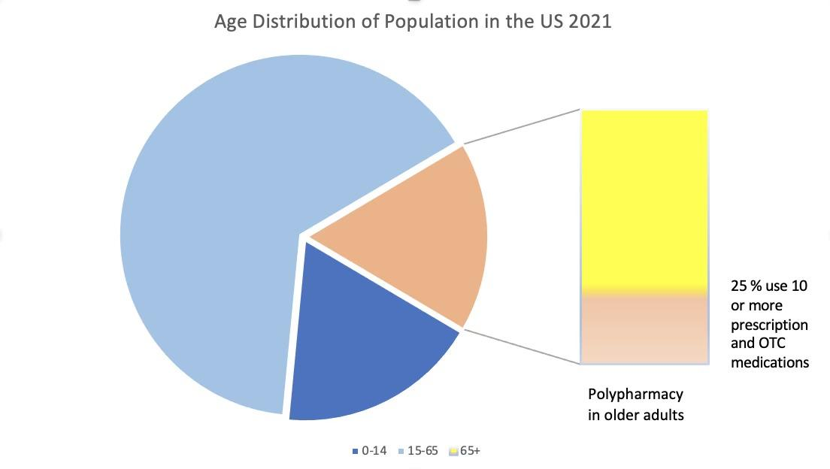
Age Distribution of Population in the US 2021
30% of all OTC sales were attributed to geriatric population
0-14
15-65
13%
65+
Stone, J. A., Lester, C. A., Aboneh, E. A., Phelan, C. H., Welch, L. L., & Chui, M. A. (2017). A preliminary examination of over-the-counter medication misuse rates in older adults. Research
in social & administrative pharmacy : RSAP. Retrieved January 8, 2023, from https://www.ncbi.nlm.nih.gov/pmc/articles/PMC4949161/
Notes:
Over-the-counter (OTC) medications are most commonly used by people over the age of 65.
●While older adults make up only about 13% of the US population, they use 30% of the total OTC medications sold each year.
●One-fourth of all older adults take 10 or more OTC and prescription medications (Polypharmacy).
https://www.ncbi.nlm.nih.gov/pmc/articles/PMC4949161/

Slide 6
88%
5 or more prescriptions
Increased risk of an ADE
Maher, R. L., Hanlon, J., & Hajjar, E. R. (2014, January). Clinical consequences of polypharmacy in elderly. Expert opinion on drug safety. Retrieved January 8, 2023, from https://www.ncbi.nlm.nih.gov/pmc/articles/PMC3864987/#R12
Nania, R. (2022, December 1). Risks from common pain relievers for those 50 and over. AARP. Retrieved January 8, 2023, from https://www.aarp.org/health/drugs-supplements/info-2021/pain-reliever-risks.html
More references in the reference slide…..
Notes:
National Institute of Aging refers Polypharmacy as the use of multiple drugs to treat diseases and other health conditions. Polypharmacy is more prevalent in older adults, many of whom have two or more chronic conditions (Multiple Chronic Conditions or MCC), such as arthritis, asthma, chronic obstructive pulmonary disease, coronary heart disease, depression, diabetes, and hypertension. However, taking too many drugs can raise safety issues and is a growing health concern in the elderly.
https://www.nia.nih.gov/news/dangers-polypharmacy-and-case-deprescribing-older-adults
About half of Americans ages 50 to 80 take two or more nonprescription medications, including supplements, a 2020 report from the University of Michigan's National Poll on Healthy Aging found.
https://www.aarp.org/health/drugs-supplements/info-2021/pain-reliever-risks.html
●The likelihood of a drug-drug interaction increased as the number of medications increased.
●Outpatients taking 5 or more medications had an 88% increased risk of experiencing an ADE in a population-based study compared to those taking fewer medications [12].
●“The prevalence of a potential hepatic cytochrome enzyme-mediated, drug-drug interaction was 80% in a prospective cohort study of older hospitalized adults taking 5 or more medications.
●The likelihood of a drug-drug interaction increased as the number of medications increased." https://www.ncbi.nlm.nih.gov/pmc/articles/PMC3864987/#R12

Slide 7
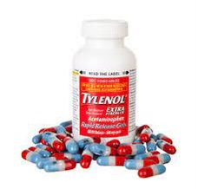
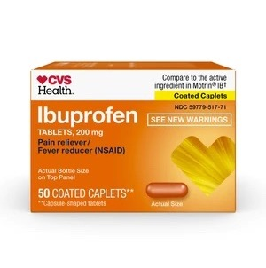
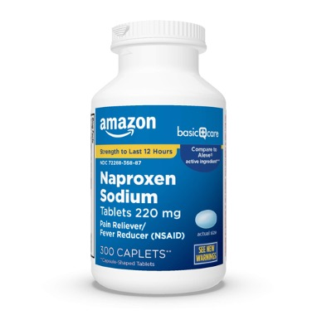
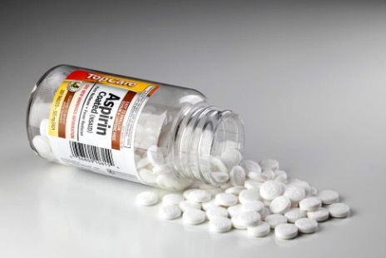
> 50 %
Significant adverse drug events associated with OTC use among geriatrics
Stone, J. A., Lester, C. A., Aboneh, E. A., Phelan, C. H., Welch, L. L., & Chui, M. A. (2017). A preliminary examination of over-the-counter medication misuse rates in older adults. Research in social & administrative pharmacy : RSAP. Retrieved January 24, 2023, from https://www.ncbi.nlm.nih.gov/pmc/articles/PMC4949161/
Notes:
The largest consumers of over-the-counter (OTC) drugs are older adults. More than 50% of significant adverse drug events involving older adults involve an over-the-counter medicine.
Four of the 10 most frequently used drugs are OTC ibuprofen, aspirin, acetaminophen, and diphenhydramine

Slide 8
Substantial daily pain-Most Common Symptom
60%
80 %
Independent
geriatric patients
Long-term care
geriatric patients
U.S. National Library of Medicine. (n.d.). Home - PMC - NCBI. National Center for Biotechnology Information. Retrieved January 24, 2023, from https://www.ncbi.nlm.nih.gov/pmc/
Stone, J. A., Lester, C. A., Aboneh, E. A., Phelan, C. H., Welch, L. L., & Chui, M. A. (2017). A preliminary examination of over-the-counter medication misuse rates in older adults. Research in social & administrative pharmacy : RSAP. Retrieved January 24, 2023, from https://www.ncbi.nlm.nih.gov/pmc/articles/PMC4949161/
Notes:
●“...studies have indicated that 60% of independent and 80% of long-term care geriatric patients report substantial daily pain clearly making it one of the most common symptoms reported by elderly patients.
https://www.ncbi.nlm.nih.gov/pmc/articles/PMC6173536/
Drug-drug interactions, with a total of 39 incidences and affecting 60% of the patients in a long-term geriatric institution, were the most prevalent type of misuse identified among the pain products chosen.
Older adult use of non-steroidal anti-inflammatory drugs (NSAIDs), such as ibuprofen and aspirin, results in 80,000 preventable ADEs annually
NSAIDs account for a burden of adverse drug events (15.4%) even larger than anticoagulants (10.2%) which is the top priority drug class for ADE prevention in the National Action Plan
In fact, the U.S. Centers for Medicare and Medicaid Services single out NSAIDs followed by diphenhydramine for review specifically because of their OTC availability and high potential for therapeutic duplication.
https://www.ncbi.nlm.nih.gov/pmc/articles/PMC4949161/

Slide 9
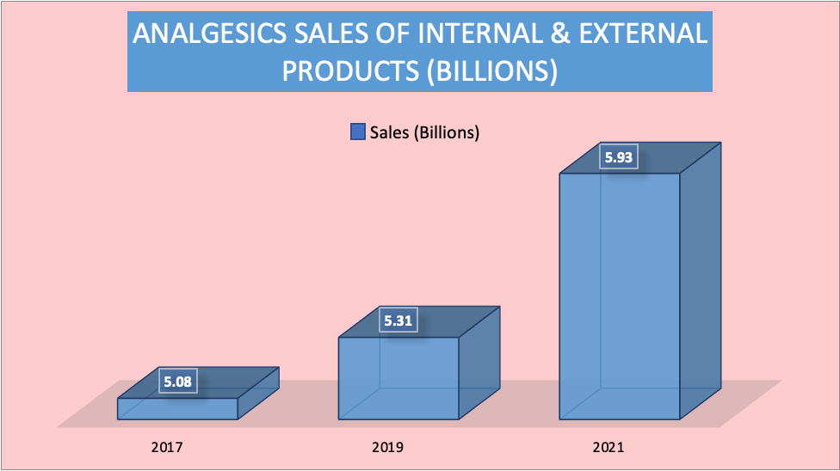
OTC Analgesics Sales in the US
OTC sales statistics. Consumer Healthcare Products Association. (n.d.). Retrieved January 24, 2023, from https://www.chpa.org/about-consumer-healthcare/research-data/otc-sales-statistics
Chui, M. A., Stone, J. A., & Holden, R. J. (2017). Improving over-the-counter medication safety for older adults: A study protocol for a demonstration and dissemination study. Research in social & administrative pharmacy : RSAP. Retrieved January 24, 2023, from https://www.ncbi.nlm.nih.gov/pmc/articles/PMC5524620/
Notes:
●According to the Washington, D.C.-based non-profit Consumer Healthcare Protection Association, the top-selling OTC drug categories in the past few years include multiple analgesics products
https://www.chpa.org/about-consumer-healthcare/research-data/otc-sales-statistics
●Adults over the age of 65 are particularly susceptible to ADEs. Over 50% of the 2.2 million older persons who are thought to be at risk for a serious ADE are at danger as a result of taking prescription and over-the-counter drugs simultaneously.
●Additionally, these medications are marketed in multiple-ingredient combinations, which account for 26% and 45% of aspirin and acetaminophen use, respectively, raising the risk of harmful overdosing.
https://www.ncbi.nlm.nih.gov/pmc/articles/PMC5524620/

Slide 10
Solution

Slide 11
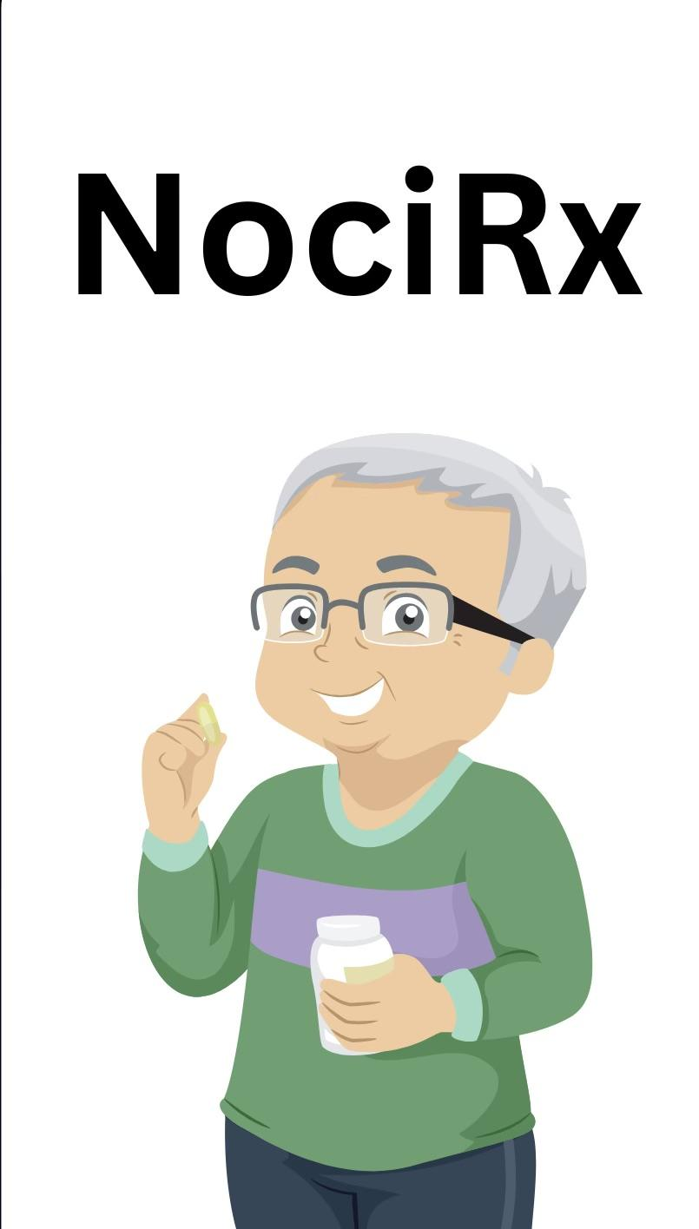
NociRx
Age-friendly app
Drug-Drug interaction between current
prescriptions & over the counter analgesics

Slide 12
How it works?
Scan the barcode of the OTC analgesic product
Health Conditions
(Optional)
3
4
5. Drug-Drug interaction will appear & its severity
2. Add all current Rx
medications, OTC,
Herbal supplements
2
5
Create an
account in a few easy
steps
1
6
6. Depending on the
severity, a message
prompt will guide
the patient

Slide 13
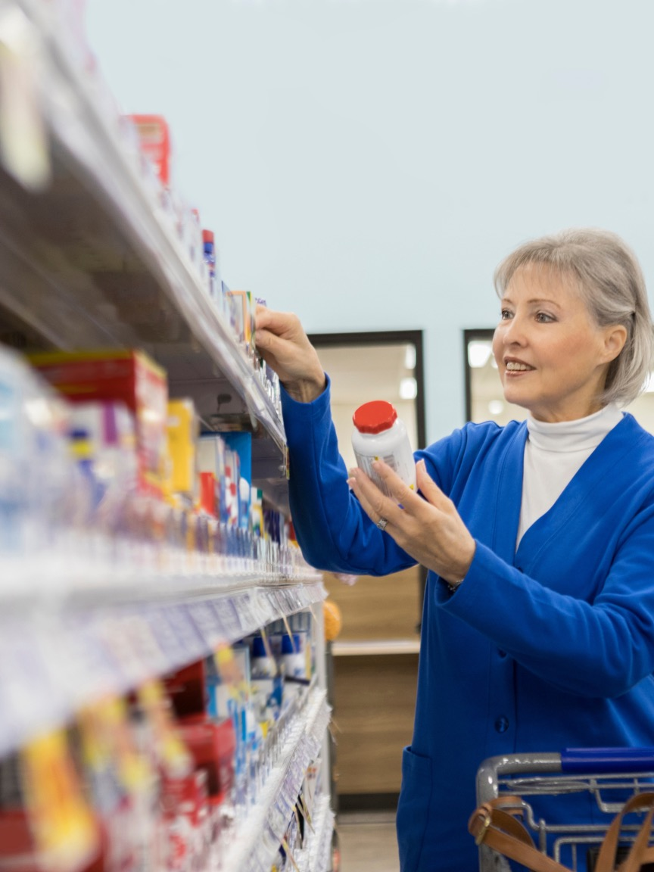
Let’s take a general example
What current Rx medications, OTC, herbal/non-prescription products is the patient taking?
Sertraline
What is the medical concern that needs to be treated?
Body ache
Which OTC medication is safe for them to take?
Ibuprofen
Acetaminophen
May increase the risk of bleeding
Micromedex products: Please Login. (n.d.). Retrieved January 24, 2023, from https://www.micromedexsolutions.com/micromedex2/librarian/deeplinkaccess
Notes:
(https://www-micromedexsolutions-com.proxy-hs.researchport.umd.edu/micromedex2/librarian/PFDefaultActionId/evidencexpert.ShowDrugInteractionsResults)
The patient is taking sertraline and started to have body ache. They have two main options for the OTC pain reliever, Ibuprofen & Acetaminophen. They chose to go with Ibuprofen. It has a severe interaction with sertraline that can cause internal bleeding. So, a better option for them is to take acetaminophen for body aches if they take sertraline.

Slide 14
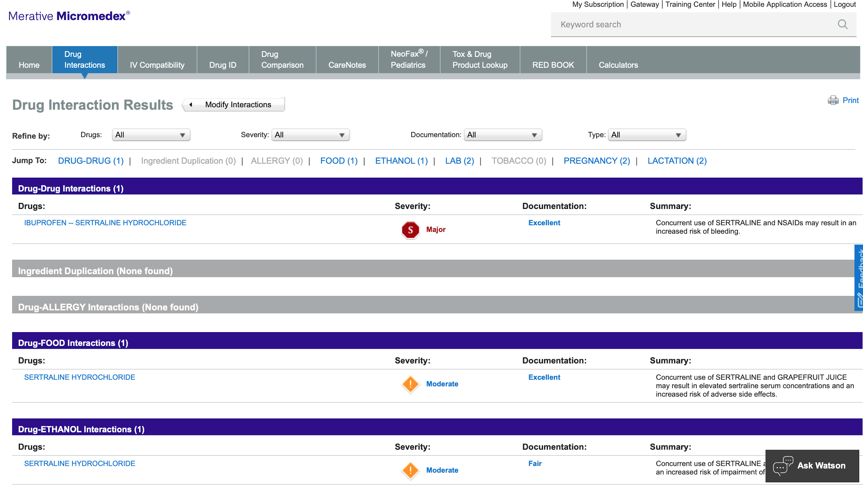
Medication Guide for Sertraline
“Increased Risk of Bleeding: Concomitant use of aspirin, nonsteroidal anti-inflammatory drugs (NSAIDs), other
Antiplatelet drugs, warfarin, and other anticoagulants may increase the risk.”
(Weis Pharmacy)
Micromedex products: Please Login. (n.d.). Retrieved January 24, 2023, from https://www.micromedexsolutions.com/micromedex2/librarian/deeplinkaccess
Notes:
https://www.accessdata.fda.gov/drugsatfda_docs/label/2016/019839S74S86S87_20990S35S44S45lbl.pdf
https://www.micromedexsolutions.com/micromedex2/librarian/PFDefaultActionId/evidencexpert.ShowDrugInteractionsResults

Slide 15
Link to the pharmacy
Available 24/7
Get answers to your medication questions
Notes:
The app has identified a possible drug-drug interaction between the OTC pain reliever and one or more of your other prescription medications. What’s next? Every time this happens, the app shows a pop-up prompt for you to chat with a registered pharmacist so you can answer your medication questions and suggest a better alternative (in our case, an OTC analgesic).

Slide 16
Age Friendly Features
Text-to-speech Tool
Font Tool
An example of assistive technology that reads digital text aloud is text-to-speech (TTS) or "read-aloud technology." TTS may take words on a computer or other digital device and turn them into audio with the click or touch of a button.
It will allow the user to change the font and size of the text.
Baig, E. C. (2021, December 22). Talking labels aid the blind ﻿with prescriptions. AARP. Retrieved January 24, 2023, from https://www.aarp.org/home-family/personal-technology/info-2021/talking-prescription-drug-labels.html
Notes:
In collaboration with the nonprofit, CVS Health announced a talking prescription label solution called Spoken Rx that is now available in its nearly 10,000 retail pharmacies in the U.S. One of the drawbacks is that this feature is generally used for prescriptions only and not for over-the-counter drugs. We want to introduce a similar text-to-speech feature in NociRx.
https://www.aarp.org/home-family/personal-technology/info-2021/talking-prescription-drug-labels.html

Slide 17
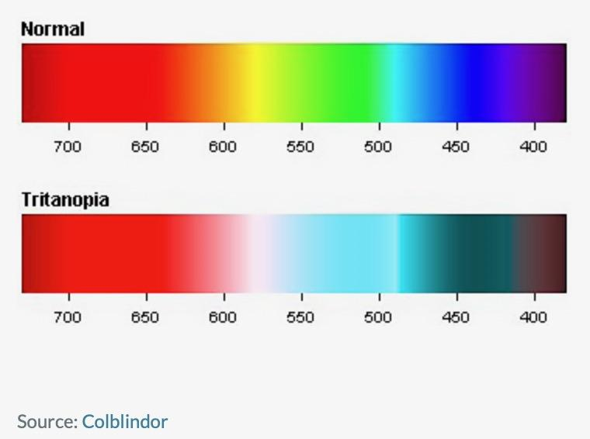
Age Friendly Features
Transient Tritanopia
Rely on colors that are easy to differentiate for individuals with transient tritanopia.
Levdikova, T. (2019, November 10). Designing apps for elderly smartphone users | Clutch.co. Clutch. Retrieved January 20, 2023, from https://clutch.co/app-development/resources/designing-apps-for-elderly-smartphone-users
Notes:
As you age, the lens of your eye can become cloudy as a result of cataracts. This can cause a very mild tritanopia, which can be reversed with cataract surgery.
Macular Degeneration, is an eye condition that occurs more often in older adults and leads to loss of central vision. As a result, loss of blue–yellow sensitivity can occur.
tritanopia does not make it difficult to tell the difference between blue and yellow but colors that contain blue or yellow. Difficulties lie between green–blue, yellow–pink and purple–red.

Slide 18
Age Friendly Features
Age-related Transient Tritanopia:
Age causes a decline in color vision or the
capacity to recognize colors. People in their
mid-70s are frequently found to have issues
with blue-yellow color vision.
When possible, avoid the sole reliance of app’s interface on colors as a guide from feature-to-feature. In case of inevitable use of color-coded features, rely on colors that are easy to differentiate for individuals with transient tritanopia.
Levdikova, T. (2019, November 10). Designing apps for elderly smartphone users | Clutch.co. Clutch. Retrieved January 20, 2023, from https://clutch.co/app-development/resources/designing-apps-for-elderly-smartphone-users
Notes:
As you age, the lens of your eye can become cloudy as a result of cataracts. This can cause a very mild tritanopia, which can be reversed with cataract surgery.
Macular Degeneration, is an eye condition that occurs more often in older adults and leads to loss of central vision. As a result, loss of blue–yellow sensitivity can occur.
tritanopia does not make it difficult to tell the difference between blue and yellow but colors that contain blue or yellow. Difficulties lie between green–blue, yellow–pink and purple–red.

Slide 19
Lowest reading grade-level content
The National Institutes of Health
Mayo Clinic
10.7
10.9
11.3
11.5
WebMD
Diagnosis Specific
Websites
NIH recommends 6-7 reading level
Hutchinson, N., Baird, G. L., & Garg, M. (2016, January 29). Examining the reading level of internet medical information for Common Internal Medicine diagnoses. The American Journal of Medicine. Retrieved January 24, 2023, from https://www.amjmed.com/article/S0002-9343(16)30068-7/fulltext
More references in reference slide…..
Notes:
●The National Institutes of Health (NIH) recommends that health materials be written at a grade 6-7 reading level, which is often not met in online reading materials.
●The NIH provided the lowest reading grade-level content (10.7), followed by WebMD (10.9), Mayo Clinic (11.3), and diagnosis-specific Web sites (11.5)
https://www.amjmed.com/article/S0002-9343(16)30068-7/fulltext
●In addition to the online health materials, the patient package inserts (PPIs), on average, were a tenth-grade reading level which is beyond the recommended readability of fifth to seventh grade.
●Design elements such as type size and paper quality, which influence patients' likelihood of using and keeping the PPI for reference, were the worst in PPls produced by pharmaceutical manufacturers.
https://www.japha.org/article/S0160-3450(15)30339-1/fulltext
●As of 2011, more than 500,000 Americans misinterpret them every year consequently.
https://www.consumerreports.org/cro/2011/06/can-you-read-this-drug-label/index.htm

Slide 20
Use of Flesch Reading Ease Score
Use of Flesch-Kincaid Grade Level
Short sentences
Simple words
Average Sentence Length
Average number of syllables
per word
Rakt, M. van de. (2022, October 13). The flesch reading ease score: Why and how to use it. Yoast. Retrieved January 24, 2023, from https://yoast.com/flesch-reading-ease-score/
Notes:
We will aim to keep the health literacy information content of our app as easy to follow as possible in accordance with the guidelines published by FDA and NIH. For this purpose, the focus would be on using the Flesch Reading Ease Score and Flesch-Kincaid Grade level equations that utilize the Average Sentence Length(ASL) and Average number of Syllables per Word (ASW) to determine the ease of the content.
https://yoast.com/flesch-reading-ease-score/

Slide 21
Use of Flesch-Kincaid Grade Level
Rakt, M. van de. (2022, October 13). The flesch reading ease score: Why and how to use it. Yoast. Retrieved January 24, 2023, from https://yoast.com/flesch-reading-ease-score/
Notes:
We will aim to keep the health literacy information content of our app as easy to follow as possible in accordance with the guidelines published by FDA and NIH. For this purpose, the focus would be on using the Flesch Reading Ease Score and Flesch-Kincaid Grade level equations that utilize the Average Sentence Length(ASL) and Average number of Syllables per Word (ASW) to determine the ease of the content.
https://yoast.com/flesch-reading-ease-score/

Slide 22
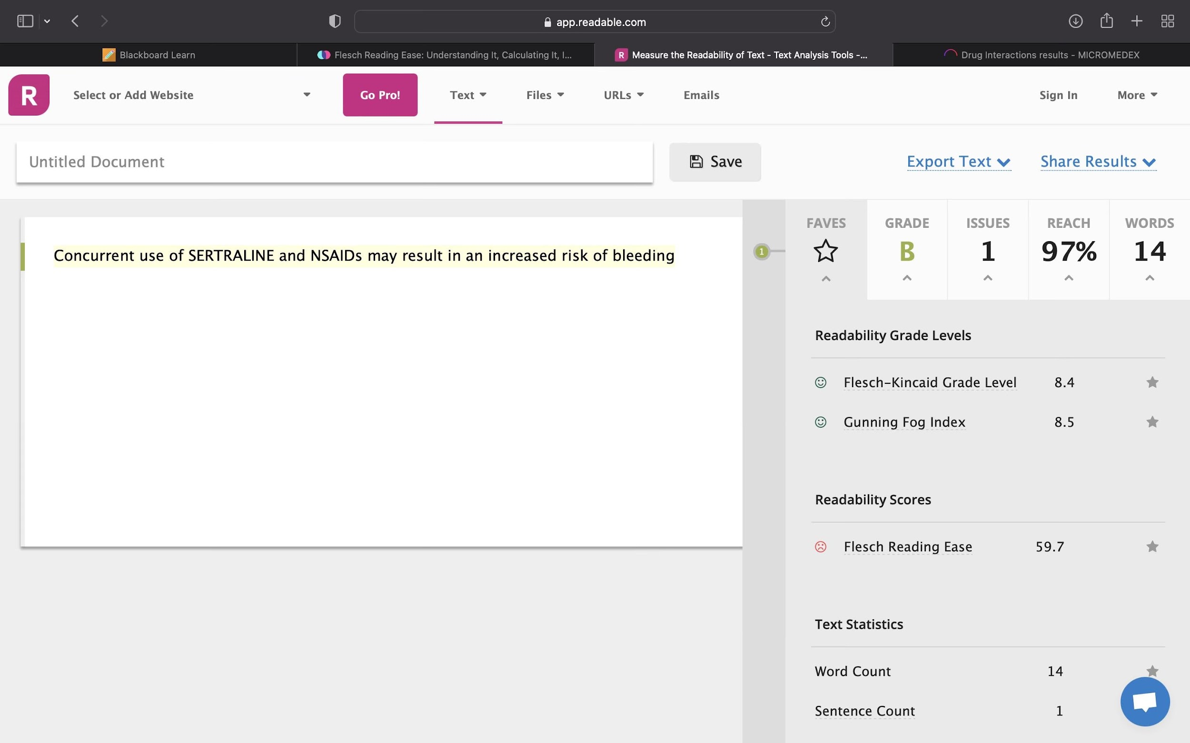

Slide 23
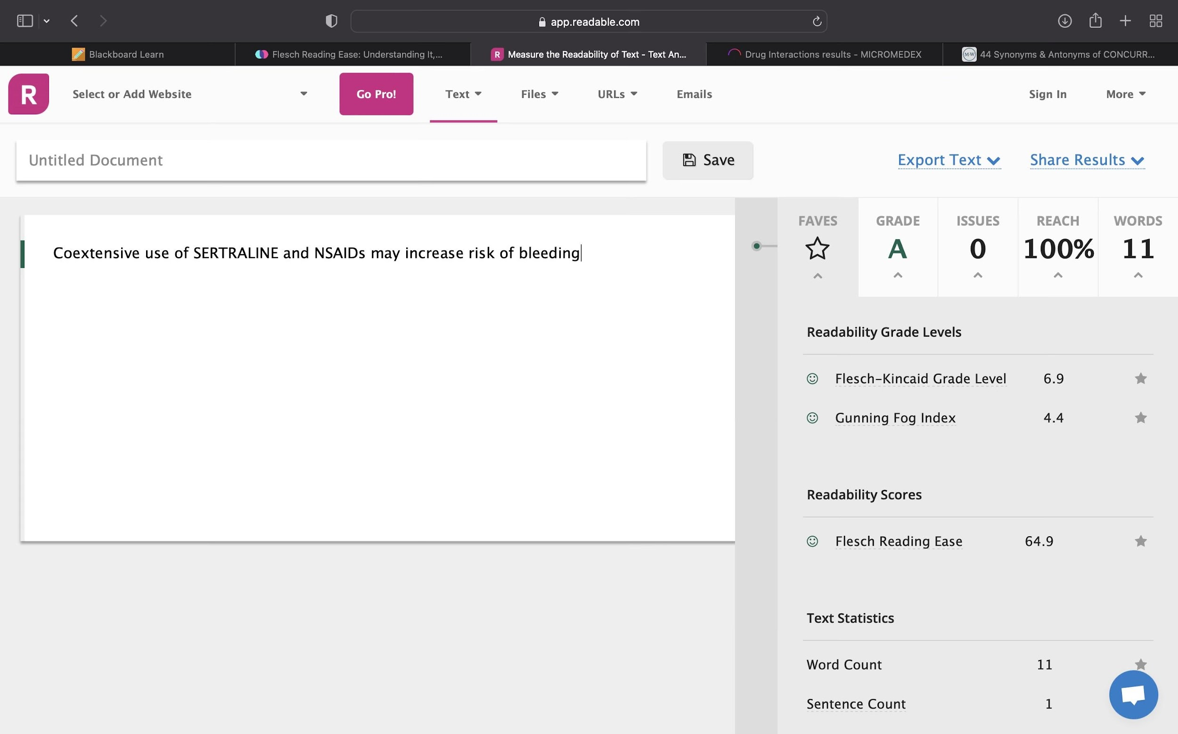

Slide 24
Impact

Slide 25
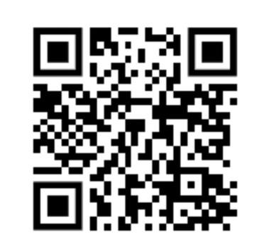
IMPACT OF TECHNOLOGY USED IN THE APP
Impact of Flesh-Kincaid Grade Level: Easy to understand and follow
Impact of barcoding: Enhance the accuracy of choosing and comparing the right drug
Impact of Online Medication List: Easy access to information from multiple prescribers and convenient access to drug allergies and drug-drug interactions
Agrawal, A. (2009, June). Medication errors: Prevention using Information Technology Systems. British journal of clinical pharmacology. Retrieved January 24, 2023, from https://www.ncbi.nlm.nih.gov/pmc/articles/PMC2723209/
Notes:
Instead of solely relying on the manual entry of the OTC analgesic we want to check the possible ADEs for, we suggest adding the feature to be able to scan the barcode or QR code on the bottle through camera of the smart phone. This would enhance the accuracy of choosing and comparing the right drug and reducing the time and effort to do so simultaneously.
The majority of PHRs must have an online medication list. Patients have access to drug information from many providers, can compare it, keep it up to date, and discuss it with their doctor. As patients are aware of both what has been prescribed and what they are really taking, a patient-initiated medication reconciliation approach is likely to be more accurate. Advanced PHRs also offer decision-supporting capabilities that let individuals foresee potential prescription errors and notify medical professionals to them, such as monitoring for drug allergies and drug-drug interactions. Since this is a new field of health IT, there isn't much concrete data at this time, but there is a lot of hope over its potential to reduce drug errors.
https://www.ncbi.nlm.nih.gov/pmc/articles/PMC2723209/

Slide 26
THANKS
ACKNOWLEDGEMENT TO OUR MENTORS
James Polli, PhD M-CERSI
Omnia A. Ismaiel, PhD CDER/OTS/OCP/DARS
Vinay Pai, PhD, MBA CDRH/OST/DDH
We contacted:
Pfizer
GSK
Bayer
Johnson & Johnson
National Council on Aging
American Association
of Retired Persons (AARP)
Please keep this slide for attribution

Slide 27
ANY
QUESTIONS?

Slide 28
Images Citation
References
Slide 6:
U.S. Department of Health and Human Services. (n.d.). The dangers of Polypharmacy and the case for deprescribing in older adults. National Institute on Aging. Retrieved January 8, 2023, from https://www.nia.nih.gov/news/dangers-polypharmacy-and-case-deprescribing-older-adults
Slide 14:
Patient package insert readability and Design - American Pharmacy. (n.d.). Retrieved January 24, 2023, from https://www.japha.org/article/S0160-3450(15)30339-1/fulltext
Slide 22 & 23:
Take control of your content with ReadablePro. Readable. (2020, April 19). Retrieved January 24, 2023, from https://readable.com/
Amazon Basic Care Naproxen Sodium Tablets, 300 Count. (n.d.). https://www.amazon.com/Basic-Care-Naproxen-Sodium-Tablets/dp/B074F2FSX4. Retrieved from https://www.medicalnewstoday.com/articles/324917#what-is-naproxen
An opened bottle of aspirin. (2011). An opened bottle of aspirin. istockphoto. Retrieved from https://www.istockphoto.com/photo/aspirin-bottle-with-tablets-spilling-out-gm458563393-17414759?utm_medium=organic&amp;utm_source=google&amp;utm_campaign=iptcurl
Cvs Health Ibuprofen Ib 200 mg Coated Tablets. (n.d.). CVS Pharmacy. Retrieved from https://www.cvs.com/shop/cvs-health-ibuprofen-ib-200mg-coated-tablets-prodid-1012235
Google. (2023, January 3). Acetaminophen. Google image result for https://cdn.britannica.com/23/130223-050-99065995/acetaminophen-suppositories.jpg
Katleho Seisa /iStock https://bestlifeonline.com/news-daily-aspirin-risk/
Remedy and Drugs by Oleg Toka Art https://canva.com/photos
Senior Citizen Man with Pills by BNPDesignStudio https://canva.com/photos
Senior pharmacy customer reads OTC medication pricing by SDI production https://canva.com/photos

Slide 29
References Continued…..
Agrawal, A. (2009, June). Medication errors: Prevention using Information Technology Systems. British journal of clinical pharmacology. Retrieved January 8, 2023, from https://www.ncbi.nlm.nih.gov/pmc/articles/PMC2723209/
Baig, E. C. (2021, December 22). Talking labels aid the blind ﻿with prescriptions. AARP. Retrieved January 8, 2023, from https://www.aarp.org/home-family/personal-technology/info-2021/talking-prescription-drug-labels.html
Borsheski, R., & Johnson, Q. L. (2014). Pain management in the geriatric population. Missouri medicine. Retrieved January 8, 2023, from https://www.ncbi.nlm.nih.gov/pmc/articles/PMC6173536/
Chui, M. A., Stone, J. A., & Holden, R. J. (2017). Improving over-the-counter medication safety for older adults: A study protocol for a demonstration and dissemination study. Research in social & administrative pharmacy : RSAP. Retrieved January 8, 2023, from https://www.ncbi.nlm.nih.gov/pmc/articles/PMC5524620/
Hutchinson, N., Baird, G. L., & Garg, M. (2016, January 29). Examining the reading level of internet medical information for Common Internal Medicine diagnoses. The American Journal of Medicine. Retrieved January 8, 2023, from https://www.amjmed.com/article/S0002-9343(16)30068-7/fulltext
Maher, R. L., Hanlon, J., & Hajjar, E. R. (2014, January). Clinical consequences of polypharmacy in elderly. Expert opinion on drug safety. Retrieved January 8, 2023, from https://www.ncbi.nlm.nih.gov/pmc/articles/PMC3864987/#R12
Nania, R. (2022, December 1). Risks from common pain relivers for those 50 and over. AARP. Retrieved January 8, 2023, from https://www.aarp.org/health/drugs-supplements/info-2021/pain-reliever-risks.html
OTC sales statistics. Consumer Healthcare Products Association. (n.d.). Retrieved January 8, 2023, from https://www.chpa.org/about-consumer-healthcare/research-data/otc-sales-statistics
Patient package insert readability and Design - American Pharmacy. (n.d.). Retrieved January 8, 2023, from https://www.japha.org/article/S0160-3450(15)30339-1/fulltext
Prescription labels and Drug Safety - Consumer Reports. Prescription Labels and Drug Safety - Consumer Reports. (n.d.). Retrieved January 8, 2023, from https://www.consumerreports.org/cro/2011/06/can-you-read-this-drug-label/index.htm
Rakt, M. van de. (2022, October 13). The flesch reading ease score: Why and how to use it. Yoast. Retrieved January 8, 2023, from https://yoast.com/flesch-reading-ease-score/

Slide 30
References Continued…..
Shibboleth authentication request. (n.d.). Retrieved January 8, 2023, from https://www-micromedexsolutions-com.proxy-hs.researchport.umd.edu/micromedex2/librarian/PFDefaultActionId/evidencexpert.ShowDrugInteractionsResults
Stone, J. A., Lester, C. A., Aboneh, E. A., Phelan, C. H., Welch, L. L., & Chui, M. A. (2017). A preliminary examination of over-the-counter medication misuse rates in older adults. Research in social & administrative pharmacy : RSAP. Retrieved January 8, 2023, from https://www.ncbi.nlm.nih.gov/pmc/articles/PMC4949161/
Levdikova, T. (2019, November 10). Designing apps for elderly smartphone users | Clutch.co. Clutch. Retrieved January 20, 2023, from https://clutch.co/app-development/resources/designing-apps-for-elderly-smartphone-users
Text-to-speech technology: What it is and how it works. Reading Rockets. (2019, October 16). Retrieved January 8, 2023, from https://www.readingrockets.org/article/text-speech-technology-what-it-and-how-it-works
U.S. Department of Health and Human Services. (n.d.). The dangers of Polypharmacy and the case for deprescribing in older adults. National Institute on Aging. Retrieved January 8, 2023, from https://www.nia.nih.gov/news/dangers-polypharmacy-and-case-deprescribing-older-adults

