Slide 1
Molecular Targets in Cancer Drug Development: Access to Precision Medicine for Children with Cancer
Gregory H. Reaman, M.D.
Associate Director for Pediatric Oncology,
Oncology Center of Excellence
Associate Director, Oncology Sciences
Office of Hematology and Oncology Products, OND, CDER

Slide 2
Cancer Drug Development for Children and Adolescents
Well recognized, long-standing challenges- biologic, societal, economic
Widely leverages adult drug discovery/development- limited opportunities for extrapolation and limited pre-clinical testing in pediatric models
Impact of legislative initiatives which support pediatric drug development has been markedly less obvious in Oncology than in other clinical areas.
Accepted off label use as part of standard of care and clinical research- delayed pediatric evaluations
Improved outcomes for children with cancer lead to misperception of the unmet clinical need for new drugs.
Unique practice model- integration of clinical research and management provides obvious opportunity to facilitate drug development.
Lag in evolution of cancer drug development paradigm in pediatrics

Slide 3
Evolving Landscape of Oncology Drug Development
Evolutionary Paradigm shift: Human genome (2003) – wide-spread availability of NGS
Genomic and proteomic interrogation of individual cancers screened for specific molecular abnormalities for which “highly specific” targeted agents are developed
Resulted in the creation of multiple rare subsets(defined by molecular phenotype) of previously common cancers and reconsideration of taxonomy
Transformative: NSCLC, Melanoma, Myeloma, AML
Tissue/histology agnostic development

Slide 4
Evolution of Identification of Genomic Alterations in Lung Adenocarcinoma
EGFR
No known genotype
No known genotype
1984 - 2003
2004
2009
2014

Slide 5
Challenges with “old paradigm”
N=800-1200
p53
Platinum doublet
EGFR
HIGH RISK PHASE 3 FAILURE OR CLINICALLY SMALL EFFECT
MET
ROS1
KRAS
ALK
Platinum doublet
+ drug X
Challenges with “new paradigm”
1% Prevalence of even common tumors: Number needed to screen > 100 patients→ need to reduce screen failure rate
1 drug/ 1 biomarker per trial unsustainable→ Need common multi-analyte platform(s)
Need Rapid Learning/ Failure/ Confirmation
Targeted
Therapy
Large, Clinically Meaningful Effect
ALK
N=100-200

Slide 6
Precision Medicine and Oncology Drug Development
Precision oncology requires novel study platforms for evaluating new targeted therapies
Multiple new targeted agents (including same in class)
Platform studies: Master Protocols
Combinations
Standard control arms
Centralized biomarker platforms
Efficiency in setting of small populations (rare subsets)
Precision cancer medicine: targeted therapy selection by identifying key gene variants.

Slide 7
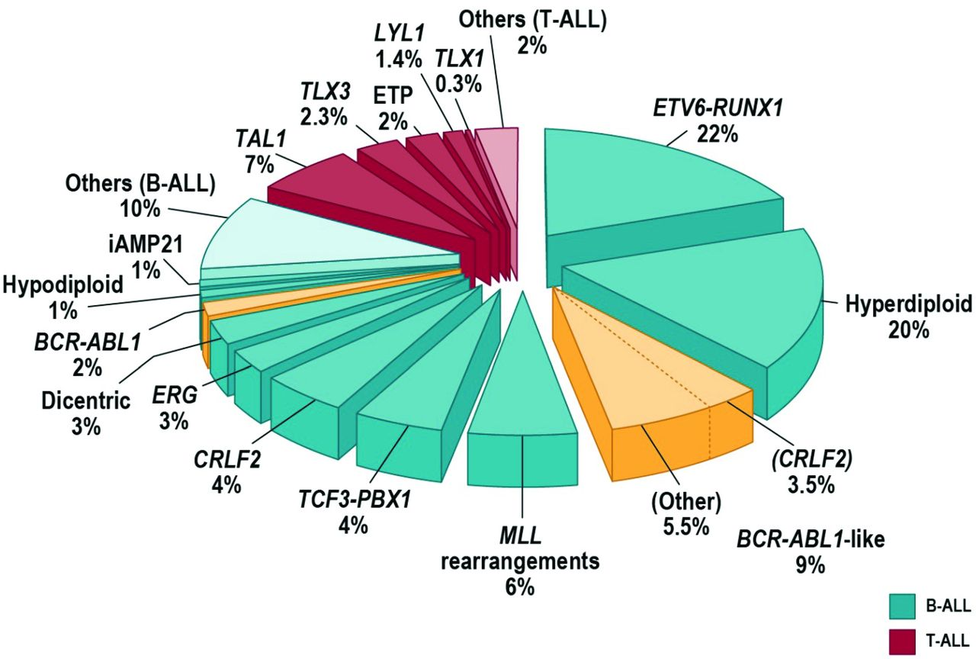
Frequency of cytogenetic subtypes of pediatric ALL.
Charles G. Mullighan Hematology 2012;2012:389-396
©2012 by American Society of Hematology
Notes:
Frequency of cytogenetic subtypes of pediatric ALL.

Slide 8
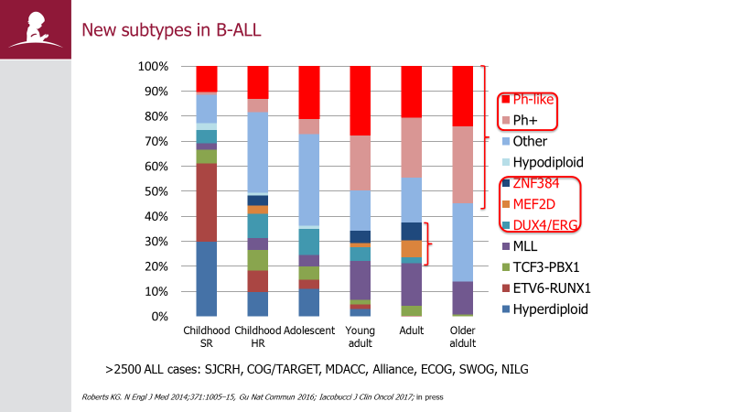

Slide 9
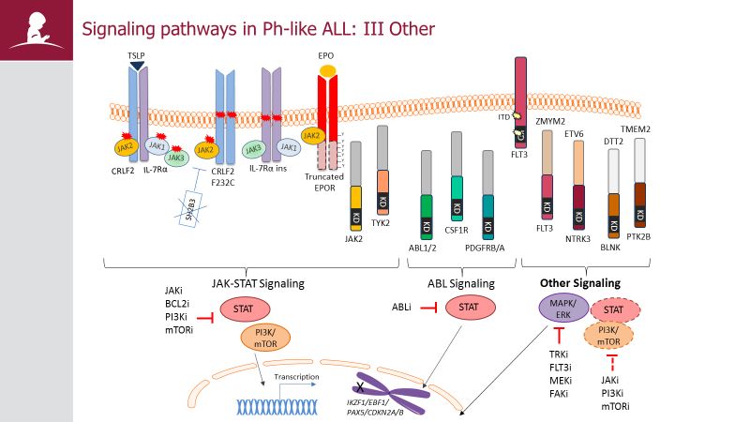

Slide 10
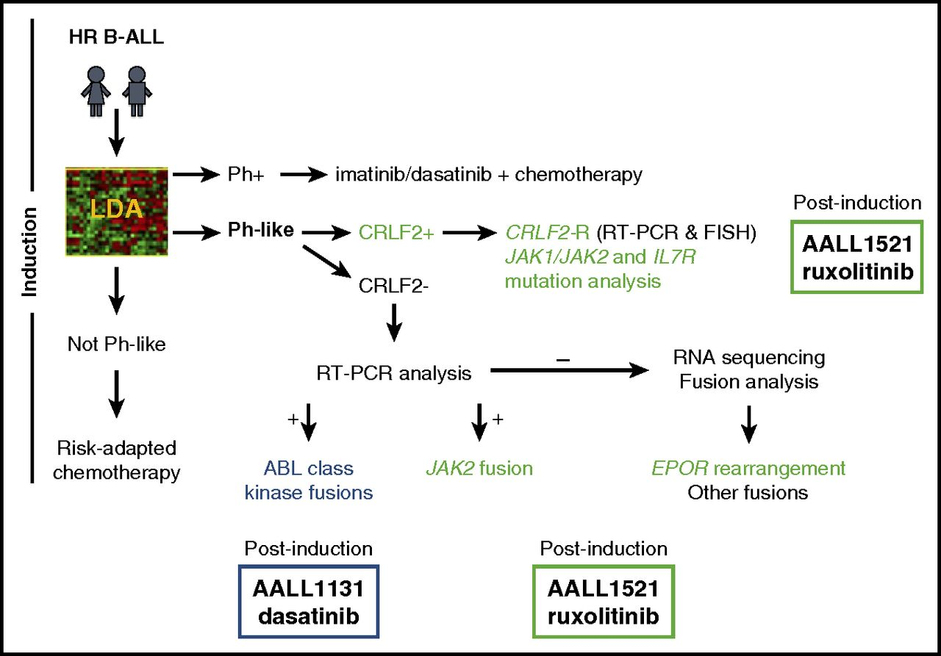
Ph-like ALL Genetic Stratification for COG ALL Trials.
Sarah K. Tasian et al. Blood 2017;130:2064-2072
©2017 by American Society of Hematology
Notes:
Current Ph-like ALL genetic testing algorithm used by the Children's Oncology Group. Diagnostic leukemia cells from children with high risk B-ALL are first screened for the Ph-like ALL gene expression signature using an 8-gene low density microarray (LDA) that includes CRLF2 as one of the 8 assessed genes.⁵¹ Specimens with the Ph-like ALL signature that lack BCR-ABL1 fusion (Ph⁺ ALL) undergo additional genetic testing. Those with high CRLF2 expression are assessed for P2RY8-CRLF2 and IGH-CRLF2 rearrangements by RT-PCR and FISH, respectively, and for JAK1, JAK2 and IL7R mutations by PCR. Ph-like ALL specimens without CRLF2 overexpression undergo multiplex RT-PCR fusion testing to detect ABL-class, JAK2, and EPOR rearrangements. Not all Ph-like fusions will be detected by this algorithm. Complete assessment may require alternative assays for identification, such as RNA-sequencing or unbiased fusion testing capable of identifying new 5′ partners. HR B-ALL, high-risk B-ALL.

Slide 11
Opportunities for Pediatrics
Embryonal solid tumors with low mutation frequency
Genetic and epigenetic evidence base for driver gene mutations differ between adult and pediatric cancers
Multiple demonstrations of actionable gene aberrations in pediatric tumors provide suggest that inhibition of the same molecular targets may result in vulnerability of select childhood cancers
Insufficient/delayed development opportunities for children require a paradigm shift in approaches to early pediatric evaluation of potentially promising new agents
Paradigm shift necessitates amendment to current legislation to accelerate timelines.

Slide 13
Somatic mutations in the pediatric pan-cancer cohort
S N Gröbner et al. Nature 555, 321–327 (2018) doi:10.1038/nature25480

Slide 14
Potentially druggable events in pediatric cancers
S N Gröbner et al. Nature 555, 321–327 (2018) doi:10.1038/nature25480

Slide 15
U.S. Legislation and Pediatric
Drug Development
PREA
Drugs and biologics
Mandatory studies
Requires studies only on indication(s) under review
Orphan indications exempt from studies
Pediatric studies must be labeled
BPCA
Drugs and biologics
Voluntary studies with incentive
Studies relate to entire moiety and may expand indications
Studies may be requested for orphan indications
Pediatric studies must be labeled

Slide 16
Pediatric Tumors are Different …but not always
ALK activated tumors
NSCLC
ALCL
IMT
NBL
EML4-ALK fusion
NPM1-ALK fusion
TPM3/4-ALK fusion
ALK mutation / amplification
RMC
VCL-ALK fusion
Adult tumor types
Children do not get NSCLC, but some pediatric tumors have ALK activation → targetability with ALK inhibitors?
NSCLC: non small cell lung cancer
RMC: renal medullary cancer
NBL: neuroblastoma
IMT: inflammatory myofibroblastic tumor
ALCL: anaplastic large cell lymphoma
Pediatric tumor types
Mano, AACR Cancer Discovery June, 2012,
Notes:
Even though the tumors types and biology are somewhat different between adult and peds, there are sometimes unexpected similarities. For instance, a tumor-driving signaling pathway could be similar between an adult cancer like NSCLC and a pediatric tumor type such as ALCL or neuroblastoma, as is seen with ALK activation. Therefore certain drugs that are efficacious in a specific adult tumor may show efficacy in pediatrics as well.

Slide 17
RACE for Children Act: Changing the Paradigm
Incorporated as Title V Sec. 504 of the FDA Reauthorization Act (FDARA), enacted August 18, 2017
Requires evaluation of new molecularly targeted drugs and biologics “intended for the treatment of adult cancers and directed at a molecular target substantially relevant to the growth or progression of a pediatric cancer.”
Amends PREA: requirement for pediatric assessment based on MoA rather than clinical indication.
Molecularly targeted pediatric cancer investigation: dosing, safety and preliminary efficacy to inform potential pediatric labeling.”
Elimination of orphan exemption for pediatric studies for cancer drugs directed at relevant molecular targets.

Slide 18
Molecular Target Definition
A molecule in human cells (normal or malignant) that is intrinsically associated with a particular disease process such as etiology, progression, and/or drug resistance. To be referred to as a target, there must be evidence that by addressing the target with a small molecule, biologic product, or other intervention, a desired therapeutic effect is produced resulting in the alteration of the disease process

Slide 19
Statutory Requirements for FDA
Establish with NCI, update regularly, and post on FDA website a list of “relevant” targets (1 year)
Establish and post a list of targets (non-relevant) leading to waivers of pediatric studies (1 year)
Work with NCI, Pediatric Subcommittee of ODAC, PeRC, investigators, sponsors, experts, and advocates on implementation and required studies
Convene an open public meeting to generate/finalize lists (1 year)
Issue guidance on implementation (2 years)

Slide 20
Framework* for Defining Relevance
Presence of target in one or more pediatric cancers- not prevalence-dependent
Target function- etiology, drug resistance, lethality
Non-clinical evidence- general and pediatric-specific
Adult clinical experience
Predictive/response biomarkers availability
Accessibility for immunotherapy-directed targets
Therapeutic agent available/in development
Focus on accelerating appropriate initial pediatric evaluations early in development timeline not increasing number of pediatric phase 1 studies
*Multi-stakeholder workshop sponsored by FoCR

Slide 21
Target Lists
Statutory requirement to address regulatory uncertainty for Industry and guide ( not dictate) decision-making re. early evaluation of a specific agent as an amended PREA requirement through the iPSP process
Designation as relevant neither an absolute nor exclusive requirement for decisions related to pediatric evaluation: studies of new products may be required if directed at a target not on the list and waivers may be justified for products directed at targets considered relevant
Not envisioned to restrict authority or flexibility
Relevant molecular targets- independent of agent and/or biomarker availability
Candidate Target List constructed by OCE with NCI and input from international content experts; reviewed in a open public meeting
Published, peer-reviewed literature, abstracts, public databases
No pre-specified minimum evidence base

Slide 22
Molecular Targets
Relevant Molecular Targets
Targets Associated with Specific Gene Abnormalities
Targets Associated with Cell Lineage Determinants
Targets on Normal Immune Cells and/or Cellular Components of the Tumor Microenvironment
Targets Associated with Pathways/ Functional Mechanisms of Cancer Cells
Non-relevant Molecular Targets Leading to Waivers
https://www.fda.gov/AboutFDA/CentersOffices/OfficeofMedicalProductsandTobacco/OCE/ucm544641.htm

Slide 23
Pediatric Cancer Platform Trial
NCI-COGS Pediatric MATCH
Following slides: courtesy of Dr. Nita Seibel, NCI

Slide 24
Update on NCI-COG Pediatric Molecular Analysis for Therapy Choice (MATCH) APEC1621 Study
A phase 2 precision medicine cancer trial Co-developed by the Children’s Oncology Group and the National Cancer Institute

Slide 25
What is Pediatric MATCH?

Slide 26
NCI-COG Pediatric MATCH
To determine whether matching certain drugs in children and adolescents whose tumors have specific gene abnormalities will effectively treat their cancer, regardless of the cancer type
This is a signal-finding trial; treatments that show promise can advance to larger, more definitive trials

Slide 27
Pediatric MATCH Screening Protocol APEC1621SC
Drug A
Screening registration children and adolescents with advanced cancers
Tissue biopsy
Tumor testing using validated single platform, with immunohistochemistry (IHC) for PTEN, SMARCB1, SMARCA4, RB
Drug B
Drug E
Drug C
Drug D
Drug E
Tumor gene abnormality matching to a trial arm?
No treatment
assignment
Yes, treatment assignment
Drug F
Drug G
Drug H
DrugI
Drug J

Slide 28
NCI Pediatric MATCH Subprotocols In Development
Agent Class | aMOI Frequency | Agent | Subarm chair | Subprotocol ID | Status
CDK4/6 | 2-3% | Palbociclib | Rajen Mody | APEC 1621-I | Active
ERK 1/2 inhibitor | 5-10% | Ulixertinib | Kieuhoa Vo | APEC 1621-J | Active
IDH1 inhibitor | 1-2% | Ivosidenib | Elizabeth Alva | APEC 1621-K | Protocol in development
HRAS inhibitor | 1-2% | Tipifarnib | Christine Pratilas | APEC1621M | Concept in development
RET inhibitor | 1-3% | LOXO 292 | Andrea Flynn | APEC1621N | Protocol in development

Slide 29
NCI Pediatric MATCH Subprotocols
Agent Class | aMOI Frequency | Agent | Subarm chair | Subprotocol ID
Pan-TRK inhibitor | 2-3% | Larotrectinib | Katie Janeway | APEC 1621-A
FGFR inhibitor | 2-3% | Erdafitinib | Alice Lee | APEC 1621-B
EZH2 inhibitor | 2-3% | Tazemetostat | Susan Chi | APEC 1621-C
PI3K/mTOR | 5-10% | LY 3023414 | Ted Laetsch | APEC 1621-D
MEK inhibitor | 10-20% | Selumetinib | Carl Allen | APEC 1621-E
ALK inhibitor | 2-3% | Ensartinib | Meredith Irwin | APEC 1621-F
BRAF inhibitor | 5% | Vemurafenib | Aerang Kim | APEC 1621-G
PARP inhibitor | 2-3% | Olaparib | Julia Glade Bender | APEC1621-H
Notes:
Highlighted arms are agents never tested in children, but based on discussions with FDA, NCI and COG it was decided that agents with an established adult recommended phase 2 dose, could be considered after careful review of toxicities and PK of the agent.

Slide 30
The Future
Full implementation of FDARA Sec. 504- August, 2020
Expansion of pediatric pre-clinical testing in progress
Prioritization of which new targeted agents for pediatric assessment by Industry and academic investigator community
Global coordination and collaboration

