Slide 1
FDA Perspective on International Clinical Trials
Kassa Ayalew, M.D., M.P.H.
Branch Chief
Division of Good Clinical Practice Compliance
Office of Scientific Investigations
Office of Compliance
Center for Drug Evaluation and Research
Food and Drug Administration

Slide 2
Disclaimer
The Views expressed in this presentation are those of the speaker and not necessarily those of the Food and Drug Administration

Slide 3
Outline
Foreign Clinical Trials and Global Distribution of Data in FDA Submissions
U.S. Law Governing Foreign Clinical Studies
Considerations for International Inspections
Challenges
Addressing the Challenges

Slide 4
Foreign Clinical Trials (FCTs)
FCTs refer to studies conducted outside the USA to support marketing applications submitted to the FDA
The number of international sites contributing data to support U.S. marketing applications for drug approval is increasing

Slide 5
Global Distribution of Data in Applications
245 submissions with data (clinsite.xpt ) in the Clinical Investigator Site Selection Tool (CISST) presented through FY2015 to FDA for site selection decisions were reviewed.
552 Studies
55,685 Clinical Investigator Sites
864,939 Enrolled Trial Participants
Source: Clinical Investigator Site Selection Tool (CISST) Database

Slide 6
Number of Sites by Location
Source: CISST Database for 245 submissions
Over half of all clinical trial sites presented in support of U.S. marketing applications were outside the U.S.

Slide 7
Number and Percentage of Sites by Region
(Source: CISST Database)

Slide 8
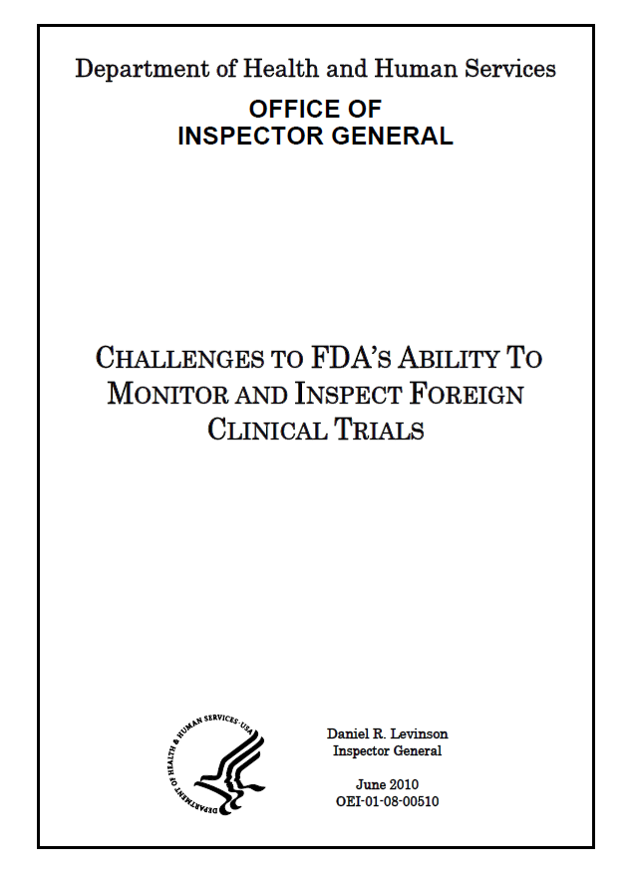
OIG Report
Over half of all clinical trial sites are outside the U.S.
80 % of applications for drugs & biologics contain data from ex-U.S. studies
78 % of all subjects were enrolled outside the U.S.
87 % of all subjects in recent biologics trials were enrolled outside the U.S.
Percentage of non-U.S. clinical investigators conducting trials under INDs has doubled over the last decade

Slide 9
FDA Regulated Investigators By Year
Percent of Total
1572s Filed
% of U.S. based investigators declined
The number of active FDA–regulated investigators based outside the United States has grown
Notes:
9
9
During the 14 year period, the % of total for U.S. based investigators declined
The number of active FDA–regulated investigators based outside the United States has grown

Slide 10
Number and Percentage of Enrollment
(Source: CISST Database)
Over half of all enrolled subjects from pivotal clinical trials presented to FDA in support of marketing applications were from outside the U.S.

Slide 11
Number and Percentage of Enrollment by Region
Foreign clinical sites contribute most of the data.
(Source: CISST Database)

Slide 12
21CFR312.120 and 21CFR314.106
U.S. Law Governing Foreign Clinical Studies

Slide 13
Acceptance of Foreign Data
When a study is conducted under an IND but is located outside of the United States, the study still must comply with all relevant FDA regulations as if it were being conducted within the United States
FDA Accepts Foreign Clinical data from studies not conducted under an IND if the following conditions are met:
Study was conducted in accordance with Good Clinical Practice (GCP)
FDA is able to validate the data from the study through an onsite inspection
Notes:
Conditions Required

Slide 14
Good Clinical Practice
Sponsor shall submit to FDA a description of actions taken to ensure research conformed to GCP:
Defined as the standard for the design, conduct, performance, monitoring, auditing, recording, analysis, and reporting of clinical trials in a way that provides assurance that the data & reported results are credible and accurate and that the rights, safety, and well-being of trial subjects are protected

Slide 15
What must be submitted to FDA
CI's qualifications
Description of the research facilities
Summary of the protocol & results of the study &, should FDA request, case records
Description & details of the product/drug used
Information showing that the study is adequate & well controlled
Name & address of the IEC, a summary of the IEC's decision
A description:
how IC was obtained
what incentives, if any, were provided to subjects in the study
how the sponsor(s) monitored the study
how CIs were trained to comply with GCP

Slide 16
Acceptance of Foreign Data to Market New Drug
Governed by 21 CFR 314.106
Data are applicable to US population and medical practice
Studies are performed by investigators of recognized competence
Data are considered valid without an on-site FDA inspection
FDA is able to validate the data through an on-site inspection
Sec. 314.106 Foreign data.

Slide 17
Waivers from GCP principles
May be requested
Explanation of why compliance unnecessary or cannot be achieved
Description of alternative submission or course of action that satisfies the purpose of the requirement
Other information justifying waiver
FDA may grant waiver if it finds that doing so would be in interest of public health

Slide 18
Record Retention
If study submitted in support of marketing application, for 2 years after an agency decision on that application;
If the study is submitted in support of an IND but not a marketing application, for 2 years after submission to the IND

Slide 19
Considerations for International Inspections

Slide 20
Validation of Data Through Onsite Inspections
Help to ensure the protection of rights, safety and welfare of research participants
Help to ensure data that are submitted in marketing applications are suitable for purpose
For regulatory decision making (Approval)
As evidence base for clinical use of drug (Label)
Allow evaluation of compliance with FDA regulations

Slide 21
Factors to Consider: When to Inspect
Importance of the study
Relevance to labeling/NDA/BLA
Contribution/size/outliers/concern of scientific misconduct, protocol violations, study discontinuations
Statistical impact of data from the site
History of the clinical investigator
Frequency and prior classification(s)
Findings of previous inspection(s)
Data Contribution
Domestic versus international

Slide 22
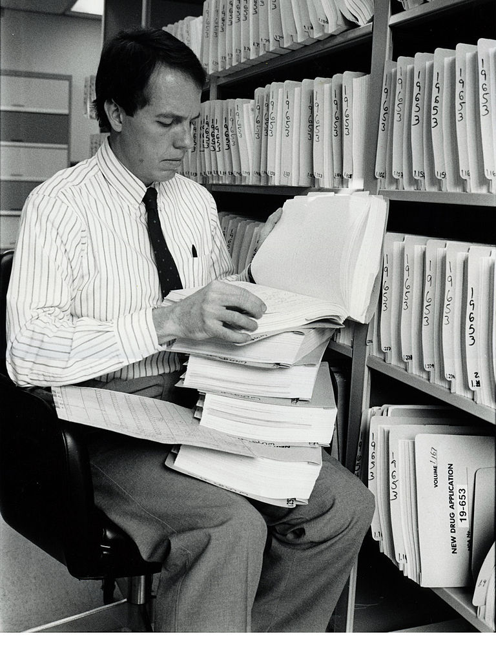
Milestones for Inspections
NDA/BLA Submission
Inspections
Identifications of CI sites at the time of NDA/BLA submission
.
Inspections will be conducted, Report prepared.
Pre NDA/BLA
Background
Assessment
Request for data at Pre-NDA/BLA meetings .
Preparation of pertinent information: protocols, CRFs, data listings, etc.
Assessment of data reliability ,protection of subjects, generation of post-inspectional correspondence
Pre NDA/BLA
01
NDA/BLA Submission
02
Background
03
Inspections
04
Assessment
05
Recommendation

Slide 23
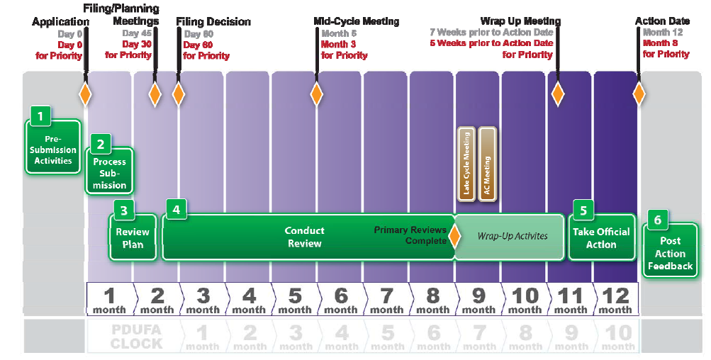
21st Century Review
Day 7-14 Loaded Tool released to reviewers
New 21st Century Site Selection Meeting

Slide 24
Assigning International Inspections
Clinical sites likely to be audited when:
only foreign data are submitted to support an application
insufficient domestic data
domestic and foreign data show conflicting results pertinent to decision-making
there is a serious issue to resolve (e.g., suspicion of fraud, scientific misconduct, significant human subject protection violations)

Slide 25
Potential Consequences of Noncompliance
Warning Letter
Disqualification
Application Integrity Policy
Referrals to FDA’s Office of Criminal Investigations
Rejection of data
IND clinical holds
Termination of IND

Slide 26
Challenges

Slide 27
Breadth of international inspections
FDA inspects 0.7% of all foreign clinical sites, compared to 1.9% of all domestic clinical sites (OIG Report 2008).
Finite inspection resources: breadth of international inspections resulting in inspection of a limited number of sites
Source: CISST Database for 245 submissions

Slide 28
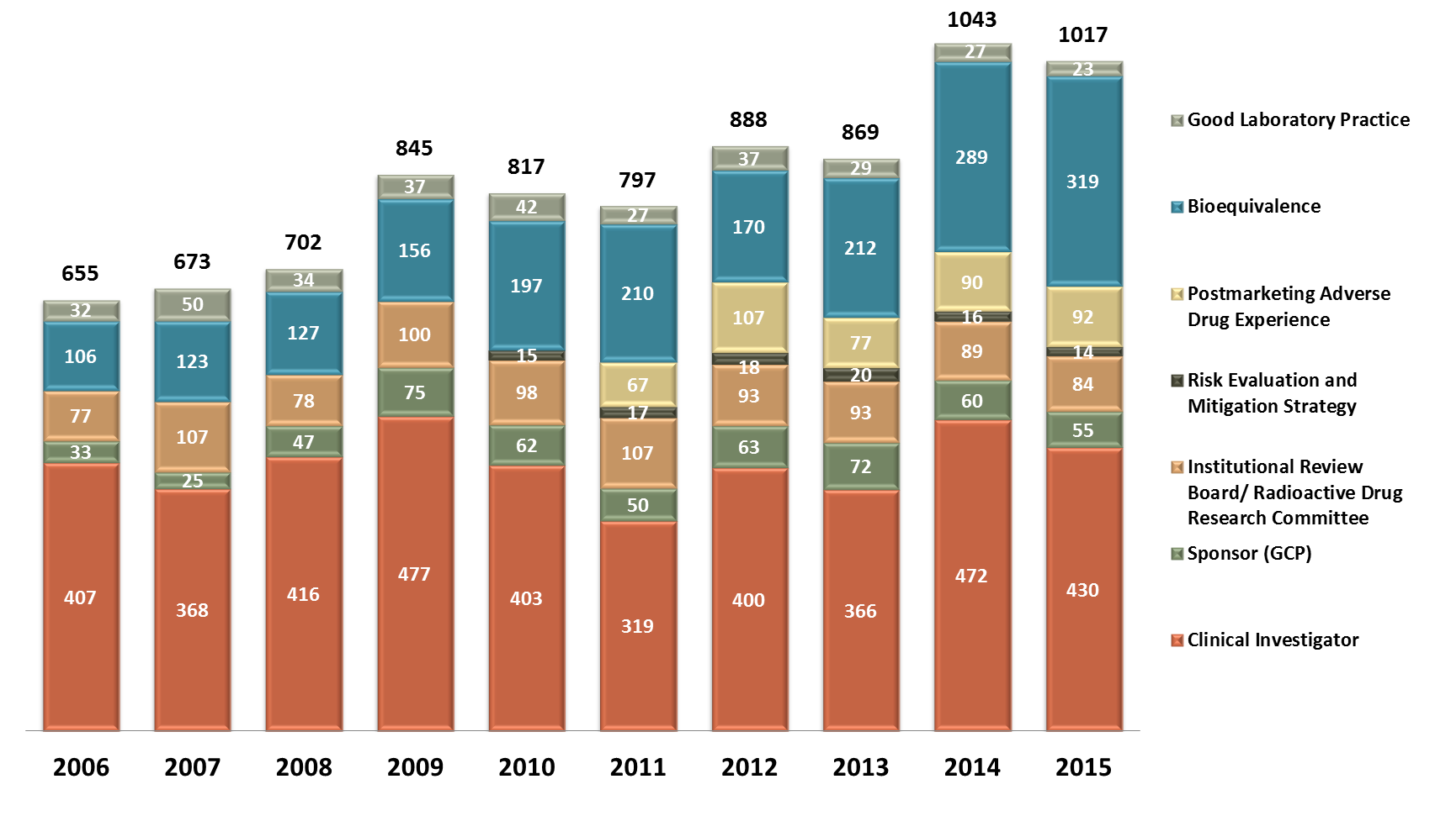
Inspections Overseen by OSI/OSIS* (CDER, FY 2006 - FY 2015)
*Based on inspection start date – [Complis database as of January 20, 2016]
IRB includes only CDER numbers – previously reported metrics may have used combined data across CDER, CBER and CDRH, Sponsor (GCP) includes Sponsor/CRO/Sponsor-Investigator
Postmarketing Adverse Drug Event and Risk Evaluation and Mitigation Strategy inspection programs incorporated into OSI June 2011

Slide 29
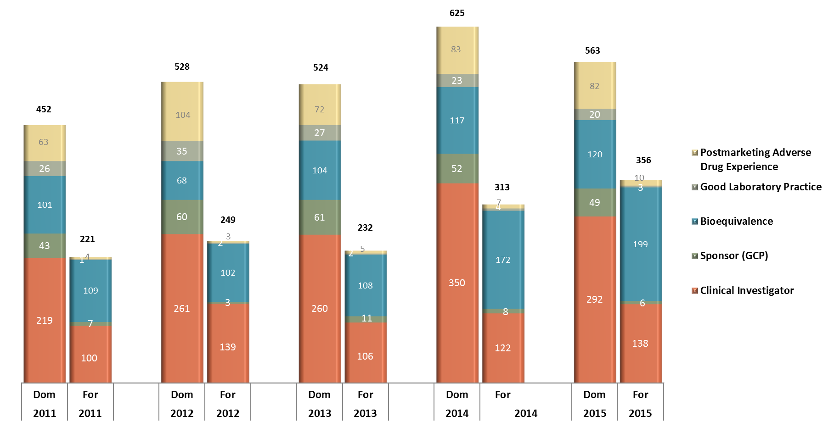
Domestic vs. Foreign Inspections Overseen by OSI/OSIS* (CDER, FY 2011 - FY 2015)
*Based on inspection start date – [Comlis database as of January 20, 2016]
Sponsor (GCP) includes Sponsor/CRO/Sponsor-Investigator
As of June 2011,Postmarketing Adverse Drug Event inspection programs were incorporated into OSI
Notes:
Updated numbers

Slide 30
Clinical Investigator Inspections by Location* (CDER, FY 2013)
*Based on inspection start date – [OSI database as of January 31, 2014]

Slide 31
Global Coverage of GCP Inspections
Conducted for FDA/CDER from 1984 through Sept 3, 2013; Based on Inspections with a start date in CDER/OC/OSI database

Slide 32
Addressing the Challenges

Slide 33
Leveraging Knowledge/ Resources
Use risk based innovative strategies & tools to identify sites for inspections
Utilize finite resources strategically and efficiently and leverage inspection
EMA-FDA Collaboration GCP Inspection Initiative:
Use a joint GCP program
Plan, coordinate, schedule, and conduct collaborative GCP inspections
Share information related to drug applications
MHRA, PMDA’s: collaboration to exchange information and collaborative inspections
FDA International Offices:
Provide a platform for inspection of foreign facilities
Offices collect & leverage local & regional knowledge
Strengthening regulatory capacity of governments to manage, assess, and regulate drug development

Slide 34
Science-Based Standards
Encouraging sponsors to utilize data standards to improve analysis and site selection for inspection
Working to converge regulatory standards to share a common foundation of science-based regulation.
Continue to work to converge regulatory standards, processes, and procedures for the pharmaceutical industry( ex. ICH, ICH Global Cooperation Group Members)

Slide 35
Final Thought
“Wherever you stand, the majority of clinical trials are being conducted elsewhere, and yet we all as regulators use these data to allow or disallow marketing of a product, and physicians and patients use these data to decide to use or not use a medicine.”
Fergus Sweeney, EMA

Slide 36
Useful Guidance
FDA Acceptance of Foreign Clinical Studies Not Conducted Under an IND Frequently Asked Questions
Issued March 2012
Provides clarifications for sponsors and applicants on how to demonstrate compliance with the requirements of 21 CFR 312.120
http://www.fda.gov/downloads/RegulatoryInformation/Guidances/UCM294729.pdf

Slide 37
Thank you!
kassa.ayalew@fda.hhs.gov

