Slide 1
Clinical Investigator Training Course Issues in Clinical Trial Design for Rare Diseases
Jonathan C. Goldsmith, MD, FACP
Associate Director Rare Diseases Program/Office of New Drugs
Center for Drug Evaluation and Research
FDA
November 7, 2016

Slide 2
Disclosures
No Conflicts of Interest
Nothing to Report
Opinions expressed are personal and do not reflect those of the FDA

Slide 3
Presentation Topics
Rare Diseases Program/OND/CDER
The Orphan Drug Act
Rare Diseases Drug Development
Regulatory Flexibility
Expedited Programs and Accelerated Approval
Illustrative Examples
Draft Guidance – Rare Diseases: Common Issues in Drug Development

Slide 4
CDER Rare Diseases Program
Mission Statement:
Facilitate
Support
Accelerate
…the development of drug and biologic products for the treatment of patients with rare disorders

Slide 5
CDER Rare Diseases Program
Objectives:
Coordinate development of CDER Policies, Procedures and Training
Assist in development of good science
Work collaboratively with stakeholders
Promote consistency and innovation in review
Work collaboratively with international regulatory partners to align regulatory requirements and advice to rare disease sponsors

Slide 6
The Public Health Impact of Rare Diseases Is Substantial
1 in 10 Americans have a rare disease
(~30 million)
over 7,000 identified rare diseases
impact often overlooked due to small numbers of patients per disease
Most rare diseases are serious and progressive, many are fatal
85% are genetic and 50% affect children - severe impact on patients and their families

Slide 7
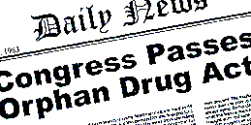
The 1983 Orphan Drug Act (ODA)
Enacted to stimulate product development for rare disease/condition diagnosis, prevention or treatment
Pre ODA less than 1 drug a year approved for rare diseases in the US

Slide 8
What does Orphan Designation provide?
Financial incentives
tax credits up to 50% of qualified clinical trial costs
waiver of FDA User Fees
note: the fee is applied if application includes an indication other than the rare disease for which the drug was designated
seven years of marketing exclusivity
PREA exemption
products with orphan drug designation are exempted from Pediatric Research Equity Act (21 U.S.C. 355c) requirements

Slide 9
The ODA does not alter the statutory standard for drug approval Patients affected by rare diseases deserve the same level of quality, safety and efficacy

Slide 10
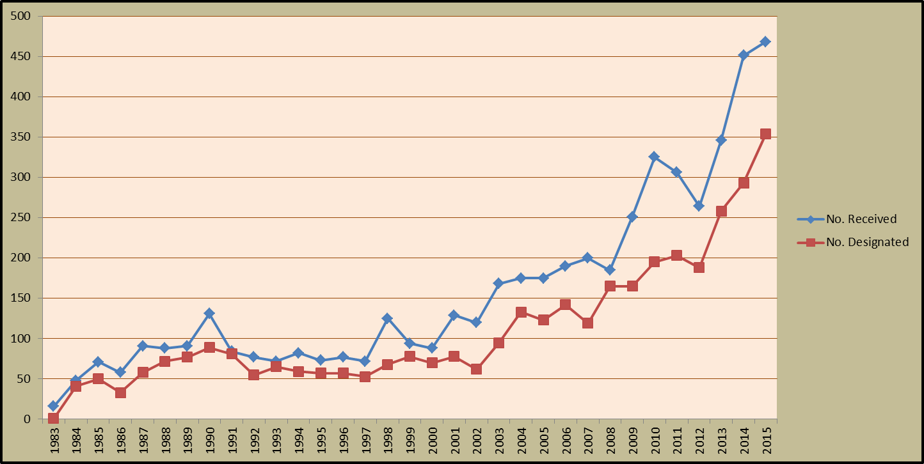
Orphan Drug Designations
468
354

Slide 11
CDER Novel Orphan New Drug Approvals First Approvals in the US – CY 2014 -2016*
* as of September 19, 2016

Slide 12
For Rare or Prevalent Disease Approval There Must Be:
Substantial evidence of effectiveness for treatment of the proposed indication
Demonstration that the benefits of the drug must outweigh its risks for the patient population for which the drug is indicated (21CFR 314.50)
Adequate manufacturing methods to ensure product identity, strength, quality (and purity)
Evidence-based drug labeling that adequately guides providers and patients on how to use the drug safely and effectively

Slide 13
Challenges in Rare Disease Drug Development and Regulation (I)
Populations are small
May restrict study design and replication
Phenotypic (disease presentation) diversity adds to complexity, as do genetic subsets
Natural history often incompletely understood
Robust endpoints, outcome measures and biomarkers usually lacking

Slide 14
Challenges in Rare Disease Drug Development and Regulation (II)
Diseases tend to be progressive, serious, life-limiting and life-threatening and lack approved therapy
Large pediatric representation/ethical considerations
Lack of precedents for drug development
Logistical trial issues due to rarity and disease burden

Slide 15
US Regulatory Requirements for Drug Approval
Demonstration of substantial evidence of effectiveness
Substantial evidence of effectiveness requires studies designed well enough “to distinguish the effect of a drug from other influences, such as spontaneous change…, placebo effect, or biased observation”
“The benefits exceed the risks under the conditions stated in the labeling.”
Usual approval standard is two adequate and well-controlled studies
21CFR 314.50 and 21CFR 314.126

Slide 16
CHALLENGE
How can drug development programs for low prevalence diseases be expected to meet the same standards as for common diseases?

Slide 17
NDA Regulations 21 CFR 314.105
While the statutory standards apply to all drugs…the wide range of uses demand flexibility in applying the standards
Thus FDA is required to exercise its scientific judgment to determine the kind and quantity of data and information an applicant is required to provide for a particular drug to meet the statutory standards

Slide 18
FDA Modernization Act 1997 (FDAMA)
Section 505(d) of the Act was amended to make it clear that the Agency may consider “data from one adequate and well‐controlled clinical investigation and confirmatory evidence” to constitute substantial evidence if FDA determines that such data and evidence are sufficient to establish effectiveness

Slide 19
Application of Flexible Clinical Development Programs CDER NME approvals 1/1/2008 – 9/25/2015
Flexible Development Programs | Rare Approvals | Non-Rare Approvals
Use of > 1 flexible development approaches* | 81% (n=73) | 36% (n=64)
Traditional development program** | 19% (n=17) | 64% (n=113)
*Flexible Development approaches are defined as approval supported by other than 2 AWC Studies and/or use of a novel end point
**Traditional Development defined as >2 AWC studies using endpoints with prior precedents

Slide 20
Expediting Rare Diseases Drug Development
Programs have been developed to target serious diseases with unmet medical needs when a new treatment could provide meaningful clinical benefit
Guidance for Industry Expedited Programs for Serious Conditions – Drugs and Biologics, May 2014
Notes:
Describes many of the rare diseases!

Slide 21
Expediting Rare Diseases Drug Development
Fast Track
FDAMA 1997/FDASIA 2012
Breakthrough Designation
FD&C Act/FDASIA 2012
Priority Review
PDUFA 1992
Accelerated Approval
21CFR314 subpart H, 601 subpart E/FDASIA 2012
Guidance for Industry Expedited Programs for Serious Conditions – Drugs and Biologics, May 2014
Notes:
These programs are targeted to serious diseases with unmet medical needs when a new treatment could provide meaningful clinical benefit.
FAST TRACK Early in development, evidence of activity in a nonclinical model, a mechanistic rationale, or pharmacologic data could be used to demonstrate such potential. Later in development, available clinical data should demonstrate the potential to address an unmet medical need. Designation offers actions to expedite development including more frequent meetings with the agency and eligibility for pre-submission of portions of marketing applications known as rolling review.
BREAKTHROUGH preliminary clinical evidence indicates that the drug may demonstrate substantial improvement over existing therapies on one or more clinically significant endpoints, such as substantial treatment effects observed early in clinical development. Designation provides intensive guidance to sponsors on efficient drug development, organizational commitment by senior managers, other actions to expedite review and eligibility for rolling review.
PRIORITY REVIEW Designation offers a shorter review clock for marketing applications, 6 months compared with the 10 months standard review time
The ACCELERATED APPROVAL Pathway is based on a favorable effect on a surrogate endpoint or intermediate clinical endpoint reasonably likely to predict a drug’s clinical benefit. FDA expects the sponsor to verify the trial’s findings through performance of a confirmatory trial.

Slide 22
Fast Track
Fast track is a process to expedite development and review, such as frequent interactions with the review team, ‘rolling review ‘ of a marketing application
Non-clinical or clinical data may be submitted to qualify
Ideally apply early in IND phase to get maximum benefit of FDA interactions

Slide 23
Breakthrough Therapy Designation
Breakthrough is a process to:
“…expedite the development and review of such drug …to treat a serious or life-threatening disease or condition and preliminary clinical evidence indicates that the drug may demonstrate substantial improvement over existing therapies on one or more clinically significant endpoints…”
FDAISA Section 902, available at: http://www.gpo.gov/fdsys/pkg/BILLS-112s3187enr/pdf/BILLS-112s3187enr.pdf

Slide 24
Priority Review
Priority review is a process for review with a User Fee Goal Date of 6 months vs. 10 months
FDA determines whether the application qualifies
Applicant may request priority review with an original BLA, NDA, or efficacy supplement; the decision is communicated at filing

Slide 25
Approval Pathways
Traditional
Accelerated

Slide 26
Approval Pathways
Both pathways must meet the statutory standards: substantial evidence of effectiveness based on adequate and well-controlled clinical study(ies) and demonstration that the benefits exceed the risks under the labeled conditions
Accelerated approval expedites new drug availability for serious unmet need by relying on a more readily measured surrogate or intermediate clinical endpoint
Consider accelerated approval when a lengthy trial would be needed to measure intended clinical benefit of a drug for a serious unmet need

Slide 27
Approval Pathway: The Importance of the Endpoint
Accelerated Approval Pathway depends on strength of evidence about ability of the endpoint to predict effect on irreversible morbidity or mortality (clinical benefit)
A surrogate or intermediate clinical endpoint is a marker thought to predict clinical benefit, not itself a measure of benefit: lab value, radiographic image, physical sign, etc.
Notes:
I think I found the answer (ORR) – guidance on EP in NSCLC:
Treatment effects on ORR have not been demonstrated to reliably predict corresponding effects
on survival in NSCLC. We consider demonstration of ORR alone to be a surrogate endpoint
reasonably likely to predict clinical benefit only when the treatment effect size is large and the
responses are durable. In these circumstances, ORR has been used as the basis only for
accelerated approval for NSCLC. In other circumstances, such as when clinical trials have
shown that ORR correlated with well-documented improvements in patient tumor-related
symptoms (e.g., photodynamic therapy for treatment of obstructing endobronchial therapy), ORR
has supported regular approval.
The description in bullet 2 applies best to a surrogate endpoint, not a intermediate clinical endpoint, since that intermediate clinical endpoint by definition is a clinical endpoint that can be a measure of how a patient feels or functions.

Slide 28
Expedited Clinical Development Programs CDER NME approvals 2008-2016*
Expedited Programs | Number Rare (n = 109) | Number Non-Rare (n = 193)
Fast Track | 54% | 22%
Breakthrough Therapy | 18% | 4%
Priority Review | 75% | 30%
Accelerated Approval | 26% | 2%
Used any Expedited Program | 86% | 35%
*as of September 7, 2016

Slide 29
Developing Drugs for Rare Diseases: Examples
glucarpidase
http://www.accessdata.fda.gov/drugsatfda_docs/nda/2012/125327Orig1s000TOC.cfm
rilonacept
http://www.accessdata.fda.gov/drugsatfda_docs/nda/2008/125249s000TOC.cfm
The presented information is derived from FDA reviews posted on Drugs@FDA; consult these links for complete information about the basis for approval

Slide 30
Example 1: Glucarpidase
A carboxypeptidase enzyme indicated for the treatment of toxic plasma methotrexate concentrations (>1 micromole per liter) in patients with delayed methotrexate clearance due to impaired renal function

Slide 31
Glucarpidase: Design Features
Single-arm, open-label, historically-controlled trial in patients
Validated pharmacodynamic endpoint in 22 patients: proportion who had rapid and sustained clinically important MTX reduction (to <1 μmol/L)

Slide 32
Scientific Rationale for Flexible Glucarpidase Design
Methotrexate in extensive clinical use since 1948; effects, mechanism of action, toxicity, excretion and metabolism well understood
Well established that 1 μmol/L plasma concentration at 48 hours → severe toxicity not treatable with leucovorin or hemodialysis rescue

Slide 33
Glucarpidase Evidence From medical officer review BLA 123327 Drugs@FDA
All patients showed large pharmacodynamic effect: ≥ 97% reduction within 15 minutes
All patients had > 95% reduction in MTX concentration maintained for up to 8 days
Efficacy endpoint success dependent on pre-treatment MTX concentration

Slide 34
Example 2: Rilonacept
An interleukin-1 blocker indicated for the treatment of Cryopyrin-Associated Periodic Syndromes (CAPS), including Familial Cold Autoinflammatory Syndrome (FCAS) and Muckle-Wells Syndrome (MWS) in adults and children 12 and older

Slide 35
Rilonacept: Design Features
47 patients in one trial with two parts
Part A: 6 week randomized, double-blind, placebo-controlled trial
Part B: All participants (blinded) received rilonacept for 9 weeks followed by a 9 week double blind, withdrawal period with randomization to rilonacept or to placebo
Primary efficacy endpoint: change in disease symptom composite score 0-10 (daily record of fever/chills, rash, eye redness/pain, fatigue, joint pain)

Slide 36
Rilonacept Evidence From medical officer review BLA 125249 Drugs@FDA
Trial Part A: Change in disease activity with rilonacept -2.6 compared to -0.3 for placebo (p<0.0001)
Part B: No change in patients remaining on rilonacept compared to increase from 0.2 to 1.2 for placebo (p=0.0002)
Effect seen within a few days after a single injection
Consistent results for multiple pre-specified secondary endpoints and serum acute phase reactant levels

Slide 37
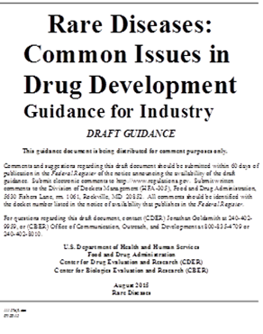
Rare Diseases: Common Issues in Drug Development August 2015 (Draft Guidance)
To assist sponsors of drug and biological products intended to treat or
prevent rare diseases
To help sponsors conduct more efficient and successful
development programs

Slide 38
Thank you very much for your attention Send us a Question at: CDERONDRareDiseaseProgram@fda.hhs.gov
Jonathan.Goldsmith@fda.hhs.gov
Rare Diseases Program/OND/CDER/FDA

