Slide 1
Issues in Clinical Trial Design for Companion Diagnostic Devices
Clinical Trials Investigator Training Course
November 7, 2016
Hisani Madison, Ph.D., M.P.H.
Division of Molecular Genetics and Pathology
Food and Drug Administration (FDA)
Center for Devices and Radiological Health (CDRH)
Office of In Vitro Diagnostics and Radiological Health (OIR)

Slide 2
Presentation Overview
Overview of Regulation of In Vitro Diagnostic Devices (IVDs)
Key Regulatory Questions:
Drug/Device Codevelopment
    Challenges & Solutions
Useful Tips & Tools
Notes:
Ask how many attendees have used IVDs in clinical trials?
Note that bullet one includes some basics of pre-market review

Slide 3
The contents of this presentation are for discussion and summary purposes only and do not describe the full extent of requirements applicable to devices, including IVDs and Companion Diagnostic Devices. Please see the Federal Food, Drug, and Cosmetic Act and 21 CFR Subchapter H for requirements applicable to medical devices.

Slide 4
Definition: In Vitro Diagnostic Device
“Reagents, instruments, and systems intended for use in the diagnosis of disease or other conditions, including a determination of the state of health, in order to cure, mitigate, treat, or prevent disease or its sequelae. … for use in the collection, preparation, and examination of specimens from the human body.”
[21 CFR 809.3]
www.fda.gov
Notes:
It has a reg – CFR is code of federal regulation

Slide 5
Human Subject Regulations
Definition of a “Human Subject”
  A human who participates in an investigation, either as a recipient of the test article or as a control. Includes both persons in normal health and patients.
  Subject is an individual on whom or on whose specimen an investigational device is used.

Slide 6
FDA Human Subject
Protection Regulations
21 CFR Part 50: Protection of Human Subjects and Informed Consent
21 CFR Part 54: Financial Disclosure of Investigators
21 CFR Part 56: Institutional Review Boards
21CFR 812: Investigational Device Exemption
  Includes disqualification of investigators
  Applies to all FDA clinical investigations
Notes:
Other important regs that apply to clinical investigators and the use of IVDs in clinical trials
Note that there is a guidance for sponsors on “informed consent for IVD using left over human specimens that are not individually identifiable”

Slide 7
Premarket Risk Based Regulation
Class I: common, low risk devices
  e.g., mass spectrometer for clinical use
    Most exempt from premarket submission
    General controls
Class II: more complex, moderate risk
  e.g., prognosis, monitoring in already diagnosed cancer patients
    Premarket Notification [510(k)]
    General & Special controls
Class III: most complex, high risk
  e.g., cancer diagnosis or screening
    Premarket Application [PMA]
    Safety, effectiveness
Notes:
Special controls could be: implementation of performance standards, post-market surveillance, patient registries, etc.
Developed with good manufacturing practices (GMP) which guides inspections in the field
What do we know about particular analytes? Request more information when sponsor comes in with new tests. They get inspected for manufacturing
Highest risk devices, require more information and a PMA for approval

Slide 8
Basis of Premarket Device Review:
Safety and Effectiveness
Safety
  Are there reasonable assurances, based on valid scientific evidence that probable benefits to health from use of the device outweigh any probable risks? [860.7(d)(1)]
Effectiveness
  Is there reasonable assurance based on valid scientific evidence that the use of the device in the target population will provide clinically significant results? [860.7(e)(1)]
Notes:
Devices reviewed based on safety and effectiveness

Slide 9

FDA Review:
Basic Components of IVD Submission
Intended use/indications for use
Device description (platform, software)
Pre-analytical performance
Analytical performance
Clinical performance
Instrumentation, software validation (as applicable)
Labeling (package insert)
Manufacturing, BIMO
Notes:
Premarket review
We examine multiple pieces of the application to get a total idea of the device safety and effectiveness
I will give a brief overview now but will go into more detail later in the presentation

Slide 10

Drug/Device Codevelopment:
Key Regulatory Questions
Will an IDE be required?
If the drug development program is based on a biomarker, will the test for the biomarker result in a companion diagnostic device?
Does the companion diagnostic device have adequate performance data to be approved contemporaneously with the drug?
Will a bridging study be required?
Notes:
Note that we already discussed one question about CTA vs. MRA

Slide 11
Drug/Device Codevelopment:
Key Regulatory Questions
Will an IDE be required?
If the drug development program is based on a biomarker, will the test for the biomarker result in a companion diagnostic device?
Does the companion diagnostic device have adequate performance data to be approved contemporaneously with the drug?
Will a bridging study be required?
Notes:
Note that we already discussed one question about CTA vs. MRA

Slide 12
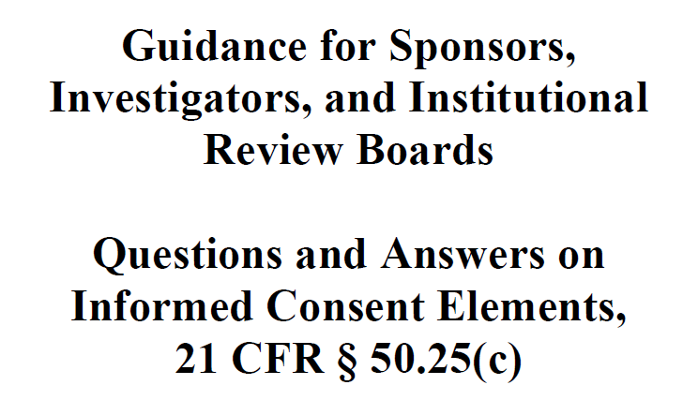
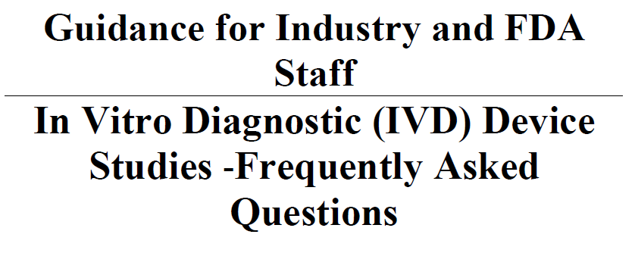
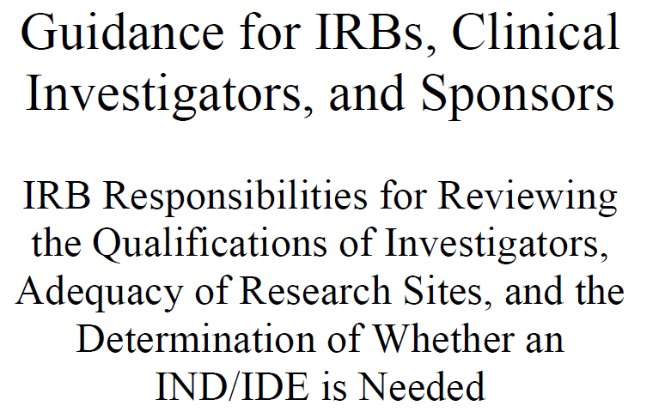
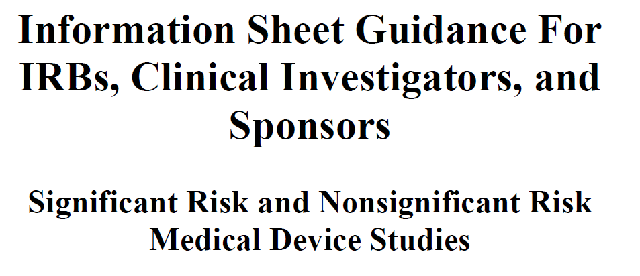
Investigational Device Exemption
http://www.fda.gov/MedicalDevices/DeviceRegulationandGuidance/HowtoMarketYourDevice/InvestigationalDeviceExemptionIDE/ucm162453.htm
Notes:
FDA has a host of guidance documents specifically geared toward the investigational use of IVDs, check out the website link, I will go into some details now

Slide 13
Investigational Use of tests:
IDEs and INDs
Sponsors of therapeutic product trials that incorporate an investigational test must consider regulations that pertain to both drugs and devices.
Exemptions from premarket approval requirements for new drugs and devices.
Investigational Device Exemption (IDE) regulation (21 CFR 812)
Investigational New Drug (IND) regulation (21 CFR 312)
IDE and IND regulations have different requirements!

Slide 14
Key Regulatory Questions:
Is an IDE needed?
If a diagnostic is used to identify a biomarker in a drug trial, then an Investigational Device Exemption (IDE) may be needed (if the diagnostic is not already FDA cleared or approved for the intended use).
FDA approval of IDE application exempts device from premarket clearance/approval requirement when used in the investigational setting.
IDE requirement is based on risk to patients – does the use of the test result pose a significant risk or a non-significant risk?
Submit risk assessment pre-submission to CDRH to determine if an IDE is needed for your diagnostic.
Notes:
Note that that I will go into more detail about IDE’s after this section.

Slide 15
Assessing Risk
Will use of the investigational test results lead to some trial subjects foregoing or delaying a treatment that is known to be effective?
Will use of the investigational test results expose trial subjects to safety risks (e.g., adverse events from the experimental therapy) that (in some “net” sense) exceed the risks encountered with control therapies or non-trial standard of care?
Is it likely, based on a priori information about the investigational therapy, that incorrect test results would degrade the safety or efficacy of subjects’ treatment?
Does specimen acquisition, done for investigational testing and outside the standard of care, require an invasive sampling procedure that presents significant risk?

Slide 16

What’s in an IDE Application?
Detailed in 21 CFR 812.20
Administrative elements
Report of prior investigations
Investigational plan
Purpose
Protocol
Risk analysis
Description of device
Monitoring procedures
Labeling
Consent materials
IRB information
Other institutions
Additional records and reports

Slide 17
Drug/Device Codevelopment:
Key Regulatory Questions
Will an IDE be required?
If the drug development program is based on a biomarker, will the test for the biomarker result in a companion diagnostic device?
Does the companion diagnostic device have adequate performance data to be approved contemporaneously with the drug?
Will a bridging study be required?

Slide 18
Key Regulatory Questions:
Is my test a CDx?
Will the test for the biomarker result in a companion diagnostic device?
Companion diagnostic requirement decision made by drug/biologic review division – [CDER/CBER]; device review center (CDRH) provides insight
Is there adequate evidence of clinical activity of the drug in the biomarker positive population identified by the companion diagnostic?
Is the companion diagnostic essential for the safe and effective use of the corresponding therapeutic product?

Slide 19
IVDs: Companion Diagnostics
Companion diagnostics are a subset of IVDs.
An IVD companion diagnostic device is an in vitro diagnostic device that provides information that is essential for the safe and effective use of a corresponding therapeutic product.
    If the safe and effective use of the therapeutic product requires a particular test result, that test is a companion diagnostic.
Drugs and their companion tests refer to each other in their labels.
  Guidance on In Vitro Companion Diagnostic Devices. http://www.fda.gov/downloads/MedicalDevices/DeviceRegulationandGuidance/GuidanceDocuments/UCM262327.pdf
Notes:
However - CDRH considers diagnosis a different indication from selecting treatment – need to consider whether your CDx is identifying a diagnostic subtype based on prognostic variables –may need CDx

Slide 20

Companion Diagnostics
Tests required to determine whether a specific drug should or should not be administered to a patient
Test used for patient selection into therapeutic trial
Clinical validation of test comes from a successful drug trial
Problems can arise when the final test intended for marketing is not the one used to screen patients for the trial
  Prescreening
  Test changes
  Missing outcome data in clinical trial assay (CTA) negative population
Notes:
Note that last bullet will be addressed in detail in the next question

Slide 21
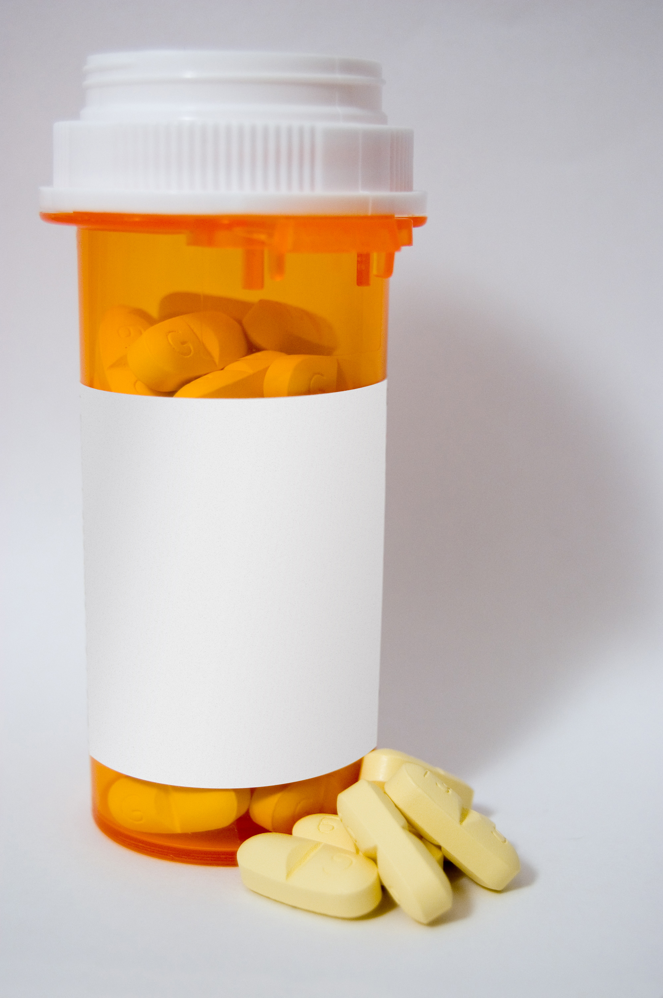
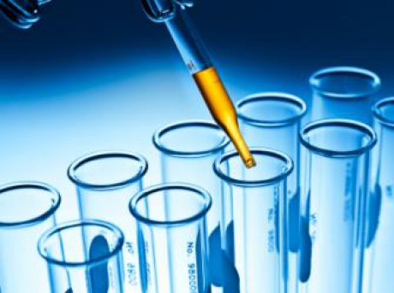

Codevelopment: Therapeutic + IVD
CDRH
IVD
Sponsor
Therapeutic
Sponsor
CDER
CBER

Slide 22
Codevelopment
The development of paired therapeutic products and diagnostic devices with interdependent uses (e.g., a drug and a companion diagnostic).
Biomarker discovery and test development can occur anytime during the drug development process.
Safety and efficacy of the new drug and new diagnostic are typically demonstrated in the same clinical trial.
From a regulatory perspective, the goal is simultaneous approval of the drug and diagnostic.
IND
Basic research
Lead optimization
Preclinical development
Clinical development
Phase I Phase II Phase III
FDA filing/approval
IDE
Biomarker discovery
Assay development
Assay validation
Clinical validation
FDA filing/approval

Slide 23
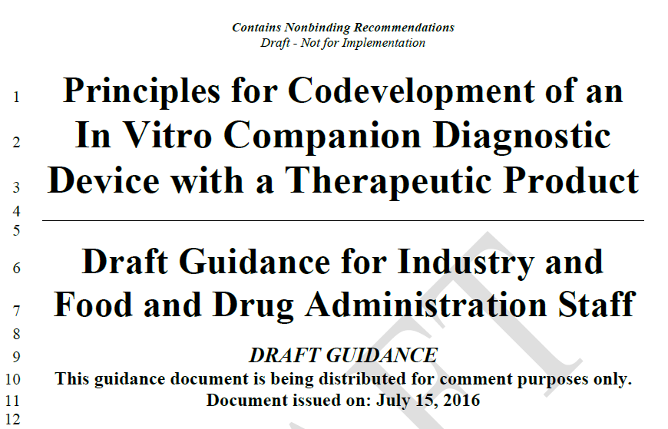
New!
DRAFT!
http://www.fda.gov/ucm/groups/fdagov-public/@fdagov-meddev-gen/documents/document/ucm510824.pdf
Notes:
Emphasize that the guidance is DRAFT
This idea first applied to the therapeutic product trastuzumab (Herceptin) paired with an IHC IVD CDx HercepTest that measure her2 in breast tissue to ID patients likely to have a therapeutic response. 1998
Note that co-development includes both benefits and challenges

Slide 24
Codevelopment: Benefits & Challenges
Benefits
Challenges
For pharmaceutical companies:
  Potential for optimum patient population and smaller future trials
  Improved drug effect if marker effective
For diagnostic companies:
  New type of diagnostic claim
  Well characterized subjects
  Extensive follow-up
May not be adequate data early on to determine the best biomarker to measure; whether test needed
Appropriate statistics (may allow for e.g., adaptive trial design if drug not effective in the general population)
Test used in drug trials not the marketed version (platform change)
Appropriate storage of clinical trial samples; IRB, IC
Notes:
Note that co-development includes both benefits and challenges
Will touch on some of the solutions for the noted challenges a bit later in the talk

Slide 25
Drug/Device Codevelopment:
Key Regulatory Questions
Will an IDE be required?
If the drug development program is based on a biomarker, will the test for the biomarker result in a companion diagnostic device?
Does the companion diagnostic device have adequate performance data to be approved contemporaneously with the drug?
Will a bridging study be required?
Notes:
Note that we already discussed one question about CTA vs. MRA

Slide 26
Key Regulatory Questions:
Is my device performance adequate?
Does the companion diagnostic device have adequate performance data to be approved contemporaneously with the drug?
Analytical Performance Validation
Performed using procured specimens from the intended use population (exception for rare mutations)
Critical performance characteristics should be assessed before using test in trial
Important to assess analytical performance at the clinical decision point (cut-off)
Clinical Performance Validation
Supported by the results of the drug trial when companion diagnostic device is used to test specimens and identify patients eligible for the trial

Slide 27
Intended Use of the IVD
“Intended Use”-driving force of the scientific review
Understanding :
Integration of disease(s)/condition(s).
Integration of patient clinical management and public health (surveillance)
  Who will be tested, where and when: outpatients, inpatients, pediatrics, adults, acutely ill, etc.
  What are the appropriate specimens and analytes: type, timing, handling
  How test result(s) may be used: patient management

Slide 28
Components of the Intended Use
What assay measures, how to use results
  Example:
  MammaPrint® is a qualitative in vitro diagnostic test service, performed in a single laboratory, using the gene expression profile of fresh frozen breast cancer tissue samples to assess a patients' risk for distant metastasis.
  The test is performed for breast cancer patients who are less than 61 years old, with Stage I or Stage II disease, with tumor size <= 5.0 cm and who are lymph node negative. The MammaPrint® result is indicated for use by physicians as a prognostic marker only, along with other clinicopathological factors.
Intended
Population
Analyte
Indication
For Use
  Types of studies depend on Intended Use claims;
  Less dependent on the technology or assay format

Slide 29
Scientific Review : IVD Performance
Analytical Performance Characteristics
  Reliability and accuracy of analyte measurements
  Studies specific to the assay technology such as accuracy for molecular assays, inter-reader agreement for IHC assays, etc.
Clinical Performance Characteristics
  Clinical sensitivity and specificity
  Positive and negative predictive values
Labeling
  Intended use, device design, directions for use, warnings/limitations, result interpretation, performance

Slide 30
Analytical Performance
For tests that detect multiple possible genetic changes, e.g., multiple mutations within a gene, should be analytically validated for each change to be detected
Establishing analytical validity creates unique challenges for new and emerging technologies, i.e. next-generation sequencing (NGS)
  Multiplex assays often require complex validation
  Representative approach for gene sequencing tests
When performing analytical validation, consideration should be made of the ultimate specimen source to be used once drug is on the market, i.e., FFPE tissue, blood, CSF
Notes:
Introduce these are considerations for analytical performance
Lead into how specimen selection can create some issue

Slide 31
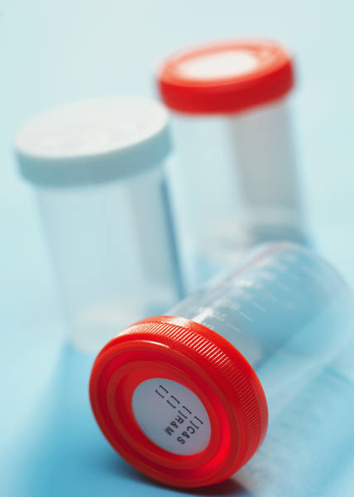
CDx Challenges - Specimens
Each claimed specimen requires analytical validation
  Tissue type (e.g., blood, bone marrow, tumor, urine),
  Tissue collection (e.g., tissue block, FNA, whole blood spot cards, special collection devices),
  Tissue collection/preparation reagents (frozen vs. FFPE; anticoagulants; preservatives)
Inability to re-test specimens
  Informed consent issues
  Poor quality sample, lack of sample, missing sample

Slide 32
Solutions - Specimens
Select one specimen type
  Specify the specimen type in the trial
  Specify the processing steps as well as volume, cell/tumor proportion, etc. so that validation requirement is limited to these specifics
  Capture protocol deviations
  Consider whether it is possible to get paired specimens at time of collection
Bank samples from all patients evaluated for enrollment
(test negative and test positive)
  Obtain adequate sample volumes for retesting
  Consider policies in foreign countries
  Ensure Informed consent documents cover the testing
Notes:
Consider impact of storage (assess whether storage impacts analytes)
Plan ahead to conduct stability testing of the samples by comparing different time points to baseline results
Plan to assess intra-biological variability with a few patients
Ensure a single uniform method is employed for specimen handling
Avoid sample handling that uses RUO instruments such as microdissection
Ensure you have adequate annotation in the event you need to retest the samples and account for missing samples
The collection device must already be legally marketed for the intended use (e.g., cleared or approved) or brought in with the submission

Slide 33
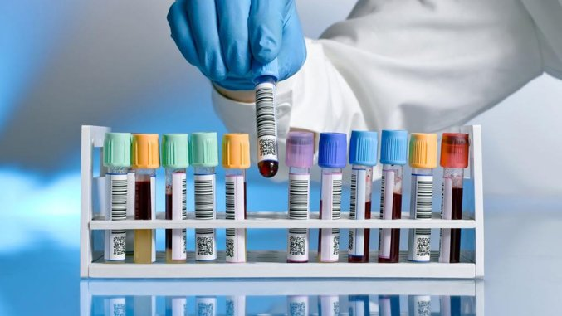
Clinical Performance
Determine how the device will be used in clinical setting and ensure study design is appropriate
Study design should support the Intended Use
Pre-specified clinical and statistical analysis plan
Establish clinical performance of device compared to an endpoint or appropriate surrogate
Analytical validation precedes clinical validation

Slide 34
Drug/Device Codevelopment:
Key Regulatory Questions
Will an IDE be required?
If the drug development program is based on a biomarker, will the test for the biomarker result in a companion diagnostic device?
Does the companion diagnostic device have adequate performance data to be approved contemporaneously with the drug?
Will a bridging study be required?
Notes:
Note that we already discussed one question about CTA vs. MRA

Slide 35
Key Regulatory Questions:
Will I need to perform a bridging study?
Is the clinical trial assay (CTA) the same device as the market ready assay (MRA) that is the subject of a PMA application?
  Various issues may arise due to the clinical trial study design and enrollment procedures
  A bridging study may help resolve the issues
A bridging study is needed to show equivalency between CTA and MRA, the CDx
  Re-test patient specimens (include CTA Positive and negative) with new/revised test to support safety and efficacy of the therapeutic product

Slide 36
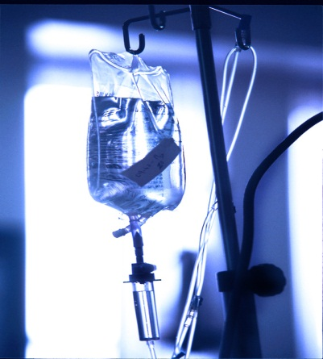

Issues – Clinical Trial Assays
CTA not the final test intended for marketing
Use of more than one CTA to enroll patients into the trial
Mid-trial changes to device such as change in cut-offs, etc.
Use of CTA without adequate analytical validation
Differences between CTA and MRA can lead to discordant results for a patient’s specimen
Pre-screening
Stability of stored specimens
Missing outcome data
Notes:
Elaborate a bit on each bullet point

Slide 37

Solution – Bridging Studies
Statistical Plan should take into account discordance, missing samples and impact on drug efficacy.
Retest population should be representative of the intended use population for the device – Beware of bias!
  Assess available sample representativeness
  Identify variables that have effects on the test result
  Identify variables that can impact therapeutic outcomes
Plan to analyze worse case scenario for missing data with sensitivity analysis using range of hazard ratios in trials
Predictive claims: the device should demonstrate a differential therapeutic treatment effect on clinical outcome(s) (e.g., overall survival).
Notes:
Re-analysis of the trial for effectiveness of device is potentially biased if subset not representative.

Slide 38
Presentation Overview
Overview of Regulation of In Vitro Diagnostic Devices (IVDs)
Key Regulatory Questions: Drug/Device
Codevelopment
  Challenges & Solutions
Useful Tips & Tools
Notes:
Re-orient to presentation overview and let them know we are wrapping up

Slide 39

Useful Tips
Establish biomarker testing strategy early
Alert lead FDA center that therapy application includes a diagnostic device
The pre-submission process is critical for new development programs/companion diagnostic programs
  Schedule pre-sub meetings with CDRH as soon as test identified to discuss design of clinical studies, etc. Helpful if both diagnostic and pharmaceutical reps. present
  Early interaction with Agency encouraged!

Slide 40

Useful Tools
Medical Devices Standards Database
  http://www.fda.gov/MedicalDevices/DeviceRegulationandGuidance/Standards/default.htm
Clinical Laboratory Standards Institute (CLSI)
  Develop global consensus standards and guidelines for healthcare testing (industry, government, professional)
  Evaluation Protocols (EP) for study design/analysis
  www.clsi.org
ISO (International Standards Organization)
  Standards for estimating bias and imprecision of test methods

Slide 41
Selection of CLSI Documents
C28-A3. Reference Intervals
EP5-A2. Evaluation of Precision Performance of Quantitative Measurement Methods
EP6-A. Evaluation of the Linearity of Quantitative Measurement Procedures
EP9-A2. Method Comparison and Bias Estimation Using Patient Samples
EP12-A2. User Protocol for Evaluation of Qualitative Test Performance
EP17-A. Limits of Detection and Limits of Quantitation
EP21-A. Total Analytical Error
GP10-A. Assessment of the Clinical Accuracy of Laboratory Tests Using Receiver Operating Characteristic (ROC) Plots;
MM17-A. Multiplex Nucleic Acid Assays

Slide 42
Useful Guidance
  In Vitro Diagnostic (IVD) Device Studies- Frequently Asked Questions: http://www.fda.gov/downloads/MedicalDevices/DeviceRegulationandGuidance/GuidanceDocuments/ucm071230.pdf
  IRB Responsibilities for Reviewing the Qualifications of Investigators, Adequacy of Research Sites, and the Determination of Whether an IND/IDE is Needed: http://www.fda.gov/downloads/RegulatoryInformation/Guidances/UCM328855.pdf
  FDA Decisions for Investigational Device Exemption (IDE) Clinical Investigations: http://www.fda.gov/downloads/medicaldevices/deviceregulationandguidance/guidancedocuments/ucm279107.pdf
  Guidance on Informed Consent for In Vitro Diagnostic Device Studies Using Leftover Human Specimens that are Not Individually Identifiable: http://www.fda.gov/downloads/MedicalDevices/DeviceRegulationandGuidance/GuidanceDocuments/ucm071265.pdf
  Significant Risk and Nonsignificant Risk Medical Device Studies: http://www.fda.gov/downloads/RegulatoryInformation/Guidances/UCM126418.pdf
  Others at www.fda.gov

Slide 43
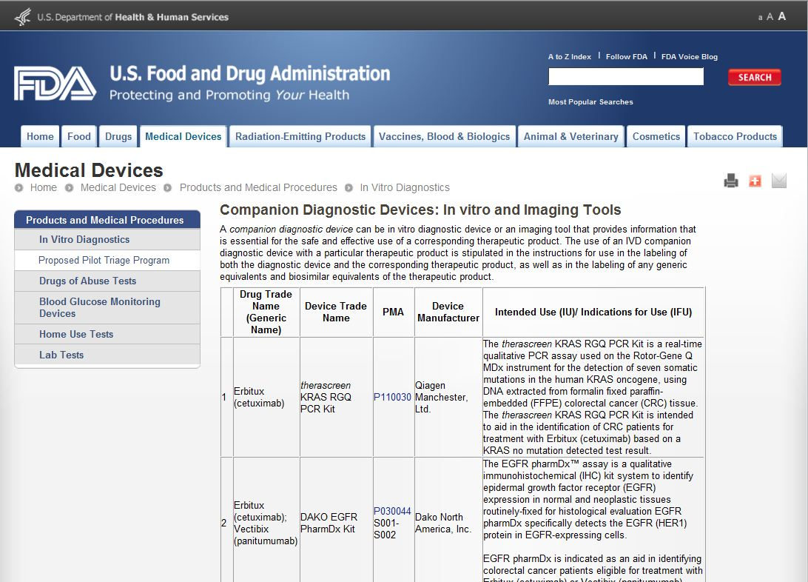
FDA Approved Companion Diagnostics www.fda.gov/companiondiagnostics
Notes:
Note that the link to the PMA is included on the website. Developers can review the SSED to get an idea of how the device was validated and how it relates to the drug efficacy data

Slide 44

Email: hisani.madison@fda.hhs.gov

