Slide 1
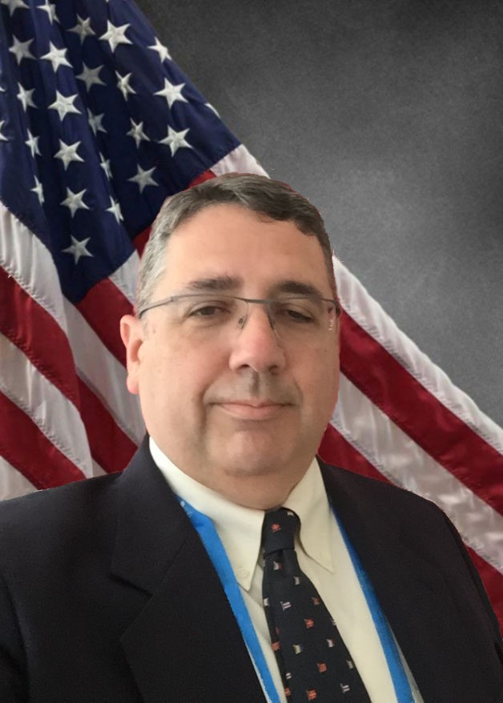
Current Program Update
E. Dennis Bashaw, PharmD.
Senior Science Advisor
Office of Clinical Pharmacology
Office of Translational Sciences
US Food and Drug Administration
Topical Drug Development – Evolution of Science and Regulatory Policy II ---- July 23-24, 2020

Slide 2
Disclaimer
The presentation today should not be considered, in whole or in part, as statements of policy or recommendation by the US Food and Drug Administration.
Throughout the talk or the discussion/Q&A portion of the program representative examples of commercial products may be given to clarify or illustrate a point. No commercial endorsement is implied or intended.
Notes:
As previously mentioned, this presentation shouldn’t be considered statements of policy or recommendation by the US FDA.

Slide 3
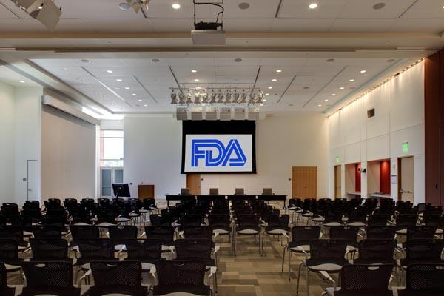
Welcome to the Great room at the FDA

Slide 4
The Current State of Dermal Absorption Assessment
?
Clinical
Pharmacology
Master
MUsT
Protocol
Development
Microdialysis
Physiologically Based
Pharmacokinetic
Models
IVPT/
IVRT
Pharmacogenetics
Translational
Medicine
Collaboration
Open Flow
Microperfusion
Biomarker
Qualification
Big data
Patient Factors
DPK
Characterization
Based
Approaches

Slide 5
Update on Dermal Absorption Activities
COVID 19 has had a dramatic impact on the FDA
The last “full staff” day at the FDA was March 16th
Large amounts of FTE resources are being allocated regards to support of COVID-19 related priorities
For the Office of Clinical Pharmacology’s Monograph Group this has revolved (not surprisingly) around hand sanitizers and related issues
Despite the difficulties in collaboration, the FDA staff working in the dermal absorption area, across all offices, have accomplished a lot that I will summarize and you will hear more about from the later speakers.

Slide 6
The FDA’s and CDER’s “DUAL” Role
Regulations
Science
Conservative
Innovation
FDA

Slide 7
The FDA’s and CDER’s “DUAL” Role
Regulations
Science
Conservative
Innovation
FDA

Slide 8
FDA Activates*
IVPT
In Vivo
MUsT
Trials
Guidance
Issuances
External
Outreach
The term “Activates” is used here as often the “actions and activities” of the FDA drive other research and the science at large
*Not a typo

Slide 9
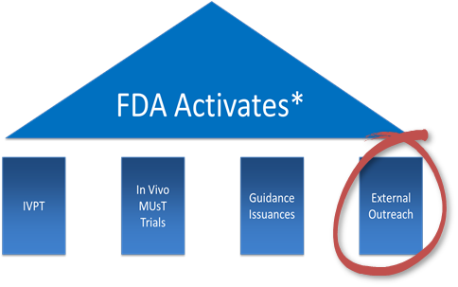
External Outreach
Complicated by COVID-19
Presentations cancelled (selected)
AAD
The Photodermatology Society
This workshop (twice)
9th International Symposia on Microdialysis
In early 2020 a series of talks were given at the New York Society for Cosmetic Chemists meeting at the end of January speakers included:
Myself
Dr. Raney
Dr. Stinchcomb
Dr. Yi

Slide 10
External Outreach
In 2021 the FDA hopes to again be able to engage with the scientific community in person rather than via webex, zoom, or emails.
For this reason, your feedback about this workshop, its pluses and minuses from an educational and scientific content delivery standpoint is very important.
Following the conference we will reach out and make available an opportunity for you to provide feedback and encourage you to do so.

Slide 11
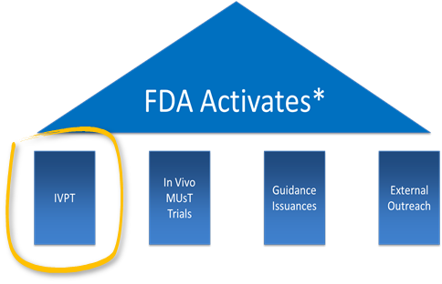
In Vitro Permeation Testing (IVPT)
IVPT is a key element in formulation selection but has historically had some issues with acceptance.
Since the last workshop the FDA has published two articles on the use of IVPT in topical drug development and evaluation.
The first article was focused as a “best practices strawman” for developing a consistent test that can be of regulatory use.
The second article was focused on the permeation of sunscreen and the data from that article will be discussed by the lead author Dr. Yang.

Slide 12
In Vitro Permeation Testing (IVPT)
Topics covered include
System selection
Static vs Flow-Thru
Skin selection for use
Donor
Skin site
Skin Integrity
Thickness
Preparation and storage
Receptor fluid
Temperature
Agitation
Duration
Study Design
Duration
Sampling time intervals
Replicates
https://doi.org/10.1177/2168479019875338

Slide 13
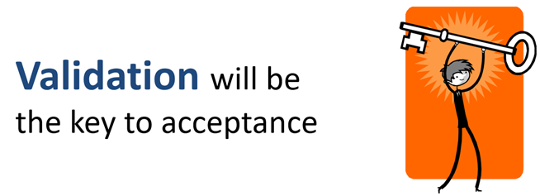
In Vitro Permeation Testing
The purpose of the paper was to be a true “strawman” to advance the conversation to begin to move a laboratory test into a regulatory test.
The biggest issue facing the migration of any test from an experimental basis, to regulatory use is reproducibility and validation across different sites

Slide 14
In Vitro Permeation Testing (IVPT)
https://doi.org/10.1016/j.jid.2020.04.009

Slide 15
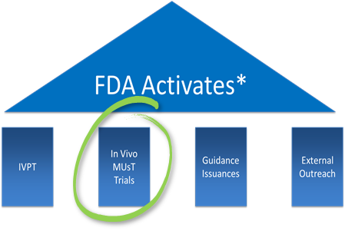
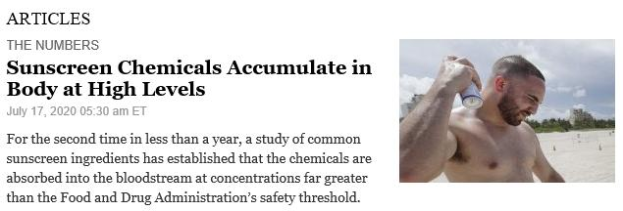
FDA In Vivo MUsT Study #2

Slide 16
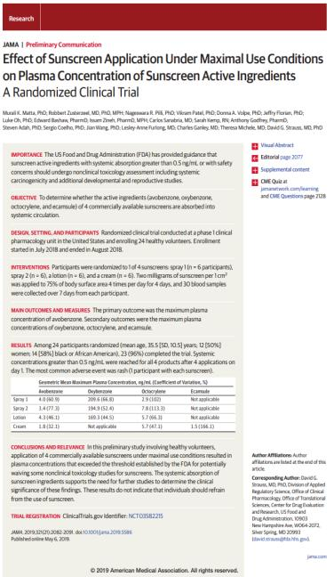
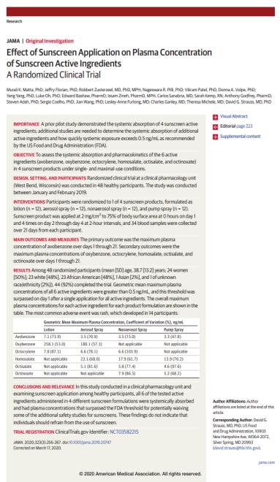
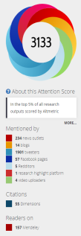
FDA MUsT Publications
on Sunscreen Absorption
May 2019
March 2020

Slide 17
Non-FDA MUsT Sunscreen Absorption
Article published August 2019 from Friedrich-Alexander Universität Erlangen-Nürnberg
20 subjects received topical application of a commercially available sunscreen containing avobenzone and octocrylene
Dosing was for 1 day with an initial dose of 2mg/cm² followed by 1mg/cm² reapplied at 2 and 4 hours to approximately 75-80% BSA.
Subjects were exposed to the sun for 9hrs.
https://doi.org/10.1016/j.envint.2019.105068

Slide 18
Non-FDA MUsT Sunscreen Absorption
Even though the study was only a one day study and was dosed at a lower level than in the FDA studies, significant levels of avobenzone, octocrylene, and octocrylene’s primary metabolite (CDAA) were seen in the plasma and urine
https://doi.org/10.1016/j.envint.2019.105068

Slide 19
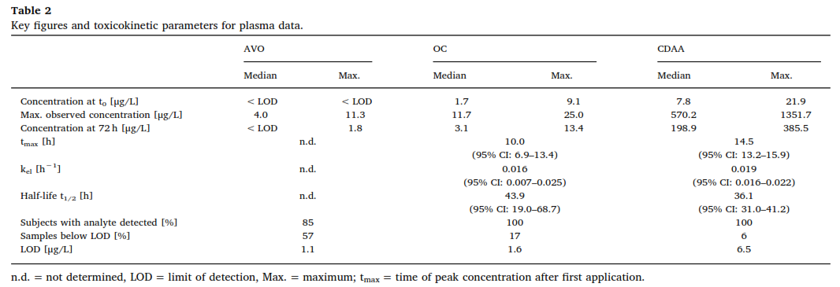
Non-FDA MUsT Sunscreen Absorption
https://doi.org/10.1016/j.envint.2019.105068

Slide 20
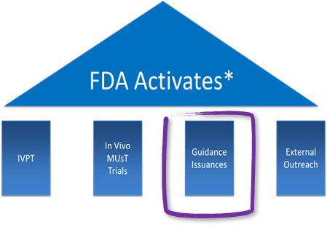
Guidance Issuance

Slide 21
FDA Pilot Guidance Snapshot
Guidance Snapshots are a communication tool that provide highlights from guidance documents using visuals and plain language to support transparent communication and dissemination of FDA guidance documents. During the Pilot, Guidance Snapshots will contain a subset of the following key features:
Explanation of why the guidance document is important
Highlights from the guidance document
Educational background about the guidance topic
Link to the full guidance document
Drug development timeline for when to apply the guidance recommendations
Guidance Recap Podcast that describes highlights and background the guidance document explained directly from the authors
Twitter hashtags to create a platform for discussing views on the guidance
Link to the FDA docket for providing official comments to the Agency (for applicable draft guidances)
https://www.fda.gov/drugs/guidances-drugs/guidance-snapshot-pilot

Slide 22
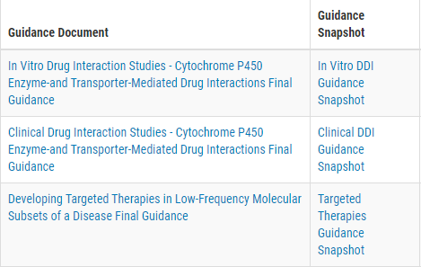
MUsT Snapshot
The MUsT Snapshot is the fourth one prepared as part of the FDA pilot program.
Previous snapshots have been issued for:
https://www.fda.gov/media/140321/download

Slide 23
MUsT Snapshot
In comparison, in the actual Guidance document, the MUsT Study Elements and Consideration section is over 5 pages and has specific verbiage on these elements and how to address them.
The snapshot provides a concise overview of the issues and why it is an element to be evaluated.
Each page of the snapshot also contains the weblink to the actual guidance

Slide 24
MUsT Snapshot
A short background is included along with an explanation, and an example as to why the guidance is important.
This information is provided to put the document into the context of drug development (in this case dermal drug development).
As noted this is the fourth snapshot to be issued in the pilot program and it was posted at the FDA on July 21st, 2020.

Slide 25
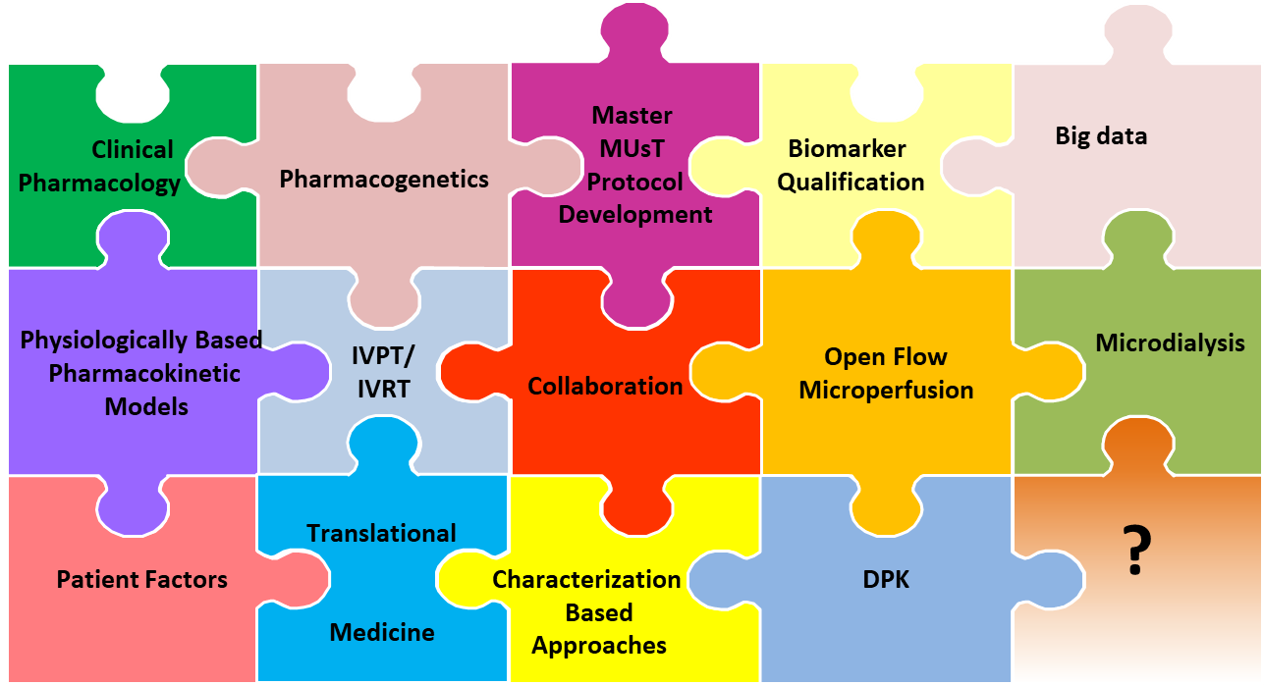
Putting the Pieces Together

Slide 26
COVID-19 has impacted the FDA and regulated industry in ways that could not have been imagined at the end of the workshop last August
Even so the FDA has continued to move forward in developing the science and in communicating with industry using the tools we have available to us
The development of the tests and the standards has moved on and will continue to do so

Slide 27
The Goal
Science Based Regulatory Policy
Master
MUsT
Protocol
Development
Biomarkers
in
drug
development
Big data
Pharmacogenetics
Biomarker
Qualification
Clinical
Pharmacology
Pharmaco-
genomics
Biomarker
Qualification
Physiologically Based
Pharmacokinetic
Models
Open Flow
Microperfusion
Microdialysis
Rare diseases
IVPT/
IVRT
Targeted
therapies
Collaboration
Translational
Medicine
Translational
medicine
?
Patient Factors
Characterization
Based
Approaches
DPK

Slide 28
The Goal
Collaboration is the KEY
To success
Science Based Regulatory Policy
Master
MUsT
Protocol
Development
Biomarkers
in
drug
development
Big data
Pharmacogenetics
Biomarker
Qualification
Clinical
Pharmacology
Pharmaco-
genomics
Biomarker
Qualification
Physiologically Based
Pharmacokinetic
Models
Open Flow
Microperfusion
Microdialysis
Rare diseases
IVPT/
IVRT
Targeted
therapies
Collaboration
Translational
Medicine
Translational
medicine
?
Patient Factors
Characterization
Based
Approaches
DPK

Slide 29
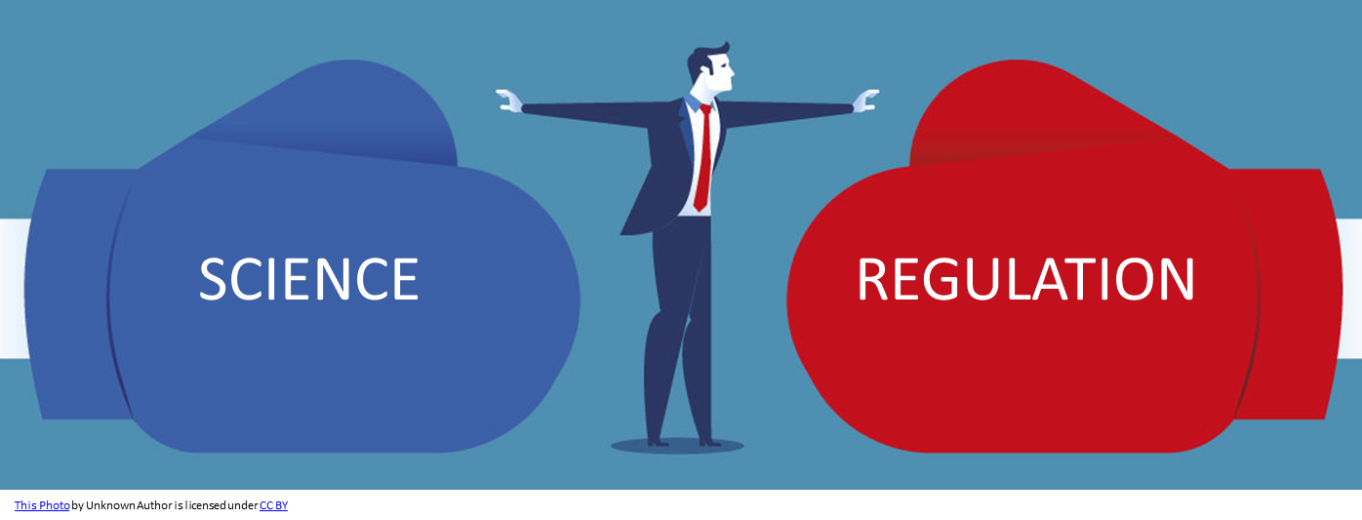
Developing a Science Based Regulatory Policy can only be done with the input of all stakeholders.
The FDA cannot do it alone
The Industry cannot do it alone
Academia, Clinicians, and the Public cannot do it alone.

Slide 30
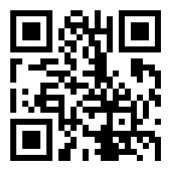
Contact Info
E. Dennis Bashaw, PharmD.
Senior Science Advisor
Office of Clinical Pharmacology
Office of Translational Sciences
US Food and Drug Administration
Edward.bashaw@fda.hhs.gov
LinkedIn

