Slide 1

FDA Welcome and Overview
E. Dennis Bashaw, PharmD.
Senior Science Advisor
Office of Clinical Pharmacology
Office of Translational Sciences
US Food and Drug Administration
Topical Drug Development – Evolution of Science and Regulatory Policy II ---- July 23-24, 2020

Slide 2
Disclaimer
The presentation today should not be considered, in whole or in part, as statements of policy or recommendation by the US Food and Drug Administration.
Throughout the talk or the discussion/Q&A portion of the program representative examples of commercial products may be given to clarify or illustrate a point. No commercial endorsement is implied or intended.
Notes:
As previously mentioned, this presentation shouldn’t be considered statements of policy or recommendation by the US FDA.

Slide 3
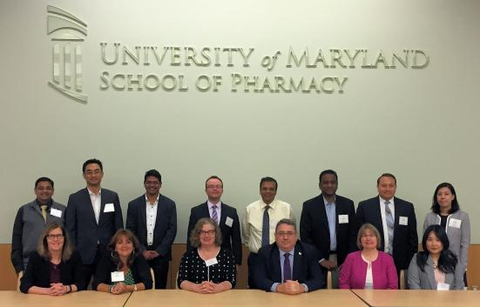
Original Workshop
"Topical Drug Development –
Evolution of Science and Regulatory Policy“
July 29th & 30 th , 2019
Presentations from last years workshop are available on line
  https://www.pharmacy.umaryland.edu/centers/cersievents/topical/agenda/

Slide 4
Why Another Workshop?
Workshop 1 (2019)
Focused more on the introduction of the Maximal Usage Trial to the group at large as its use outside of the NDA process was limited.
Discussion on the data from the first FDA sunscreen study that was reported out in May 2019
Workshop 2 (2020)
More focused on the entire area of dermal absorption evaluation to include:
  MUsT
  In Vitro
  In Silico
Update on the totality of the FDA Sunscreen Study results
Inclusion of more clinically oriented speakers
Expanded to two days to allow for a broader discussion

Slide 5
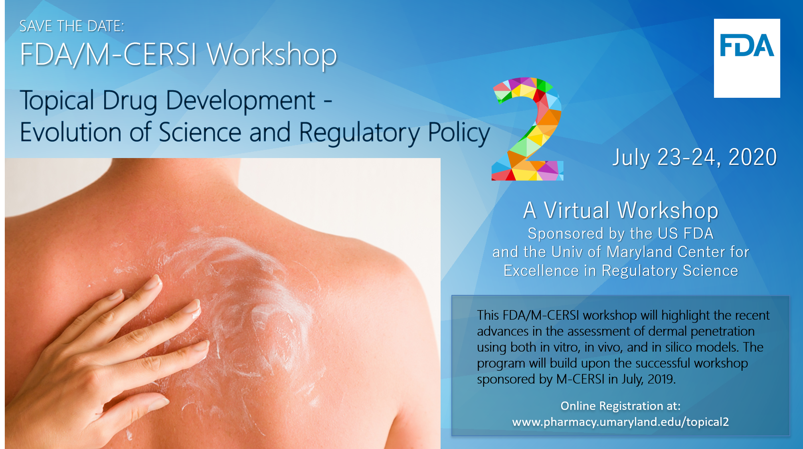

Slide 6
Program Objectives:
  To facilitate discussion as to the design elements and concerns of both in vivo and in vitro methods in both the new drug and over-the-counter drug space.
  To present recent advances and examples of the use of in vitro and in silico methods in the assessment of dermal absorption from both a new drugs and generic drug development perspective.
  To provide an update on the progress on the developments in the area of topical absorption.
  To stimulate discussion between interested parties in the evolution of science in the area of topical drug development and dermal absorption testing.

Slide 7
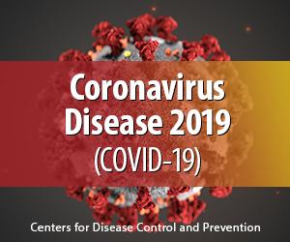
Timing is Everything……..

Slide 8
OTC Monograph Reform
On March 27, 2020, the President signed into law H.R. 748, the “Coronavirus Aid, Relief, and Economic Security Act” (CARES Act)
The CARES Act includes an important legislative initiative that reforms and modernizes the way OTC monograph drugs are regulated in the United States
Notes:
On March 27, 2020, the President signed into law H.R. 748, “the Coronavirus Aid, Relief, and Economic Security Act” or the “CARES Act”.
The CARES Act includes an important legislative initiative that reforms and modernizes the way OTC monograph drugs are regulated in the United States.
For simplicity, we will refer to the regulatory framework under the CARES Act as OTC Monograph Reform, throughout this presentation.

Slide 9
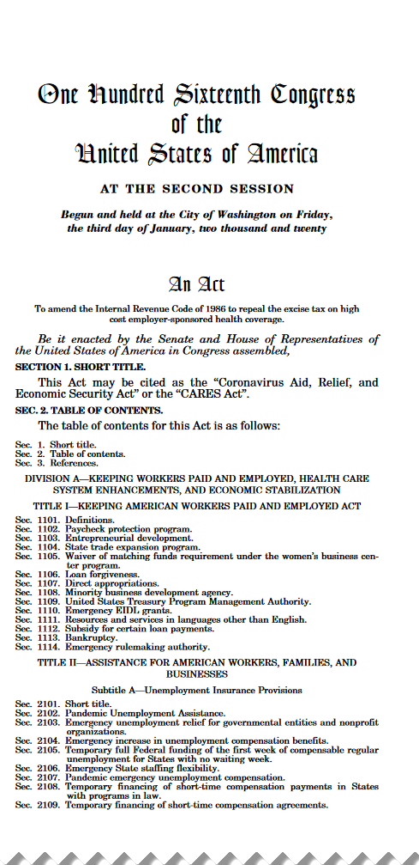
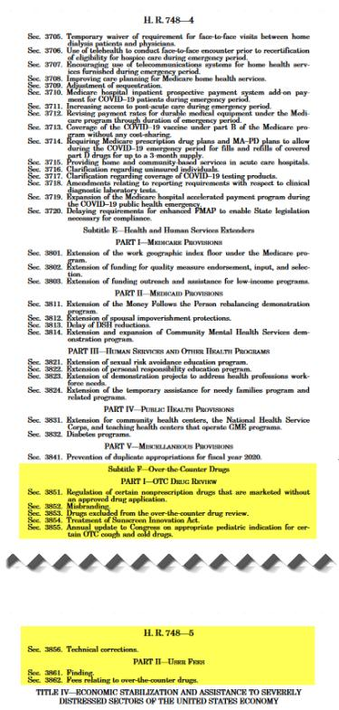
The “CARES ACT”
335 Pages Long
OTC Drug Review
Pages 155-188
https://www.govinfo.gov/content/pkg/BILLS-116hr748enr/pdf/BILLS-116hr748enr.pdf

Slide 10
OTC Drug Review Prior to CARES Act
Began in 1972 to evaluate the safety and effectiveness of OTC drug products marketed in the United States before May 11, 1972
Established GRASE* conditions for each OTC therapeutic drug class in the form of OTC monographs
Three-phase public rulemaking process to establish the OTC monographs
In effect until the CARES Act was passed in March 2020
*Generally Recognized as Safe and Effective
Notes:
The next question you may ask is how did we get these OTC monographs and why did the monograph system start?
In brief, the OTC Drug Review was established in 1972, nearly 50 years ago, to address the safety and efficacy of hundreds of thousands of OTC products that were on the market at that time. The OTC drug review was a way to look at the safety and effectiveness of all the drugs on the OTC market without requiring each one to come to FDA and submit a separate New Drug Application.
The OTC drug review as it was in effect prior to passage of the CARES Act consisted of a three-phase public rulemaking process to establish OTC monographs, which I’ll talk about on the next slide

Slide 11
CARES Act
The CARES Act amends the FD&C Act to
  Modernize the OTC drug review and
  OTC monograph drug development process
  Provide FDA with the authority to collect user fees dedicated to OTC monograph drug activities
Over-the-Counter Monograph User Fee Program Performance Goals and Procedures Document
  Specifies FDA and industry mutually agreed upon timelines
Notes:
As I previously mentioned, on March 27, 2020, the President signed into law H.R. 748, “the Coronavirus Aid, Relief, and Economic Security Act” or the “CARES Act”.
Subtitle F of the CARES act amends the Federal Food, Drug, and Cosmetic Act to modernize the OTC drug review and OTC monograph development process and provides FDA with User fees to support OTC monograph drug activities.
In support of the law, a performance and goals document was drafted specifying timelines that FDA and industry mutually agreed to.

Slide 12
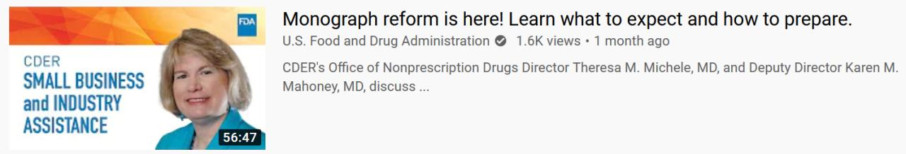
What Will Not Be Covered Today
A discussion of the impact of the CARES Act on topical product development for the OTC space is beyond the scope of this workshop.
The FDA Small Business Industry Assistance (SBIA) Program has posted a video overview of the CARES Act as it relates to monograph reform online (6/1/2020):
https://www.youtube.com/watch?v=88gZr0RDoww

Slide 13
What Will Be Covered Over the Two Days
Computational models of drug absorption
Use of in vitro methods
Bioequivalence assessment via characterization based approaches
The combining of different methods (in vitro and MUsT) to present a fuller picture of absorption
A clinical perspective
FDA sponsored and conducted research
Quo
Vadis

Slide 14
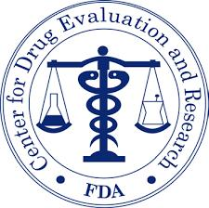
Center for drug evaluation and research

Slide 15
The FDA’s and CDER’s “DUAL” Role
Regulations
Science
Conservative
Innovation
FDA

Slide 16

Dermal Drug Review
“Paleoregulatory”*
Prior to the early 1990s, most topical dermatologicals had little or no direct assessment of in vivo bioavailability.
Clinical efficacy trials or surrogate markers of drug absorption were used.
Waivers of in vivo bioavailability testing were the norm and not the exception
“Maximal dosing” was an unexplored concept
Sunscreen absorption was not considered
*Jon Wilkin, MD

Slide 17
Types of Evidence to Establish Bioavailability or Bioequivalence*
(paraphrased)
Determine the drug/metabolite levels in man in biological fluids as a function of time
  An in vitro test that has been correlated with and is predictive of in vivo bioavailability
  An in vivo test in animals
Urinary excretion data
In vivo test of an acute pharmacological event over time
Well controlled clinical trials
In vitro testing
*21 CFR 320.24

Slide 18
Common Features of In Vivo Dermal
Bioavailability Studies pre-1990
Study done in subjects with healthy skin
Study done on small surface areas
Study done with inadequate analytical methods
Study done with too few subjects
Study done as a single dose study
The information gained from such studies was inadequate for any attempts at PATIENT based individualization for NDA products or for assessment of “Maximal Use”

Slide 19
Factors* That Influence Dermal Bioavailability
Intersection of Factors Controlling In Vivo Bioavailability
Delivery System Factors
Ingredient
Factors
Skin Factors
Primary Factors
Dosage Form Technology
  Cream
  Lotion
  Gel, etc.
Deployability
Spreadability
Dosing Pattern
Amount Applied
Primary Factors
Diseased vs Non-diseased
Surface Area
Site of Application
  Scalp
  Back, Chest, etc.
Aged Skin
Primary Factors
Molecular Weight
Solubility
Melting Point
pKa
Concentration
*A non-exhaustive list of factors

Slide 20
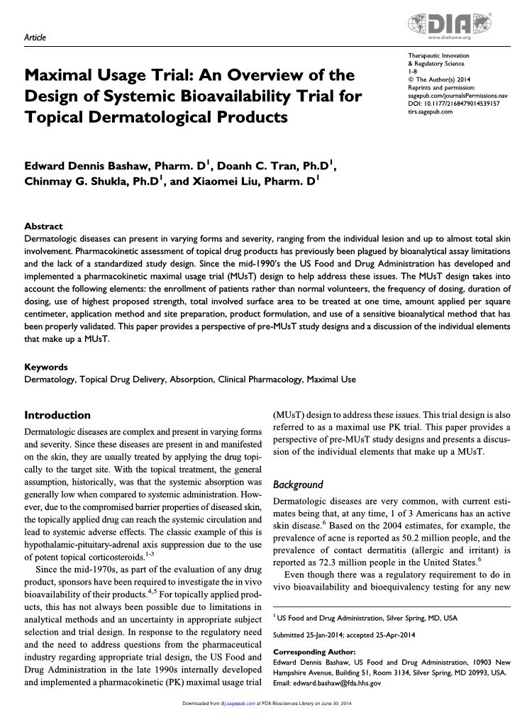
Maximal Usage Trial (MUsT)

Slide 21
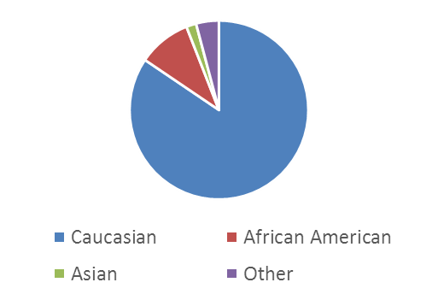
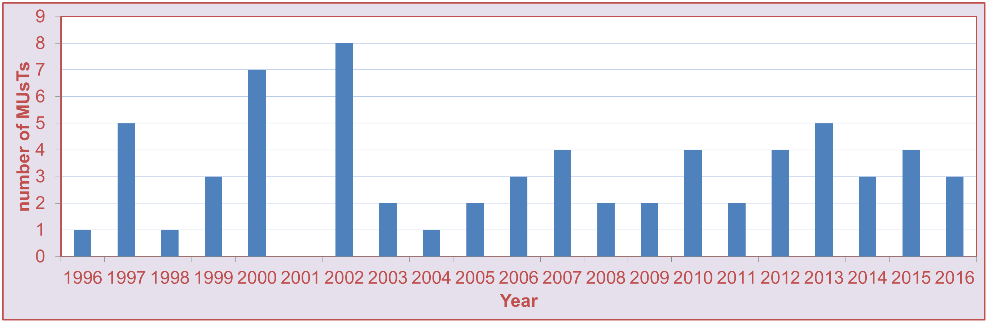
MUsT Survey 1996-2016
Original NDAs Only
A total of 66 MUsT trials have been conducted over 20yrs
  An additional 20-30 trials have also been submitted as part of supplements
Of the 66 trials they enrolled 1,545 patients
  887(58.6%) Male and 658(43.4%) Female

Slide 22

Maslow’s Hammer and MUsT
"It is tempting, if the only tool you have is a hammer, to treat everything as if it were a nail.”
Abraham Maslow, 1966

Slide 23
Beyond MUsT
While the MUsT methodology has provided the FDA with usable information that has informed the labeling, it has never been seen as a stopping point.

Slide 24
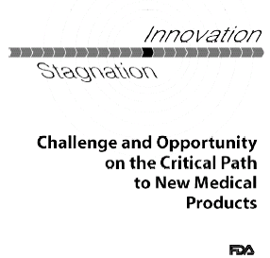
FDA Whitepaper on Critical Path issued on March 16th, 2004
http://www.fda.gov/oc/initiatives/criticalpath/whitepaper.html

Slide 25
FDA Critical Path Initiative
"A new focus on updating the tools currently used to assess the safety and efficacy of new medical products will very likely bring tremendous public health benefits."
Former FDA Commissioner Lester M. Crawford

Slide 26

Bringing Improved Drug Development
Tools to Bear
INNOVATIVE ANALYSES
Improved Computing Resources
Quantitative drug-disease-trial models
Exposure-response models
INNOVATIVE TRIAL DESIGNS
Clinical trial simulations
Enrichment, adaptive, dose-response
KNOWLEDGE MANAGEMENT
Leverage prior data

Slide 27
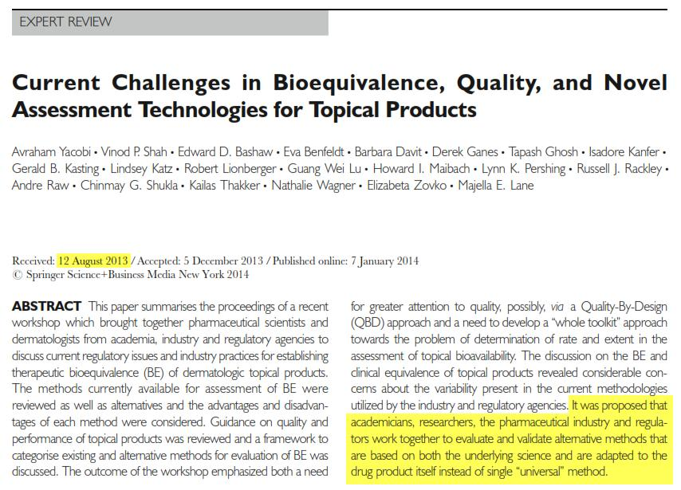
We Have Been Here Before….
Pharm Res (2014) 31:837–846
DOI 10.1007/s11095-013-1259-1

Slide 28
Revisiting the Methods
Current Methods (2013)
  Clinical Endpoints
  MUsT
  Dermal Vasoconstrictor Assay
Methods for Consideration
  Dermatopharmacokinetics
  Microdialysis
  Open Flow Microperfusion
  Confocal Raman Spectroscopy
  In Vitro Skin Permeation Studies
  In Vitro Release Testing
  Modeling/Pharmacometric Approaches

Slide 29
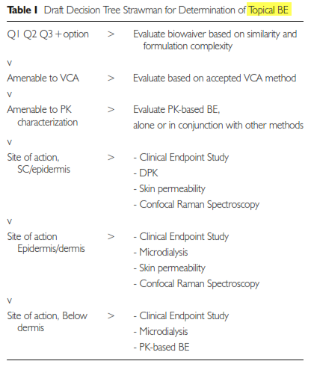
The 2014 Strawman
While focused on assessment of bioequivalence, the same methods can be applied to bioavailability assessment, albeit with an understanding of the different scientific and regulatory focus.
Pharm Res (2014) 31:837–846

Slide 30
General Test Characteristics
Well defined procedures
  Validation
  Standardized Training
Be reproducible
  Run to Run
  Site to Site
Be predictable
Be relevant clinically

Slide 31
General Test Characteristics
Well defined procedures
  Validation
  Standardized Training
Be reproducible
  Run to Run
  Site to Site
Be predictable
Be relevant clinically
Relevant in that it MUsT inform the development process

Slide 32
“We need to have a valid scientific understanding of dermal absorption. This can inform both testing of the risk and benefit of topically applied drugs.”
-Janet Woodcock, MD

Slide 33

Charge to the Workshop
As new drug development tools are developed and gain acceptance, regulatory policy will have to evolve to maintain its relevancy.
The FDA, thru it’s research, is willing to consider alternatives to standard methods, but ultimately the validation of the tools and their implementation are a group responsibility.
Validation will be the key to acceptance

Slide 34


Contact Info
E. Dennis Bashaw, PharmD.
Senior Science Advisor
Office of Clinical Pharmacology
Office of Translational Sciences
US Food and Drug Administration
Edward.bashaw@fda.hhs.gov
LinkedIn

