Slide 1
Trifarotene Cream (AKLIEF®): Formulation screening from in vitro Permeation Testing to Clinical studies
Nathalie Wagner
July 23, 2020

Slide 2
Agenda
Context
Why formulation screening was needed?
Selection tool kit
In vitro skin permeation studies (IVPT)
Clinical phase 1 PK study in healthy volunteers
Clinical proof of efficacy studies in subject with acne
Conclusion

Slide 3
Trifarotene: Selection of the To-Be-Marketed formulation
New Chemical Entity
Trifarotene: New Chemical Entity (NCE) - Agonist of retinoic acid receptors (RAR), with particular activity at the gamma subtype of RAR - Retinoid indicated for the topical treatment of acne vulgaris
Early Formulation
Gel: - High % of ethanol to ensure adequate physical and chemical stability of Trifarotene - Early formulation used in the positive proof of concept (POC) study in subjects with acne
Prototypes
Trifarotene Cream (AKLIEF®): - Efficacy and tolerability demonstrated - Limited systemic exposure (high safety margin)
To-Be-Marketed Formulation
Creams adapted to the target indication: - Substitute most of the ethanol content - Reduction of oil phase is best adapted for the treatment of acne - Overcome precipitation of trifarotene in the presence of an aqueous phase due to its low water solubility

Slide 4
Trifarotene: Selection of the To-Be-Marketed formulation
Selection PK tool kit
In vitro skin permeation studies (IVPT)
Clinical phase 1 PK study in healthy volunteers
Clinical proof of efficacy studies in subject with acne

Slide 5
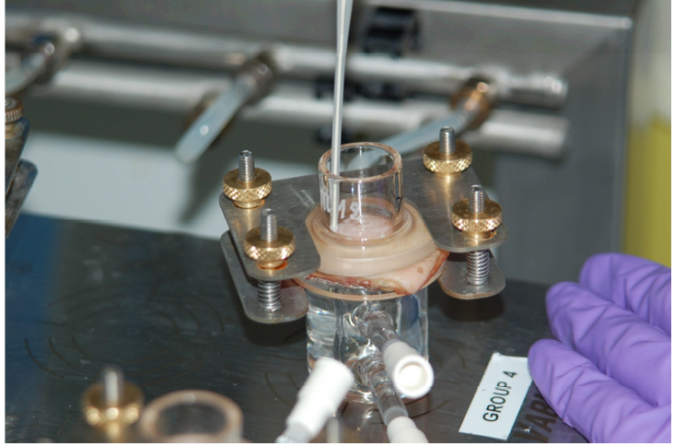
In vitro skin permeation Test (IVPT)
Experimental conditions
Static diffusion cell
2 cm²
3 mL receptor fluid
Physiological saline solution with nonionic surfactant
Sink conditions ➔solubility should not be a limiting factor for diffusion through the skin
Skin surface temperature 32°± 1°C
Human skin
Frozen human : Abdominal and breast areas
3 donors
Full thickness skin (from 0.71 to 1.82 mm)
Skin integrity tested by Trans Epidermal Water Loss (TEWL ≤ 9 g/m²/h)

Slide 6
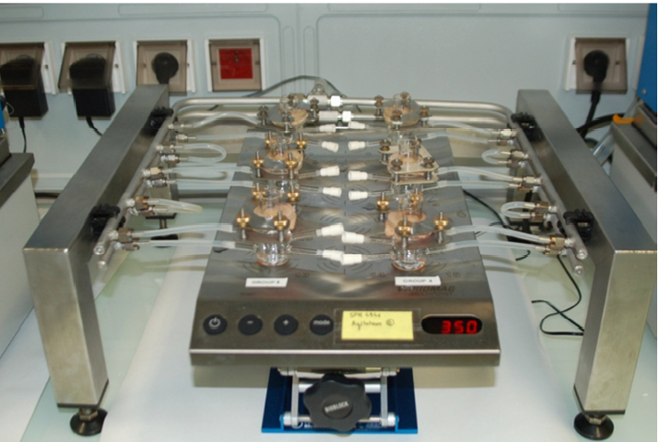
In vitro skin permeation Test (IVPT)
Experimental conditions
Tested formulations
Gel used in POC
Cream A and Cream B: Alternative to the Gel
50 µg/g
Application conditions
2 mg/cm²
Application duration: 16 hours
Each formulation tested on the same skin donor in duplicate (N=6)
Trifarotene quantification (LC-MS/MS method)
Surface Excess (Mass Balance)
Stratum corneum (Tape stripping)
Epidermis
Dermis
Receptor fluid

Slide 7
In vitro skin permeation Test (IVPT)
Results in vitro Skin penetration
Similar mass balance between the 3 formulations :
> 97 % of the applied dose
Formulation effect on the Trifarotene total skin penetration
Gel : 7 ± 0.8 ng/cm² 7% of the applied dose
Cream A : 3 ± 0.5 ng/cm² 3% of the applied dose
Cream B : 11 ± 0.7 ng/cm²
11% of the applied dose

Slide 8
In vitro skin permeation Test (IVPT)
Results Skin Distribution
No Formulation effect on the Trifarotene skin distribution
Exponential skin distribution
Trifarotene is mainly distributed in the stratum corneum
70 to 80% of the trifarotene skin penetration
Low penetration into the dermis
No trans-cutaneous penetration
Trifarotene quantities recovered in the fluid receptor not quantifiable for the 3 formulations

Slide 9
Trifarotene : From POC to the to-be-marketed formulation
Selection PK tool kit
In vitro skin permeation studies (IVPT)
Clinical phase 1 PK study in healthy volunteers
Clinical proof of efficacy studies in subject with acne

Slide 10
Clinical PK study
Study design
Healthy volunteers
10 subjects per cohort:
Application once daily on the face, back and chest for 29 days
2 mg/cm² on a fixed surface area
All applications performed under controlled conditions
PK assessments
Plasma samples at days 1, 5, 15 and 29
Tape stripping and Skin biopsies at day 5
Gel
25 µg/g
50 µg/g
Cream A
Cream B
100 µg/g
50 µg/g
50 µg/g

Slide 11
Clinical PK study
Results in vivo Skin penetration (Day 5)
Formulation effect on the total skin penetration
Gel : 6 ± 2.6 ng/cm²
Cream A : 2 ± 1.6 ng/cm²
Significant different skin penetration 3.0 fold lower than Gel 2.4 fold lower than cream B
Cream B : 5 ± 2.7 ng/cm²
No significant difference versus Gel

Slide 12
Clinical PK study
Results (Day 5)
Skin distribution: No clear Formulation effects on the skin distribution
Exponential skin distribution
Trifarotene is mainly distributed in the stratum corneum
60 to 80 % of the total quantity of Trifarotene recovered in skin
Plasma concentrations ≤ 10 pg/mL for the 3 formulations

Slide 13
In vitro versus clinical studies
Predictive value of the IVPT for skin distribution, formulation ranking and total quantities recovered in the skin

Slide 14
Trifarotene : From POC to the to-be-marketed formulation
Selection PK tool kit
In vitro skin permeation studies (IVPT)
Clinical phase 1 PK study in healthy volunteers
Clinical proof of efficacy studies in subject with acne

Slide 15
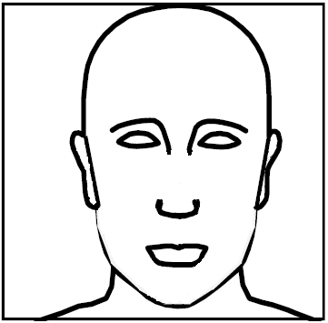
Clinical proof of efficacy studies
Patients with moderate to severe acne vulgaris
ca 20 patients per group
2 studies:
Intra individual (split face) comparison
Study #1:
Gel versus vehicle
Cream A versus vehicle
Study #2:
Gel versus vehicle
Cream B versus vehicle
4 weeks once daily application under controlled conditions (2 mg/cm²)
Primary clinical endpoint
Total acne lesion count and percent reduction of lesion count at week 4

Slide 16
Clinical proof of efficacy studies
Study #1
45 %
p = 0.09*
33%
Trifarotene Gel showed significantly different efficacy compared to its vehicle for % reduction in total lesion count in the two studies

Slide 17
Clinical proof of efficacy studies
Study #1
Study #2
38 %
25 %
p = 0.579
% of reduction in total lesion count
Cream A showed no significant difference compared to its vehicle
Cream B showed significantly better results compared to its vehicle

Slide 18
Conclusion
IVPT was used as formulation screening tool to compare the skin penetration of trifarotene from different creams versus the gel used in the positive POC
Clinical PK data in Healthy Volunteers were used to confirm the formulation ranking from IVPT
Clinical data in patients with moderate-to-severe acne were used to assess the clinical use conditions
PK data (blood sample): Lesional skin is physiologically different from normal skin and might impact PK profile
Efficacy data: To confirm the outcome of the POC with the To-Be-Marketed formulation
Cream B (AKLIEF® Cream, 0.005%): Formulation that delivers the right exposure at the target site of action without compromising patient safety

Slide 19
Take home messages
IVPT powerful tool for
Formulation screening
Prediction of the skin penetration and skin distribution
PBPK modeling (informative data)
IVPT powerful tool but
Method should be clinically relevant
Technical constraints (skin integrity, sink conditions, analytical method, Mass balance ,..)
Dose range to be tested
Communication between experts is instrumental (formulation, in vitro and Clinical)
Formulation concept and complexity should be acknowledged
Clinical skin PK data are needed to confirm the predictability of IVPT and should be generated at the early stage of the project
Additional data should be considered, such as efficacy, safety, and skin tolerance
Caveat :
What was observed with trifarotene might not be applicable to other NCE or other skin diseases
For NCE, the safety of the to-be-marketed formulation must be confirmed in a Maximal Usage Trial (MUsT)

Slide 20
Acknowledgments
These slides summarize a collaborative worldwide team effort that has benefited greatly from the input of many people from Galderma
Non Clinical PK group
Clinical PK and Bioanalytical groups
Pharmaceutical group
Biometry group
Clinical operation
Medical expertise

Slide 21
I PK

Slide 22
Questions ?
nathalie.wagner@galderma.com

