Slide 1
Laboratory Developed Tests Regulations, Lessons from Theranos, Inc.
“America’s Got Regulatory Science Talent” Competition
Team Clinical Lab Scientists
Department of Medical and Research Technology

Slide 2
Team Clinical Lab Scientists
Department of Medical & Research Technology
University of Maryland, Baltimore
Team Captain: Diran Dasi
Team Members: Peyton Liebhardt
Rebecca Collins
Marilyn Bekima
FDA Advisor : Juliane Carvalho, MS, RAC-Drugs
Faculty Advisor Ivana Vucenik, PhD

Slide 3
Background - Theranos
Claims of “revolutionizing” medicine by performing a series of chemical test on essentially a drop of blood
Operated for 15 years before shut down by regulators
CEO Elizabeth Holmes indicted
Cover of Forbes 400 Sept 2015 issue: "The Freshman: Elizabeth Holmes leads the class of 2014"
Laboratory Developed Tests (LDTs)
Also called home brew or in-house tests
LDTs are developed and implemented to meet unmet analytical and/or clinical care needs
Most commonly, LDTs are developed when an FDA cleared or approved assay is not commercially available, is not compatible with instrumentation owned by the laboratory, or does not meet the performance goals desired for clinical care in a particular setting
Notes:
REBECCA:
Theranos Inc., was a privately held technology firm in Silicon valley established in 2003 by 19 year old Elizabeth Holmes who was a college dropout. It advertised a patented Nanotainer technology that required only "a drop of blood" using the analyzer the Edison. They were able to drum up a whopping $700 million in investments. Theranos introduced a panel of laboratory tests to patients as a laboratory developed test or a LDT device without pre-market approval from FDA or validation from peer-reviewed scientific research experts.
A laboratory developed test or LDT is a form of in vitro diagnostic test that is created, produced, and utilized by a single laboratory. Theranos was able to avoid the device certification process by claiming their new device product as an LDT. They also avoided FDA clearance by claiming the blood-collection container as Class I device for which special labels, performance standards and post-market surveillance regulations are not required as compared to a class II medical device. The Nanotainer was later classified as a class II device by the FDA.
Due to the fact that LDTs are relatively basic lab tests manufactured in limited quantities and intended to be used within a single laboratory, the FDA has traditionally not enforced premarket review and other applicable medical device regulations. Historically, LDTs were manufactured using components legally marketed for clinical use and met the needs of the local population. More recent LDTs are much more complex with claims not adequately supported by scientific evidence data. As you can see, this is a regulatory loophole that may expose patients to unnecessary or inappropriate medical device systems that can cause harm.She was later indicted to court and recently sentenced to 11 year in federal prison

Slide 4
Some Key Events in the Development of Laboratory Developed Tests (LDT) Regulations
Year | Event
1976 | Medical Device Amendments enacted from the FD&C Act
1988 | Clinical Laboratory Improvement Amendments of 1988 (CLIA '88)
2014 | Publication of two FDA Guidance documents: Draft Guidance for Industry, Food and Drug Administration Staff, and Clinical Laboratories. Framework for Regulatory Oversight of Laboratory Developed Test (LDTs) Draft Guidance for Industry, Food and Drug Administration Staff, and Clinical Laboratories. FDA Notification and Medical Device Reporting for Laboratory Developed Tests (LDTs)
2020 | Introduction of the Verifying Accurate Leading-edge IVCT Development (VALID) Act into Congress
Notes:
DIRAN: The Medical Device Amendments enacted from the Federal Food, Drug, and Cosmetic (The FD&C) Act in 1976 provide the FDA regulatory oversight of in vitro diagnostic devices (IVD) inclusive of LDTs but FDA has exercised enforcement discretion towards LDTs
CMS under CLIA (CLIA 88) oversees the regulations of Laboratories including LDTs but the FDA feels there is more to be done in addition to their regulations towards LDTs for reasons like; premarket evaluations, clinical validity AND ALSO because;
The manufacturing of LDTs have evolved greatly; From simple manual laboratory tests being used in a single laboratory for the local population to currently where LDTs are high in information technology and used to offer results across states
As a results the FDA is rethinking its discretion as a means to increase patient safety. In 2014, the put forward two draft documents which with recommendations for a risk-based approach toward oversight of LDTs. AND in 2020, the VALID Act was introduced.
The FDA hopes to gain more oversight with these steps and prevent occurence like Theranos in the future

Slide 5
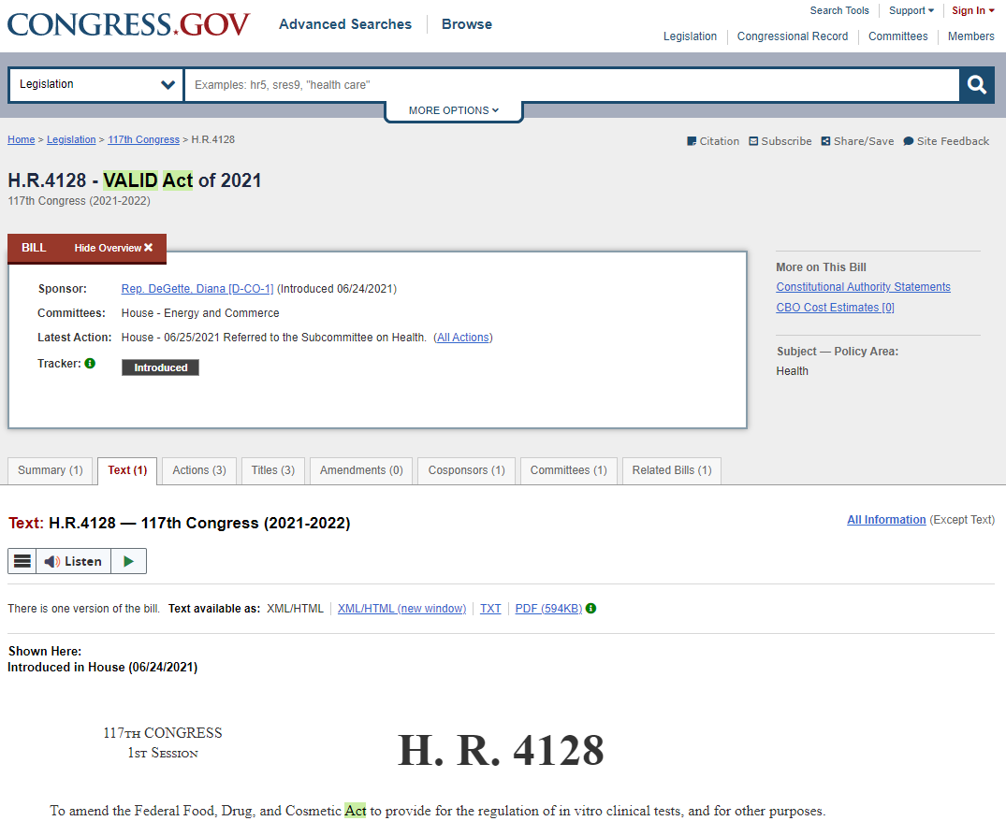
VALID Act
Long-Term Solution
Notes:
PEYTON:
The Valid Act was introduced in 2020 and again in 2021. It is a great start for the FDA to begin regulating in vitro diagnostic testing in laboratories. If approved, this legislation would create a risk-based framework for regulating LDTs that resembles the existing approach the FDA takes toward other medical devices.

Slide 6
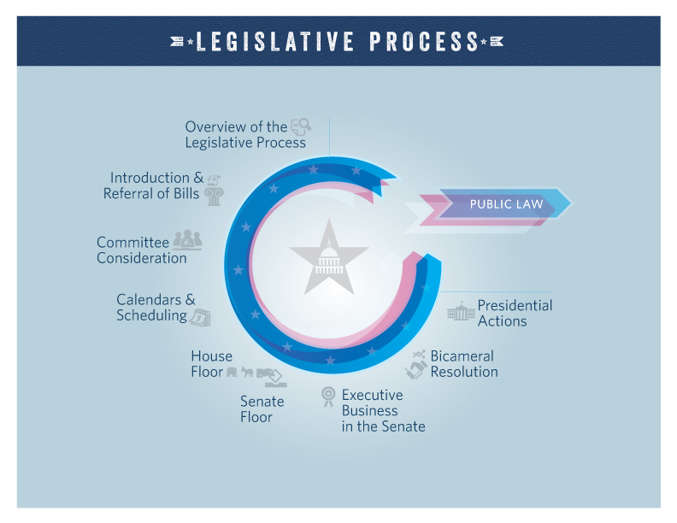
Note: Sourced from Congress.gov
Notes:
PEYTON:
As you can see in the graphic of the legislative process cycle, there is a total of 9 steps that a proposed bill must go through to become part of an effective law. The Valid Act is still in the beginning stages after 3 years since being introduced, proving that, although it is a reasonable solution, it will be years until regulations of in vitro testing become effective. This period of waiting may allow for another Theranos to emerge. The public deserves a short-term solution in order to prevent patients from potential harm.

Slide 7
Proposed Short Term Solutions
Leverage current CMS/CLIA and other accrediting agencies quality systems requirements to address LDT development activities
Encourage manufacturers to seek FDA feedback or submit prospective LDTs data for review and advice early in the development process
Expand third party premarket review program to include certain LDTs
Publish review memorandum for LDTs reviewed by FDA
Flexible policy to certain class I devices that enables manufacturers of LDTs to make appropriate adjustments without undue regulatory burden
Encourage general public engagement in the regulatory decision-making process
– (Patients Ask FDA)
Source: Discussion Paper on Laboratory Developed Tests (LDTs) January 13, 2017 https://www.fda.gov/media/102367/download
Notes:
Marilyn

Slide 8
Conclusion
Short-term regulations for LDTs should be in place to prevent the next “Theranos”
“Patient safety is everyone’s responsibility”
Notes:
Encourage sponsors to seek regulatory advice early in the development process
Promote public databases i.e CLIA (Clinical Laboratory Improvement Amendments)
Encourage general public engagement in the regulatory decision-making process
Patients Ask FDA

Slide 9
References
COLA, Insights into lab developed tests, November 2015. Accessible from https://www.cola.org/insights-newsletters/2015/Nov/insights.pdf (January 30, 2023)
Commissioner, O. of the. (2022, November 4). Search for fda guidance documents. FDA. https://www.fda.gov/regulatory-information/search-fda-guidance-documents
Genzen, J. R. (2019). Regulation of laboratory-developed tests. American Journal of Clinical Pathology, 152(2), 122–131. https://doi.org/10.1093/ajcp/aqz096
Hata, J., Madej, R., & Babady, N. E. (2021). What every clinical virologist should know about the valid act on behalf of the pan-american society for clinical virology clinical practice com. Journal of Clinical Virology, 141, 104875. https://doi.org/10.1016/j.jcv.2021.104875
Health, C. for D. and R. (2019, February 9). Laboratory developed tests. FDA. https://www.fda.gov/medical-devices/in-vitro-diagnostics/laboratory-developed-tests
H.R.4128 - 117th Congress (2021-2022): VALID Act of 2021. (2021, June 25). https://www.congress.gov/bill/117th-congress/house-bill/4128
The Legislative Process: Overview (Video). (2023, January 30). https://www.congress.gov/legislative-process
S.2209 - 117th Congress (2021-2022): VALID Act of 2021. (2021, June 24). https://www.congress.gov/bill/117th-congress/senate-bill/2209
Yuzuki, D. (2019, February 13). Theranos, the fda, and the ldt loophole. Singlera Genomics. https://singleraoncology.com/theranos-the-fda-and-the-laboratory-developed-test-ldt-loophole/

