Slide 1
Bioanalysis validation: case example
Michael Cohen-Wolkowiez, MD PhD
Pediatric Trials Network
Professor of Pediatrics, Duke University

Slide 2
Background
Meropenem study
188 infants
PK and safety
NIH funded ($~5M)
Registration to FDA for labeling consideration
Bioanalysis information
Blood volume: appropriate
FDA standards?

Slide 3
Meropenem study: high level results
CL = 0.122 X (0.5/SCR)^{0.267} X (PMA/32.7)^{1.46}
SCR: serum creatinine; PMA: postmenstrual age

Slide 4
FDA observations and recommendations
Anticoagulant used for QC and calibration standard preparation different from patient samples
Stability samples used for freeze/thaw and bench top stability not compared against freshly prepared references
Failure to use appropriate QC sample concentrations
Failure to reject analytical runs when low concentration QCs were outside 15% of their nominal value
Recommendation: clinical trial data unacceptable

Slide 5
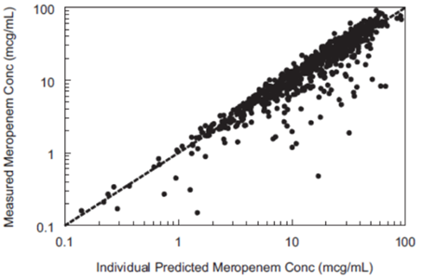
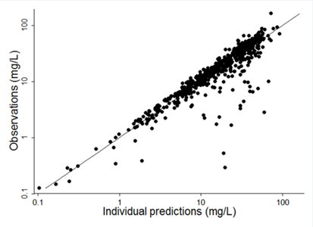
Action and results
 | Lab 1 | Lab 2
N | 188 | 171
Gestational age (weeks) | 28 (23-40) | 28 (23-40)
Postnatal age (days) | 22 (1-92) | 23 (1-92)
Serum creatinine (mg/dL) | 0.5 (0.1-1.9) | 0.4 (0.1-1.9)
Albumin (g/dL) | 2.3 (1.0-4.5) | 2.3 (1.0-4.5)
Lab 1
Lab 2

Slide 6
Tips: big ticket items
FDA guidance for bioanalysis
Blood volume
Anticoagulant
Concentration range
Lower limit of quantification (LLOQ)

